Slide 1
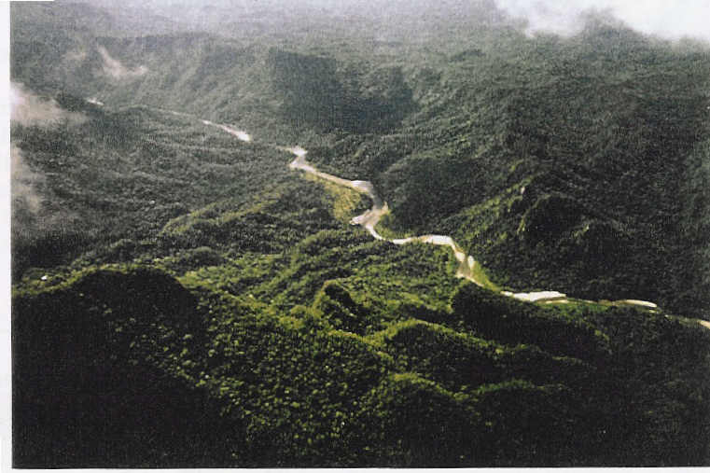
SOVI BASIN PROTECTED AREA
GEFPAS4
NATIONAL STEERING COMMITTEE MEETING 06 FEBRUARY 2015
E.ERASITO
DIRECTOR
NATIONAL TRUST OF FIJI

Slide 2
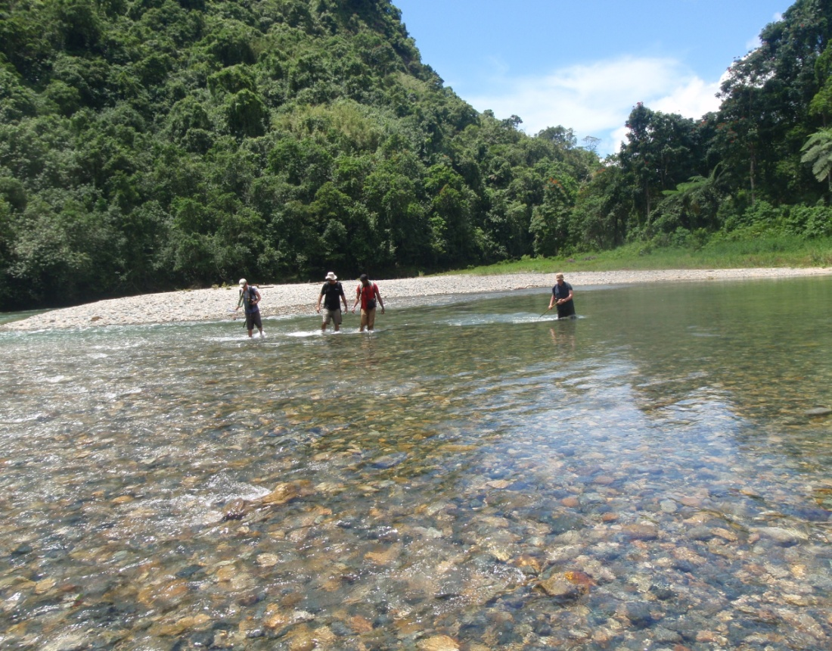
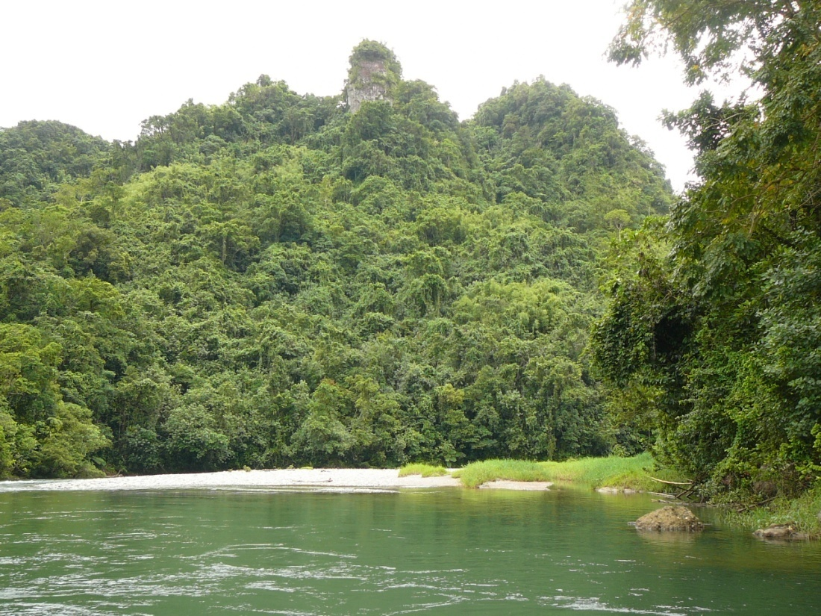
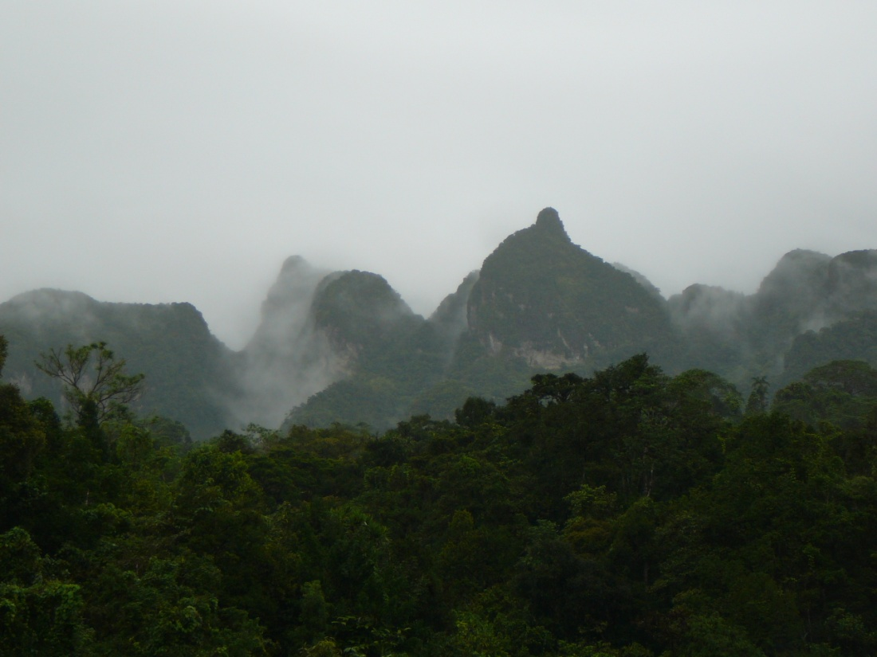
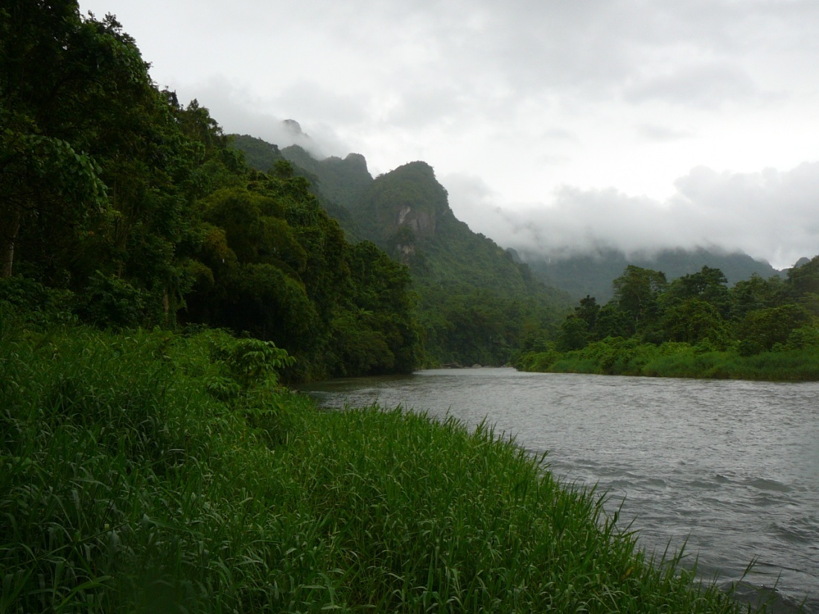

Slide 3
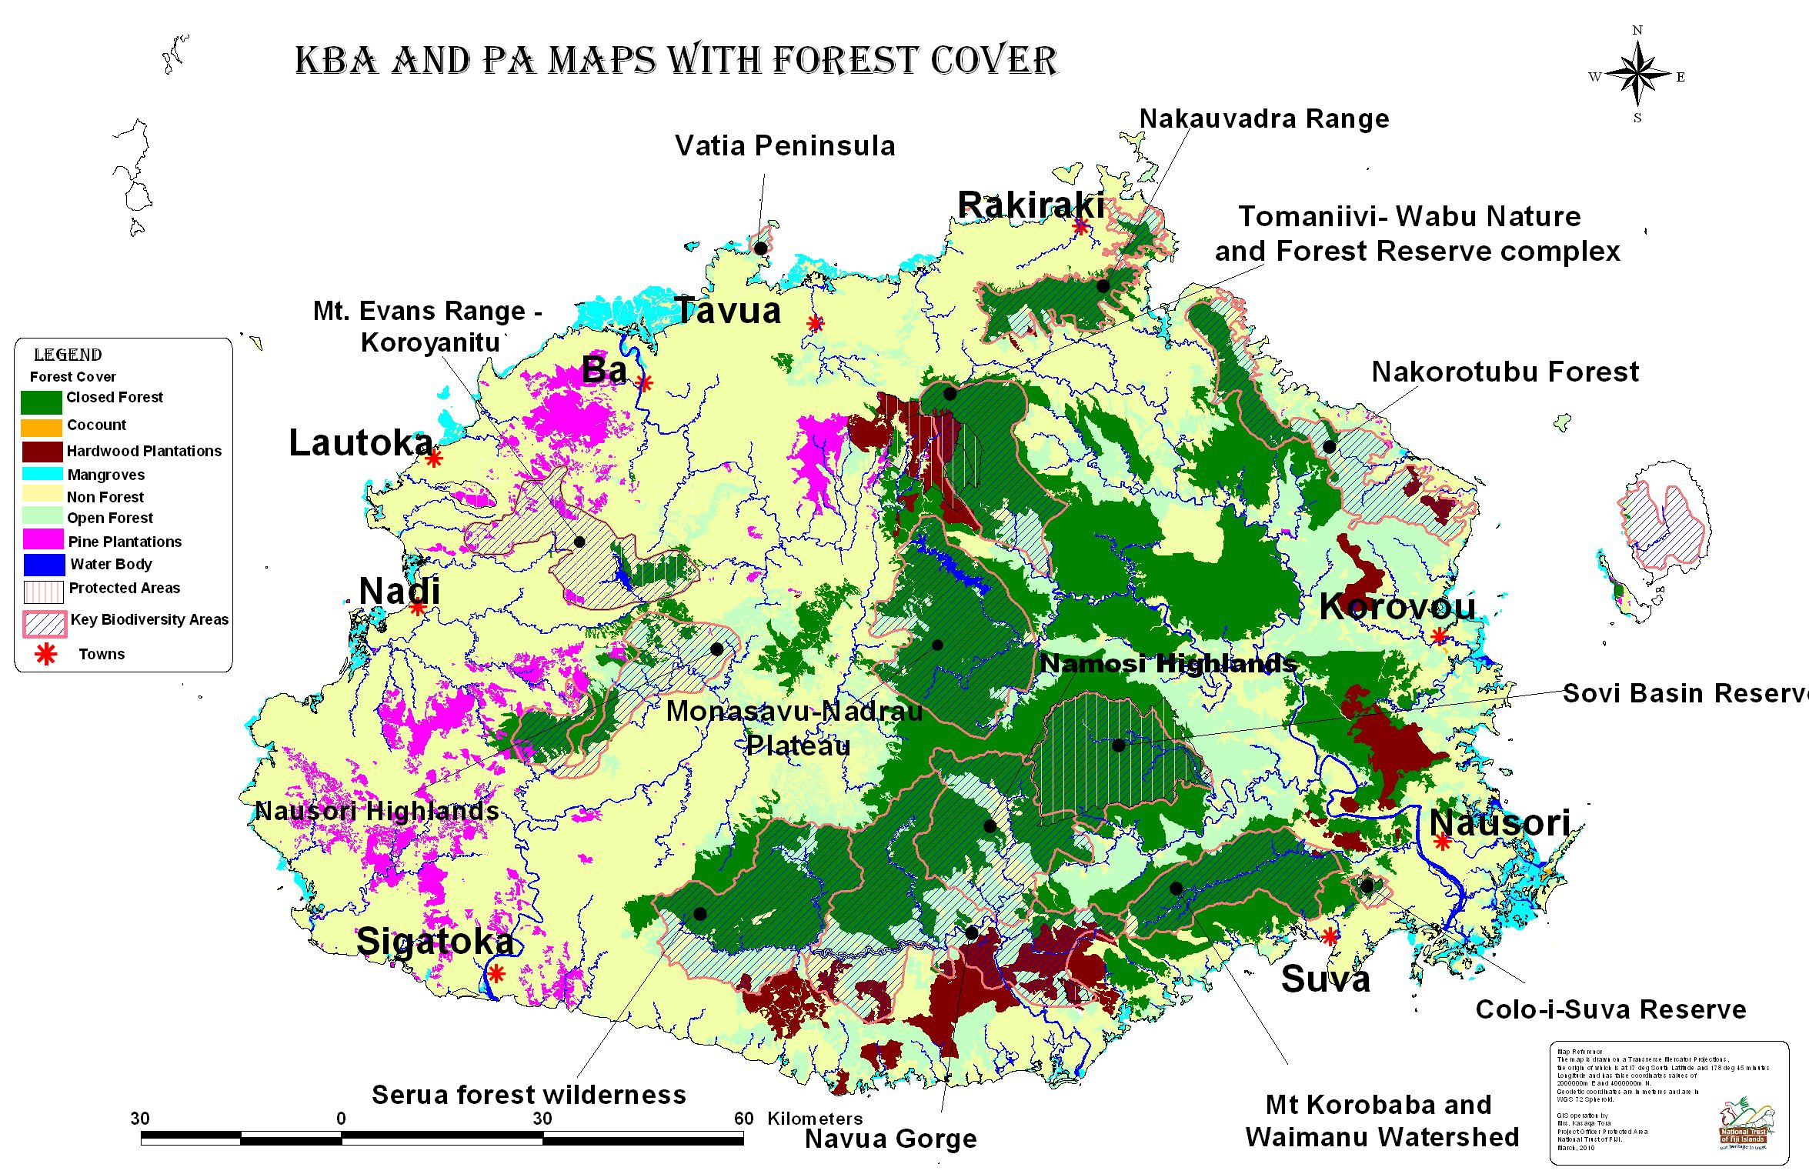

Slide 4
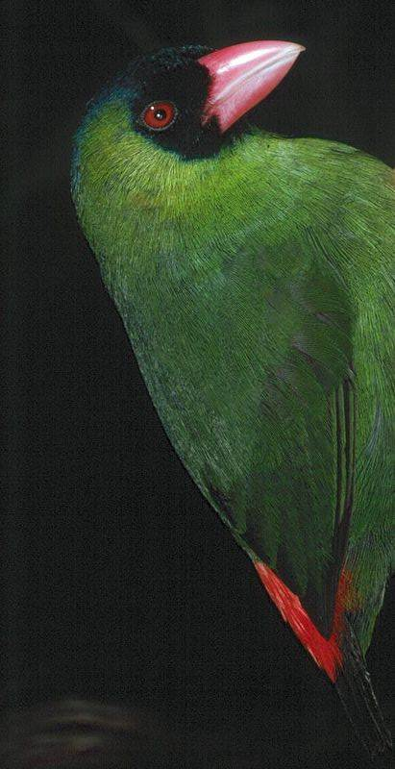
At REGIONAL LEVEL:
Most biologically diverse terrestrial ecosystem in the entire Polynesia/Micronesia Hotspot
CEPF Sub-regional Profile analysis for Fiji classified Sovi Basin the highest priority landscape conservation outcome in Fiji.
on the tentative World Heritage List- UNESCO World Heritage Declaration
Sovi Basin PA
Pink-billed parrotfinch

Slide 5
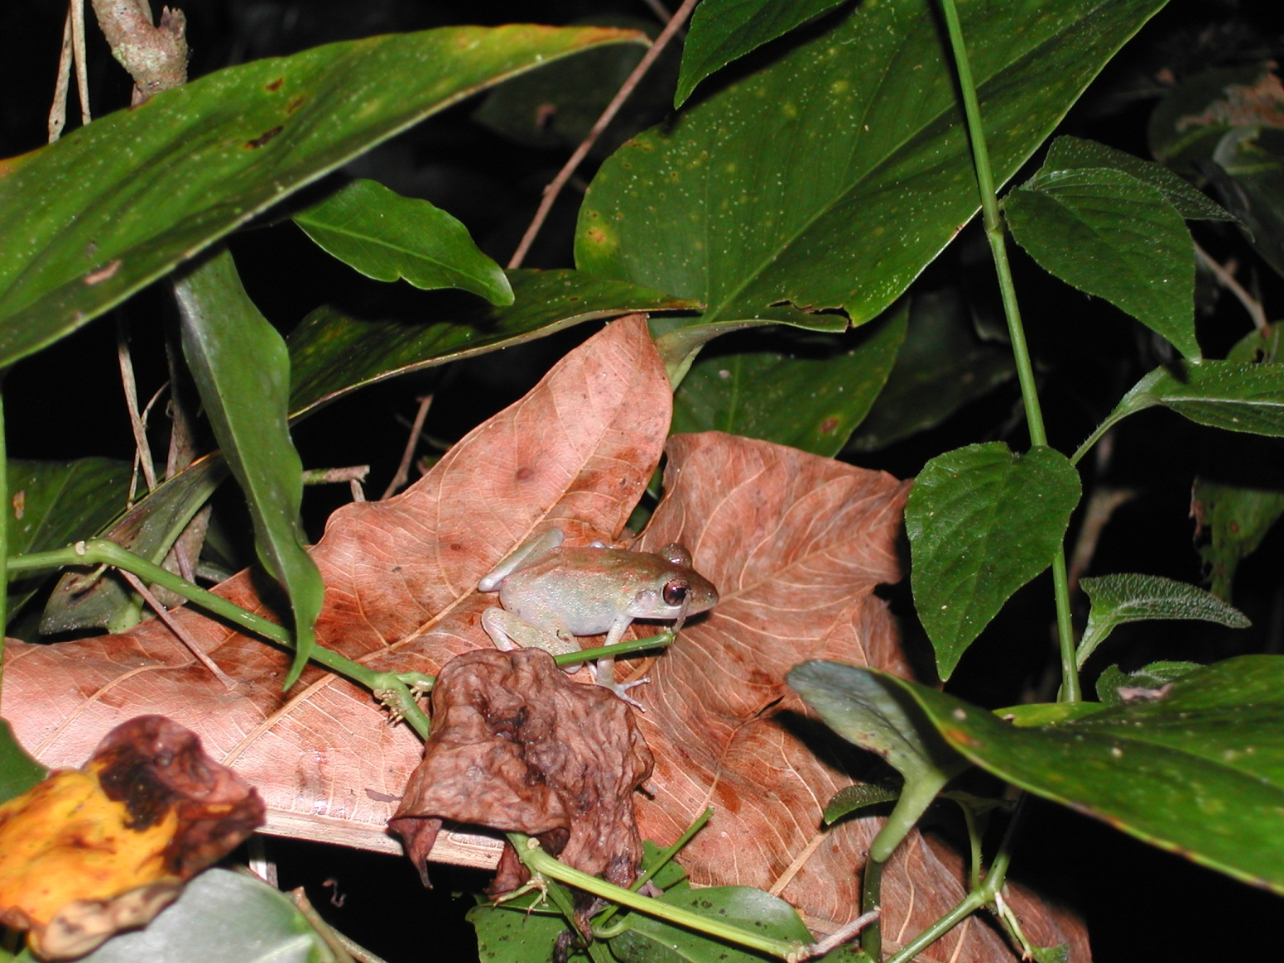
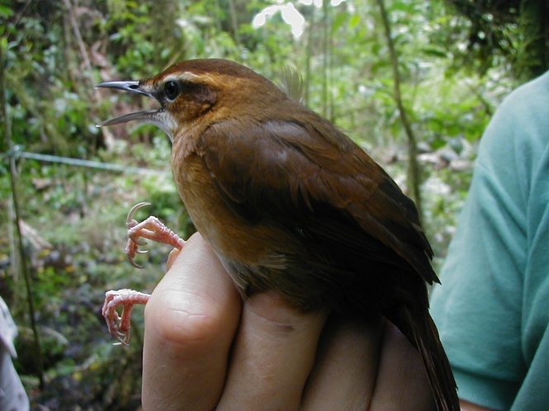
AT NATIONAL LEVEL
Site of National Significance (NBSAP 2010)
Fiji’s largest terrestrial protected area (16300ha)
Fiji’s largest surveyed and registered land under lease with Taukei Lands Trust Board (99 year lease)
The first PA with sustainable financing mechanism in place
Sovi Basin PA
Fiji ground frog
Long legged warbler

Slide 6
Supports strategy to develop forest corridor on main island of Viti Levu.
Fiji’s most important terrestrial ecosystem in terms of biological & landscape heritage.
The Basin is home to endemic birds, plants, freshwater plants and fish & herpetofauna
Remaining largest undisturbed block of tropical lowland forest.
WHY PROTECT Sovi

Slide 7
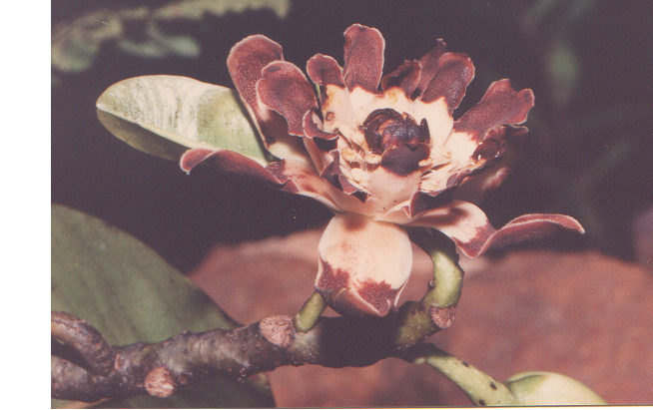
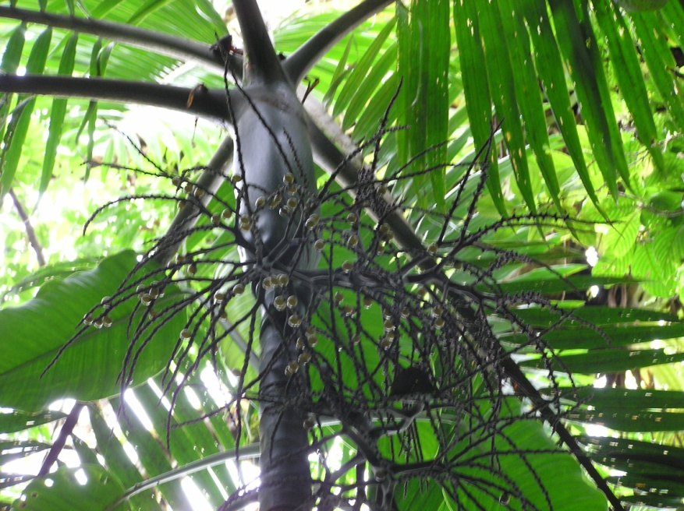
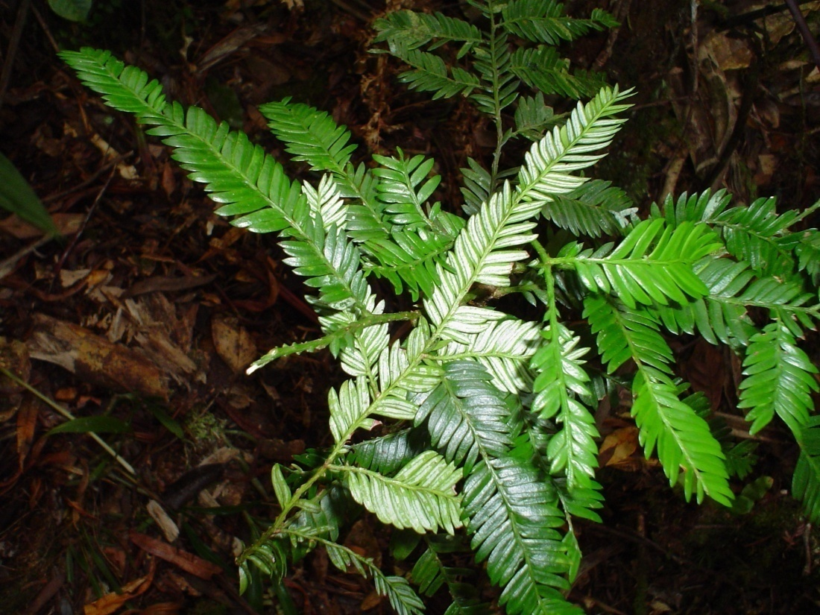
PLANTS
660 species
46% endemic
29 species rare or endangered

Slide 8
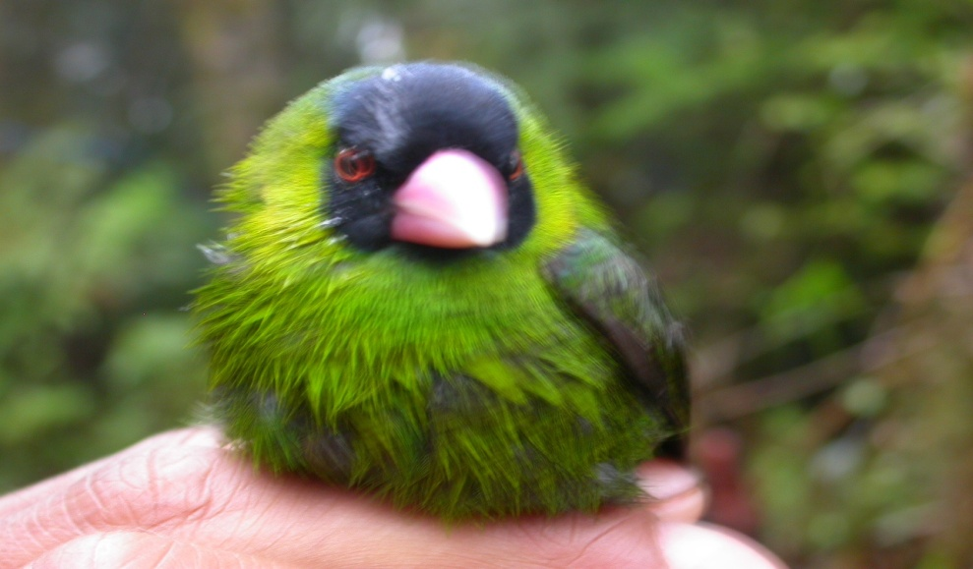
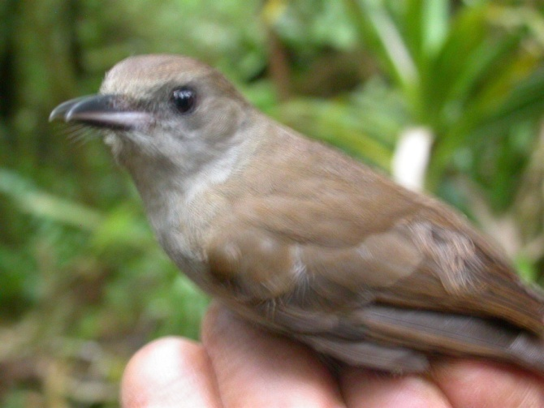
BIRDS
34 species
43% endemic
3 species endemic to Viti Levu
5 species threatened

Slide 9
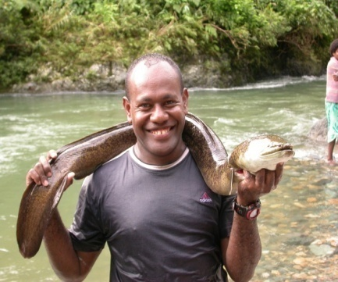
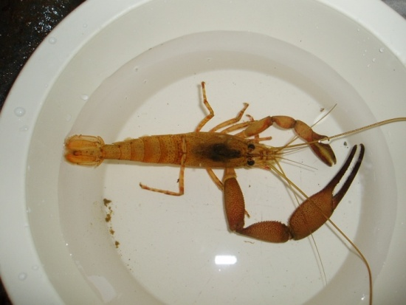
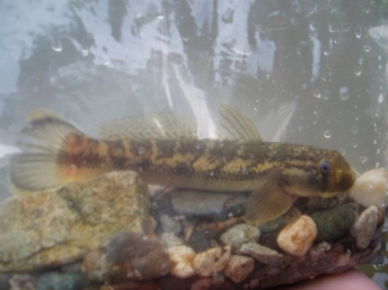
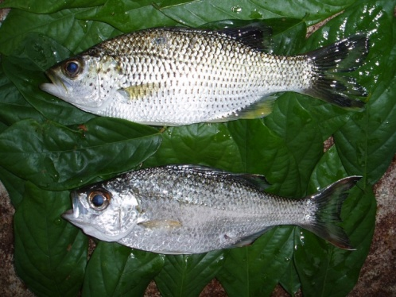
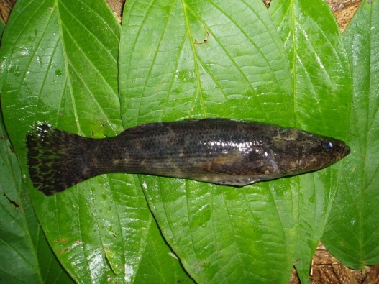
FRESH WATER PRAWNS & FISH
12 species of freshwater fish.
2 endemic.
11 native.
1 introduced.
6 species of freshwater prawns.

Slide 10
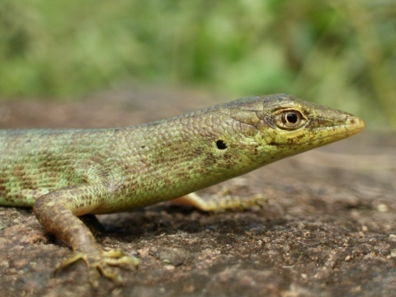
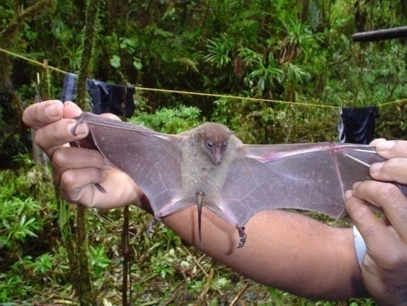
Herpetofauna / Mammals
3 species of skinks.
1 species of gecko.
Tree fog.
Cane toad.
Pacific Boa
2 fruit bats.
1 species of gecko.
1 blossom bat.
Wild pig

Slide 11
MANAGEMENT ARRANGEMENT
Initial community consultation & Ground work on Trust Fund carried out by Conservation International (CI), DoForestry, USP, iTaukeiAffairs
CI works with local partner – National Trust of Fiji (NTF) to build capacity and support for natural heritage
Lease of Sovi PA issued to NTF
NTF takes lead role in PA management and community liaison once lease is issued
NTF manage the Sovi Basin Endowment Trust Fund

Slide 12
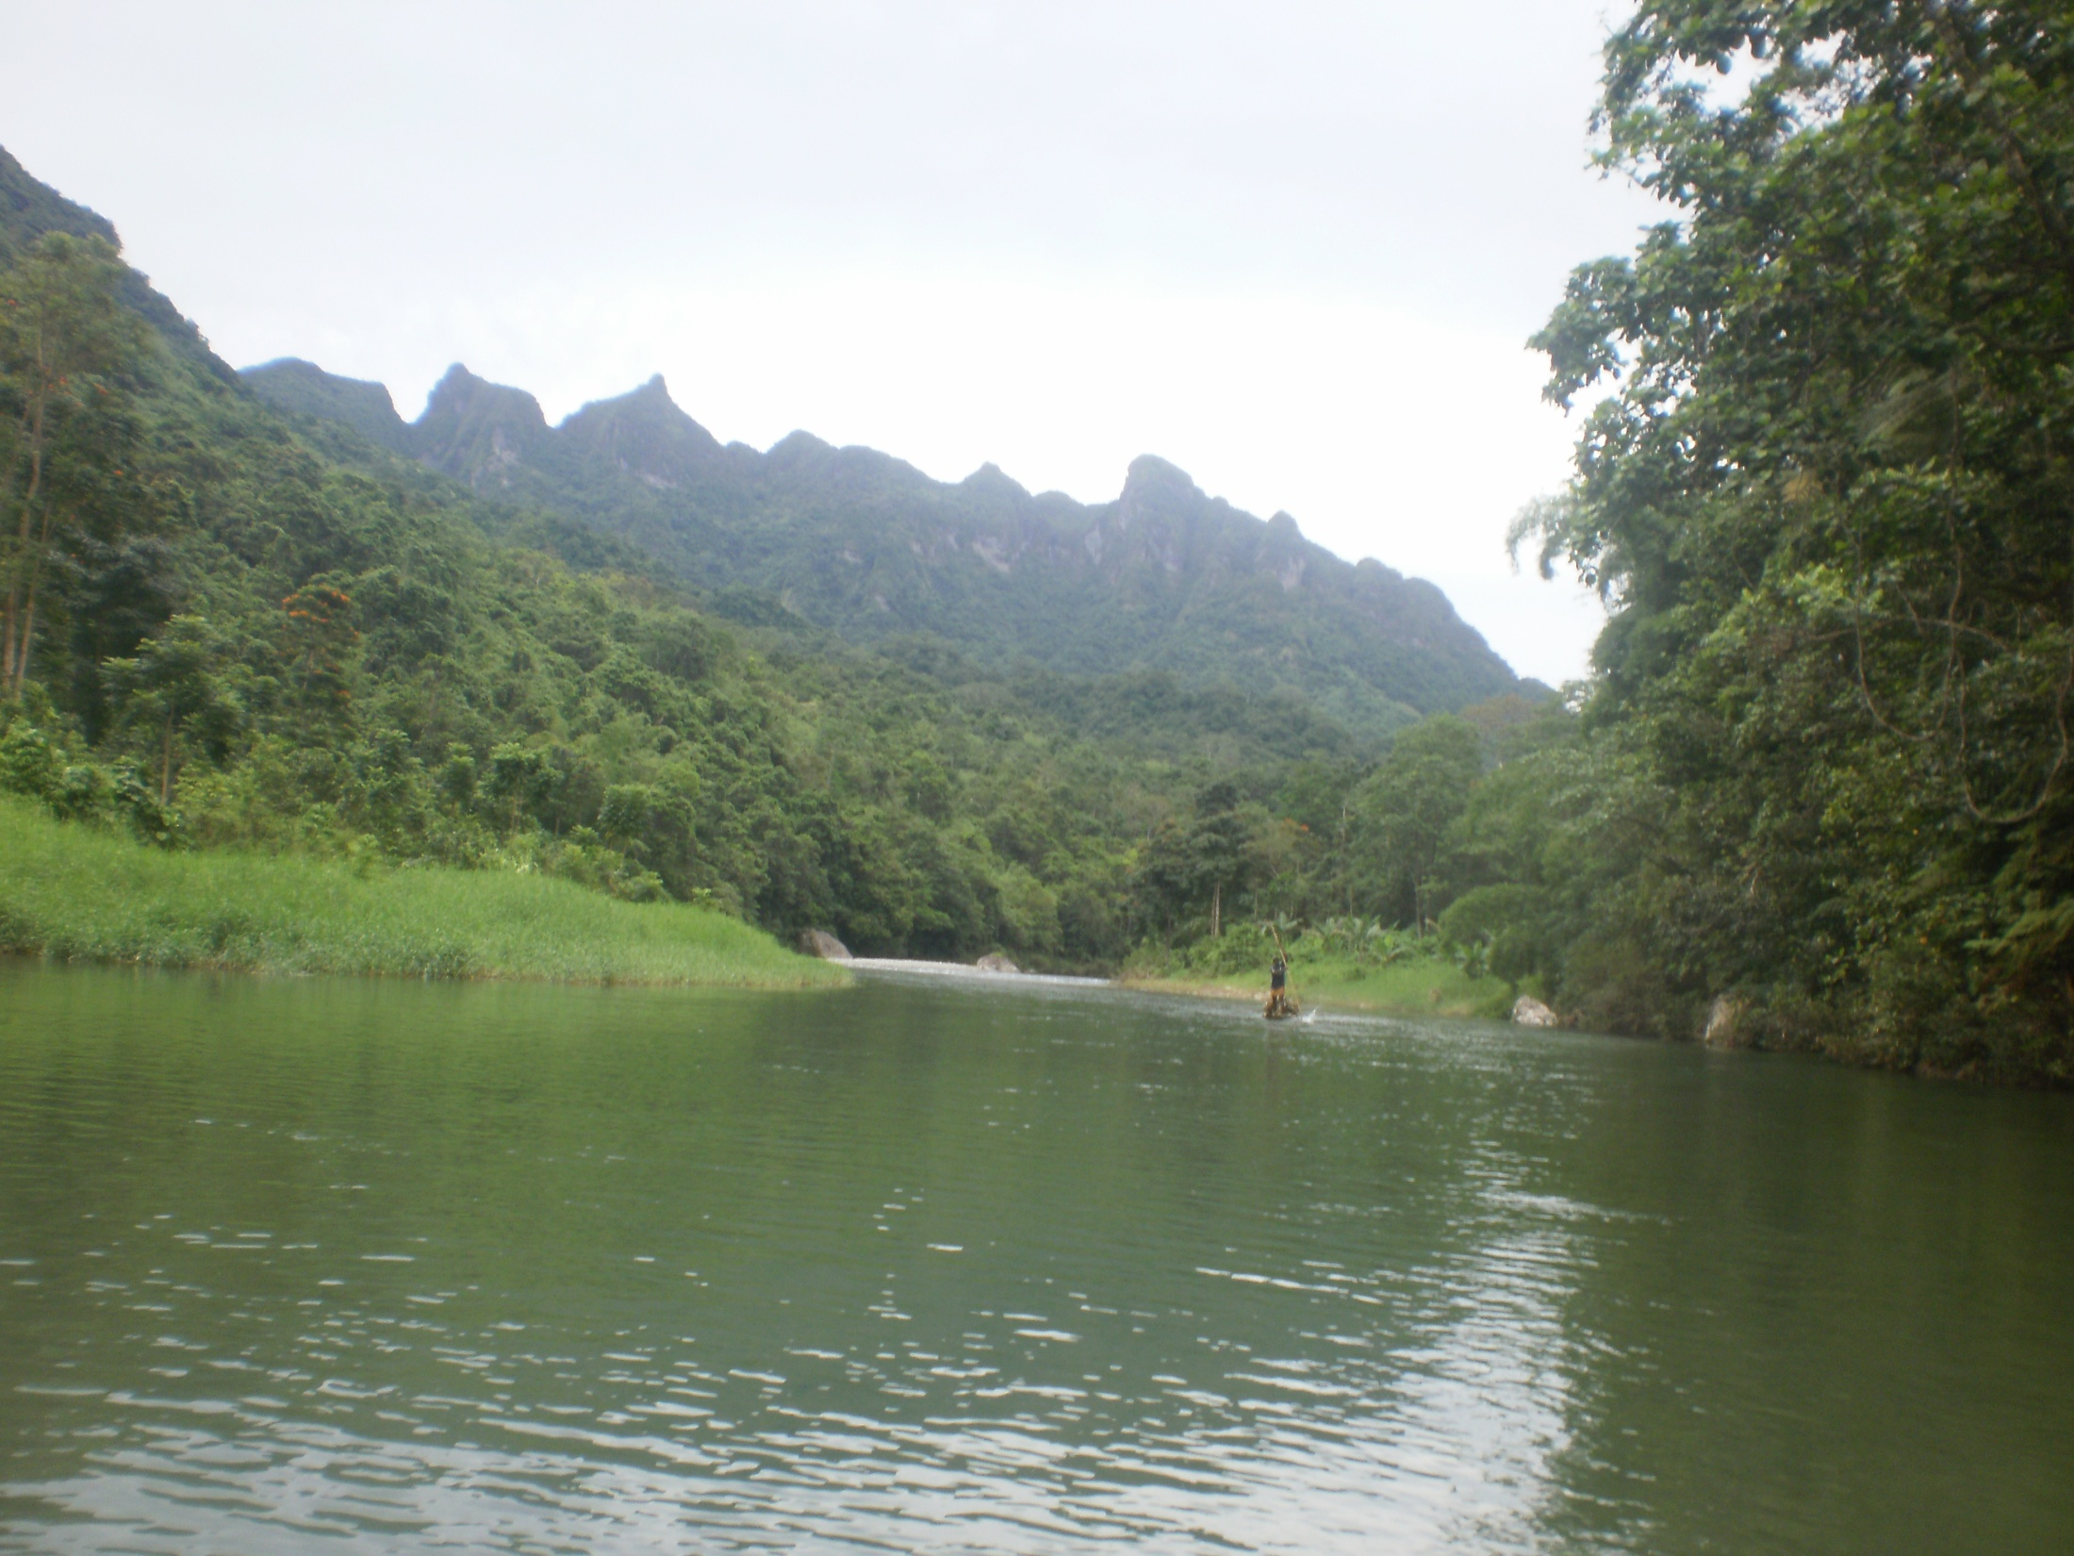
Endowment TRUST FUND
To sustainably finance the conservation of the Sovi Basin PA for 99yrs

Slide 13
ENDOWENT Trust FUND
Capitalisation : $3.626m USD
Donors –
Global Conservation Fund,
Fiji Water Foundation,
GEFPAS4 (FAO- negotiation in progress)
The Trust Fund supports three broad cost categories:
Annual royalty and lease payments to SBPA landowners
Annual contributions to a Community Conservation and Development Fund
Management budget for the Natural Heritage Unit.
An innovative mechanism for conserving habitat while providing economic and social benefits for stakeholders including local communities and public/private sectors.

Slide 14
Donor Board
TRUST FUND STRUCTURE
NTF
Investment
Bank
Donor
Endowment Account
Steering Committee
Community Development Fund
Management
iTaukei LTB
Landowners Steering Committee
Maintenance Cost
Royalty & Lease

Slide 15
Donor Board
TRUST FUND STRUCTURE
NTF
Investment
Bank
K
Donor
K
K
Endowment Account
Steering Committee
Community Development Fund
Management
iTaukei LTB
K $
$
K $
Landowners Steering Committee
Maintenance Cost
Royalty & Lease

Slide 16
GEFPAS 4 & SBPA
Contribution to Trust Fund
us$225,000
Direct deposit to HSBC (Singapore)
Govt. Support needed
Documentation from FAO to facilitate deposit
SBPA Graphic Design of Management Plan (FJ$3,000)
Ecotourism Study (FJ$10,000)
Bio-RAP (negotiation in progress - USP)
Video documentary (negotiation in progress – PSA)

Slide 17
STATUS of SOVI BASIN MANAGEMENT
STEERING COMMITTEE established 2013
Landowners Development Committee (LDC) established 2013
Landowner workshops help to relay arrangements and appoint a LOU Representative
LOU Representative is attached with NTF for training and capacity building on management of PA
Sovi Basin Management Plan widely consulted and currently reviewed by TLTB
CI & NTF consolidate Work plans and management activities to be supported by the Trust Fund

Slide 18
SBPA Management Framework
Management Plan
14 Policies
Co-MANAGEMENT
CUSTOMARY RIGHTS
STRENGTHEN LEGAL FRAMEWORK FOR PA
ZONING
BOUNDARY MARKING
TRAINING
TOURISM
INVASIVE SPECIES
SPECIES THREATENED WITH EXTINCTION
MONITIROING AND INFORMATION MANAGEMENT
ENVIRONMENTAL IMPACT ASSESSMENT
INFRASTRUCTURE DEVELOPMENT
MINNING AND QUARRING
RESEARCH
GEFPAS funded graphic design of the MP

Slide 19
CO-MANAGEMENT FRAMEWORK
Communication and Information Exchange
Adopt, honour and support traditional leadership
SBPA Landowner Committee
Communicate among landowners
Communicate with SBPA Steering Committee
Communicate with other stakeholders e.g. TLTB
Promotion of landowner interest
Reaching of agreements on roles, responsibilities and procedures

Slide 20
Conservation Agreement (Vola ni Veidinadinati ni kena Maroroi na i yau bula)
Threats to Biodiveristy
Opportunity Cost
Tavi me maroroi kina na yaubula (Conservation Actions)
Veika eda rawata (Benefits)
CO-MANAGEMENT TOOL
Vakaraitaki
Kua na qoli duva
Kua na musu kau vakaveitalia
Kua na benu ca e wai
Vakaraitaki
Soli na scholarship
Vakatubu I lavo
Veivuke ni tei kakana dina/ginger
Notes:
Opportunity cost = value of what is foregone under the business as usual. E.g logging royalty that is part of the lease agreement;

Slide 21
MAJOR THREATS TO THE ENVIRONMENT
RESULT OF SOCIOECONOMIC SURVEY 2013
Communities:
Nukusere, Delailasakau, Nasevou, Nadakuni Naivucini

Slide 22
POTENTIAL Opportunity cost
RESULT OF SOCIOECONOMIC SURVEY 2013
Communities:
Nukusere, Delailasakau, Nasevou, Nadakuni Naivucini

Slide 23
Community CONSERVATION AGREEMENT in SBPA
PARTNERS IN AGREEMENT
NTF (Grantor)
SBPA Village Community (Grantee)
SBPA Landowner Committee (Witness)
Provincial Office (Witness/Arbitrator)
Conservation International (Advisor)

Slide 24
Threats to Biodiveristy
Conservation Agreement (Veidinadinati)
Opportunity Cost
Tavi me maroroi kina na yaubula (Conservation Actions)
Veika eda rawata (Benefits)
Vakaraitaki
Kua na qoli duva
Kua na musu kau vakaveitalia
Kua na benu ca e wai
Vakaraitaki
Soli na scholarship
Vakatubu I lavo
Veivuke ni tei kakana dina/ginger
Notes:
Opportunity cost = value of what is foregone under the business as usual. E.g logging royalty that is part of the lease agreement;

Slide 25
CONTENT OF CCA
Background – AI KAU
Stakeholders – VEIWEKANI E VAUCI ENA VEIDINADINATI
Objectives - NAKINAKI RARABA
Sanctions – VEIVAKADONUI
Coordination of Activities – TUVATUVA NI VEIKA E QARAVI
Duration of Agreement – BALAVU NI VEIDINADINATI
Arbitration – VEIVAKASALATAKI & VEIVAKAMEAUTAKI

Slide 26
TOURISM
Tourism Master Plan for SBPA
(Vili Koyamaibole – Consultant)
Assessment of the site – feasibility study
Value Chain
Market Access
Governance Structure (Community)
Co-Management Framework

Slide 27
Monitoring, Evaluation & Information
Biodiversity Survey (USP & Partners)
REASSESSMENT OF PERMANENT MONITORING PLOTS
10 YRS
USP/IAS, & PARTNERS
INDICATORS FOR BIODIVERISTY
REVIEW INDICATORS
ASSESS IMPACTS OF CHANGE OVER TIME

Slide 28
Economies of scale
legitimacy
Community resilience
LESSONS LEARNT FROM SOVI BASIN
Notes:
Economies of scale – large areas are more logical to worj with under the Sovi model hence the network of PA corridor is proposed to be dealt with as a package rather than piece meal individual attempts
Opportunities to expand the Sovi Trust Fund to cater for other PA in Fiji
Legitimacy – the legal framework needs to be strengthened to support development of larger flexible management regimes where some level of community extraction of resources are allowed. The current legislation supports Forest or Nature Reserve both of which have limited application to aspirations of the landowners and conservation objectives
Community resilience – important to do this RIGHT at the first attempt to ensure long term buy-in from community members with the focus on stewardship of resources rather than strict protection of biodiversity. With increasing pressure from other development options, the messaging needs to be streamlined and consistent

Slide 29
CONNECTING THE DOTS…….
Notes:
Ci is also working in the Province of Ra
Reforests an area of 1,135 ha which results in the sequestration of at least 280,000 tCO2 over the 30 year project lifespan, validated and verified to the Climate, Community and Biodiversity Standards (CCBS); - we have been certified with CCBS,
• Increases forest cover around the Nakauvadra Range to expand critical habitat for endangered and endemic species living there, and enhances forest connectivity with other adjacent forest blocks;
• Enables local landowners to benefit from job creation, increased revenue, and the enhancement of livelihoods in both the short and long term.

Slide 30
CONSERVATION CORRIDOR
Notes:
CI has recently signed up to work in the Greater Tomaniivi/Wabu through GEFPAS4 to secure the consent of landowning communities to extend the boundary of existing Nature Reserve in Tomaniivi/Wabu. This will ensure meaningful investment on conservation of larger critical land area with high biodiversity thus supporting the strategy for connecting conservation corridor on Viti Levu.

