Slide 1

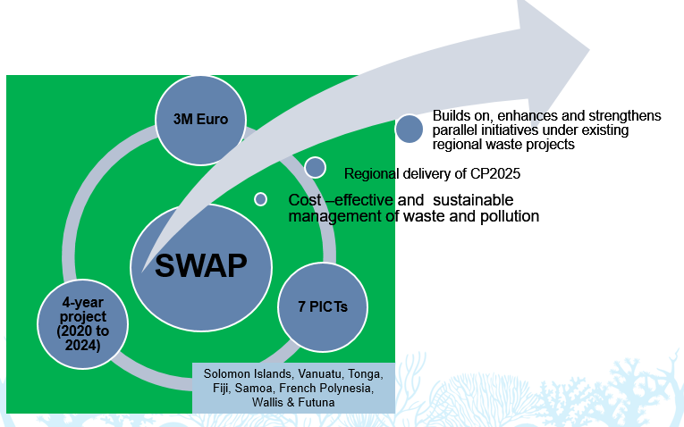

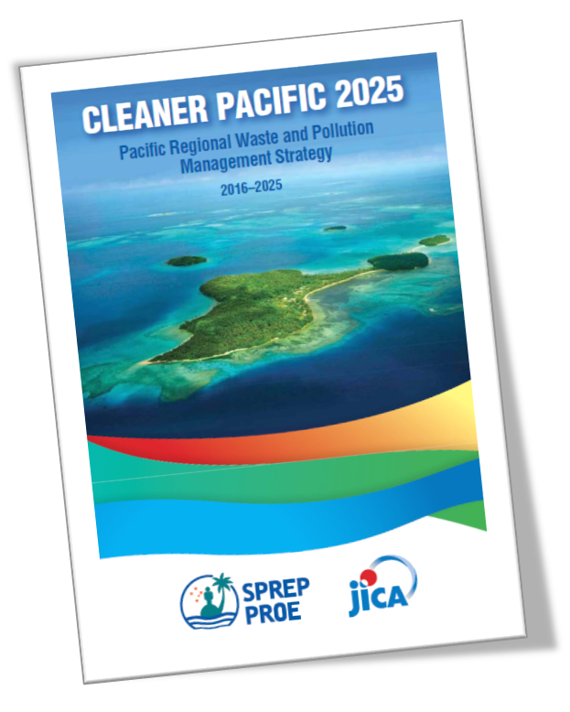
Solid Waste Management Initiative in the Pacific (2011-2014)
Sustainable Waste Actions in the Pacific (SWAP)
Notes:
The satisfactory rating of the AFD Phase 1 project and the CP2025 are the drivers for the development of the Sustainable Waste Actions in the Pacific Project.
SWAP is a 4-year project with a value of 3M Euro involving 7 PICTs
The project intends to address cos-effective and sustainable management of wastes, contribute to the delivery of CP2025, and builsds on, enhances and strengthens parallel initiatives under existing regional waste projects.

Slide 2
Project Components
Thematic Areas
Training
Pilot Projects
SWAP
Community of Practice
Used Oil Management
Disaster Waste
Marine Debris
Sustainable Financing
SWAP
Notes:
Training will cover all thematic areas.
Theory of waste management practice and project management
Presentation of successful case studies
Demonstration of best practices from the Pacific, if available, and other countries with similar conditions.

Slide 3
Pilot Projects
Submission of concept note
Evaluation by SPREP and TWG
Alignment with other regional projects
Approval by Steering Committee
Support to CDL
Coastal clean-ups
Data collection
Scoping study for a potential disposal site to be climate proofed
Rehabilitation of disposal facility
Institutional mechanisms
Storage facilities and collection systems
Treatment and recycling plants
Disposal of used oil
Sustainable Financing
Used Oil
Marine Debris
Disaster Waste
Identified activities

Slide 4
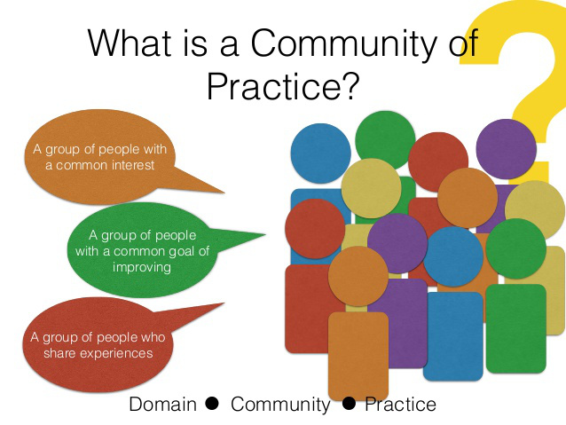
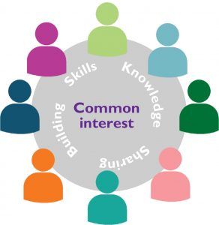
Community of Practice
Platform for sharing project outcomes including progress, challenges and lessons learned
Information dissemination is the key outcome
Workshops and meetings with the involvement of the TWGs

