Slide 1



Japanese Technical Cooperation Project for Promotion of Regional Initiative on Solid Waste Management in Pacific Island Countries (JPRISM II)
Nadi, Fiji
JPRISM II, 10 February, 2020
Mayu NOMURA JICA Expert (Solid Waste Management Training/ Monitoring), J-PRISM II Email nmr.mayu@gmail.com

Slide 2
J-PRISM2 at a Glance
Donor | JICA: Japan International Cooperation Agency
Scheme | Technical Cooperation
Partner | SPREP
Beneficiary Countries | 9 countries; FJ, TO, SA, SI, VU, PNG, FSM, RMI, PA
Budget | Approx. 17. 6 Million US$ (Planning Base)
Duration | February 2017 – February 2022 (5 years)
Framework | Combination of 9 Bilateral Projects and 1 Regional Project
Decision Making Protocol | Based on the; Joint Coordination Committee (JCC) for each Country (1/year) Steering Committee Meeting (StC) for Whole Project (1/year)
Number of Experts | 18 in Total + α

Slide 3










Logical Framework of J-PRISM2
“Human and institutional capacity base for sustainable SWM in the Pacific Region is strengthened through implementation of the CP 2025”
Overall Goal in PICs
Project Purpose for each Country
Mutual Project Purpose
Bilateral PJ and Regional PJ
Project Purpose for Regional Project
9
Bilateral Projects
Strategic Actions in CP 2025
Regional Project
SA Project
TO Project
FJ Project
Collaboration
SI Project
VU Project
PNG Project
Regional
Project
Collaboration
PA Project
RMI Project
FSM Project

Slide 4
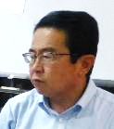


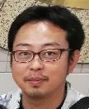
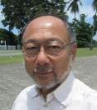

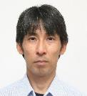




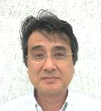

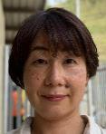
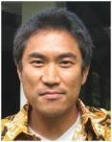

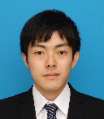

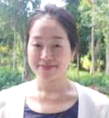
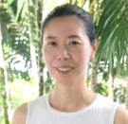
Project Team
Group1
Group2
Project Office
Chief: Miyata Nobuaki
COACH
COACH
Visit and Stay Assigned Countries for several weeks
Stationed in SA
“DO IT YOURSELF” Approach
Total Inputs at Field:
1,111 Days/Group1
(As of March 2019)
Total Inputs at Field:
1,985 Days/Group2
(As of March 2019)
Information
sharing on daily bases
Visit
Micronesia Region
Melanesia& Polynesia
SPREP WMPC
PLAYER
Project Director
Project Director
Project Manager
Project Manager

Slide 5
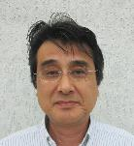


Key Activities under the Bilateral Project
Palau
 | Output | Example of Key Activities
1 | Submission of New NSWMS (2017-2026) and its action plan | Conduct baseline survey Organize series of discussions among stakeholders Formulate NSWMS and its action plan
2 | Promotion of good practice | Compile and share case studies Accept Tuvalu officials to share lessons learnt
3 | Waste collection improvement in Babeldaob Island and Koror State | Conduct baseline survey in BBI Prepare specification of new collection system in details
4 | Smooth transition from current landfill to new landfill | Develop 3D drawing of M-dock Advice on contract work for berm extension of M-dock

Slide 6
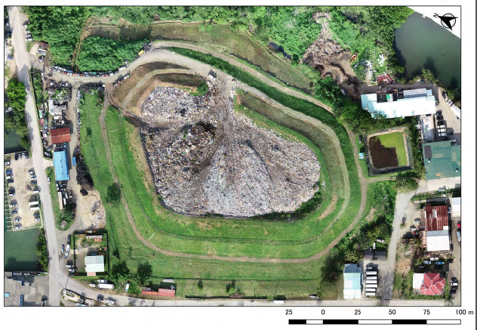
Berm extension of M-dock

Slide 7

Key Activities under the Bilateral Project
FSM
State | Example of Key Activities
(National) | Drive formulation of SWMS for each state by DECCEM through series of inter-state workshop Compile/ share good practice in 4 states
Yap | Formulate SSWMS of Yap (based on baseline survey) Expand waste collection service beyond Colonia through pilot project.
Kosrae | Formulate SSWMS of Kosrae (based on baseline survey) Commence Inter-Municipal Collection Service
Chuuk | Formulate SSWMS of Chuuk (based on baseline survey) Conduct survey, law amendment and facility procurement support to commence operation of CDL in Chuuk
Pohnpei | Formulate SSWMS of Pohnpei (based on baseline survey) Conduct survey and facility procurement support to improve current practice of CDL in Pohnpei

Slide 8
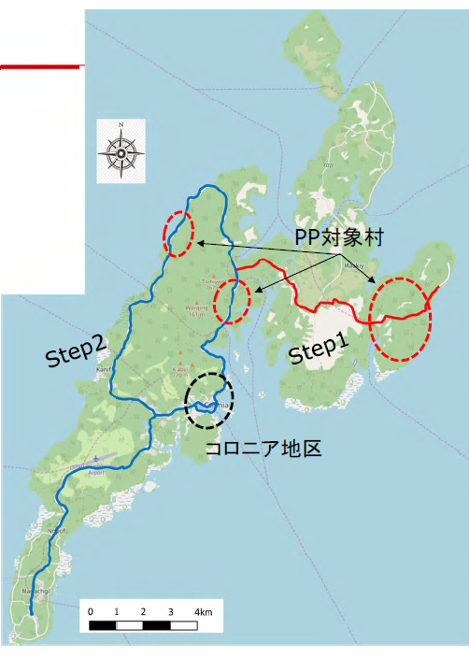
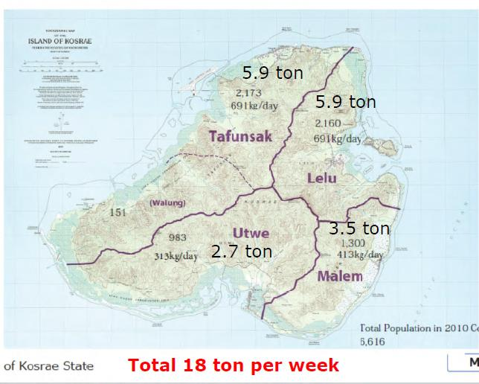
Yap State
Kosrae State

Slide 9

Key Activities under the Bilateral Project
RMI
 | Output | Example of Key Activities
1 | Official Approval of policy documents regarding SWM | Conduct baseline survey in Majuro and Ebeye Formulate SWM Plan for Majuro Formulate SWM Plan for Ebeye Formulate National WM Strategy
2 | Promotion of good practice | Compile and share case studies
3 | Enhancement of CDL mechanism | Formulate/amend laws and regulations at National level to commence CDL (Aug. 2018) On-site training for officials of Recycling Center on CDL operation
 | Others: technical advise on operating disposal site | Develop 3D drawings for life periods estimation and operation planning

Slide 10
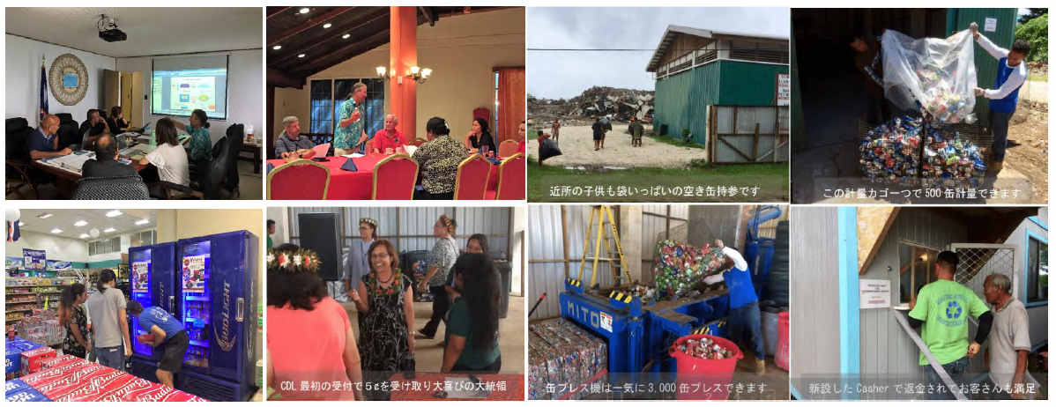
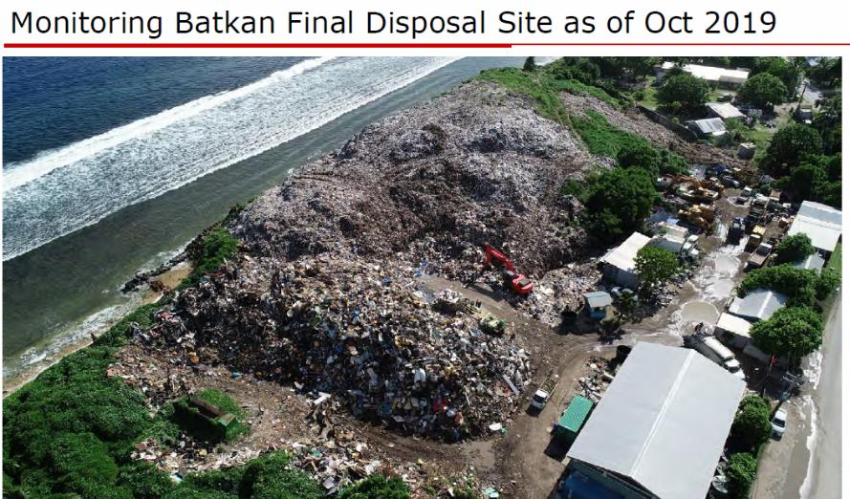
J-PRISM

Slide 11


Key Activities under the Bilateral Project
Tonga
 | Output | Example of Key Activities
1 | Institutional capacity development of Waste Authority Limited (WAL) through 5-Year Business Planning | Conduct SWM baseline survey Conduct waste amount survey by incoming waste data analysis in Tapuhia L.F. Study revenue and expenditure survey of WAL
2 | Capacity building of WAL through providing service in Vava’u Island | Formulate SWM plan in Vava’u Carry out OJT on collection, L.F. management, public awareness Commence WAL’s service (May 2018)
3 | Preparation for WAL’s service expansion to Ha’apai Island and Eua Island | Conduct baseline survey in Ha’apai and Eua Formulate SWM plan in Ha’apai and Eua

Slide 12
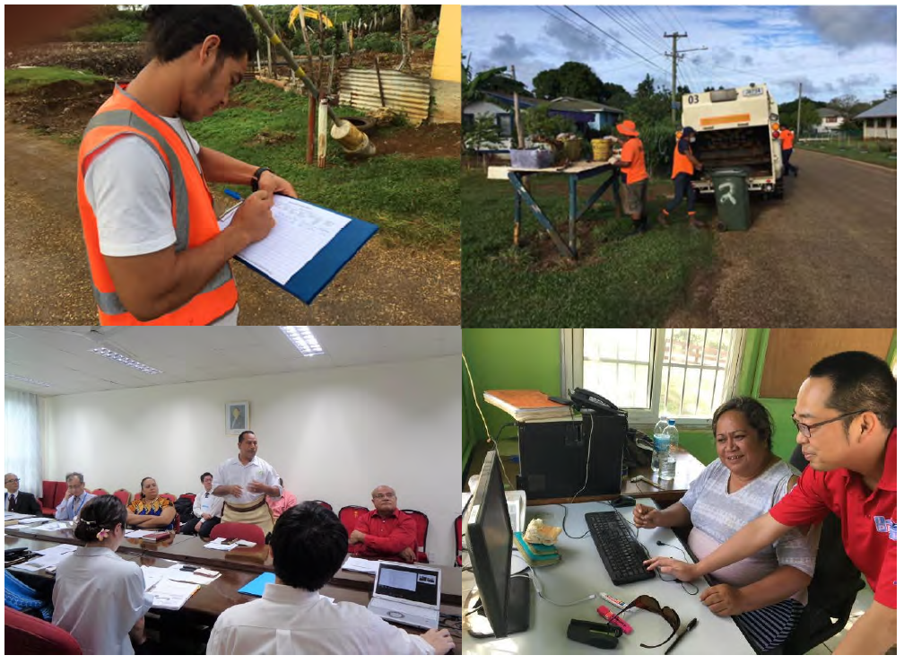

Slide 13

Key Activities under the Bilateral Project
Samoa
 | Output | Example of Key Activities
1 | Development of National Solid Waste Management Strategy | Conduct baseline survey Set up W.G. for the Strategy Formulate the Strategy (Cabinet approval in January 2019)
2 | Establishment of waste collection monitoring system nationwide | Analyze status of rubbish collection service Coordinate stakeholder meeting with contractors Introduce rubbish collection monitoring system (from 2020)
3 | Feasibility study of financial option (User-Pay) | Conduct preliminary survey Study tour to Vanuatu and Tonga Organize Steering Committee and Public Consultation for the system

Slide 14
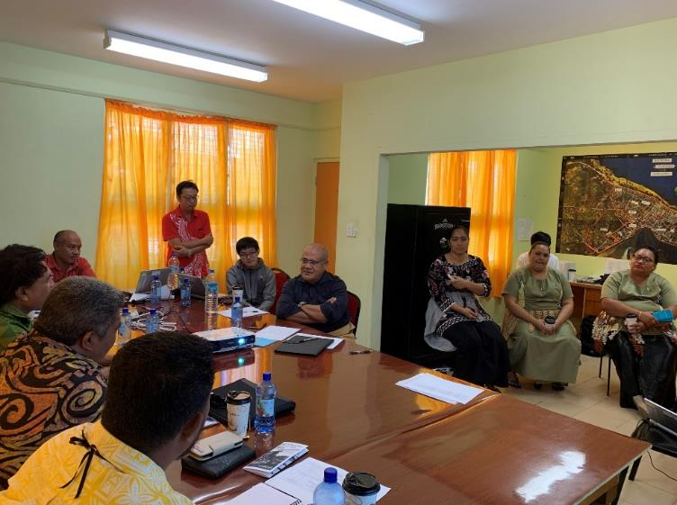
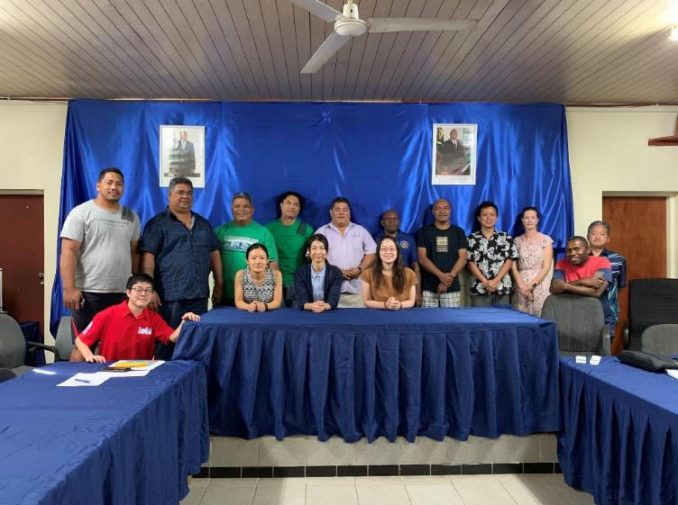

Slide 15

Key Activities under the Bilateral Project
Vanuatu
 | Output | Example of Key Activities
1 | Institutional Capacity Development of DEPC to implement National Waste Management an Pollution Control Strategy (2016-2020) | Set up W.G. for the national Strategy Identify and implement 4 priorities Assist Provincial/Municipal Councils on SWM planning Conduct pre-feasibility study of CDL, COM approval, 1st CDL W.G. Identify measures to facilitate waste minimization Disseminate environmental education program nation-widely
2 | Implementation and monitoring of SWM Plan in Port Vila Municipal Council | Conduct supplemental survey of PVMC Formulate SWM Plan 2021-2030 Conduct pilot project(s) to test viability of SWM Plan

Slide 16
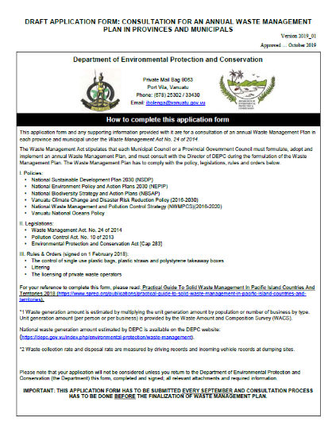
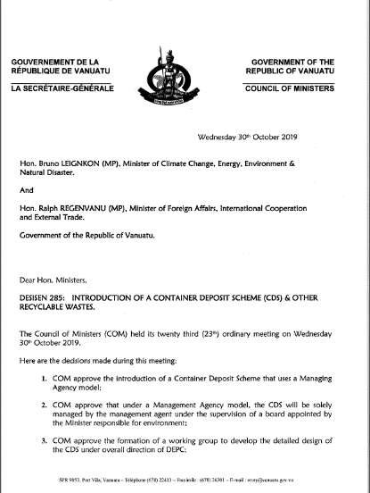
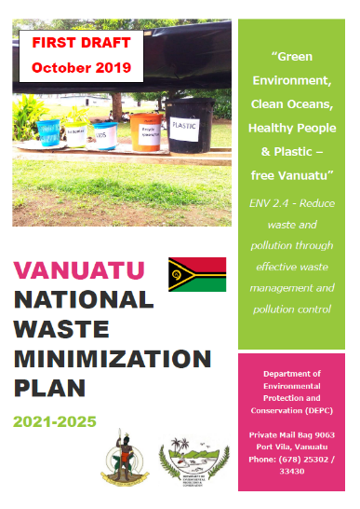
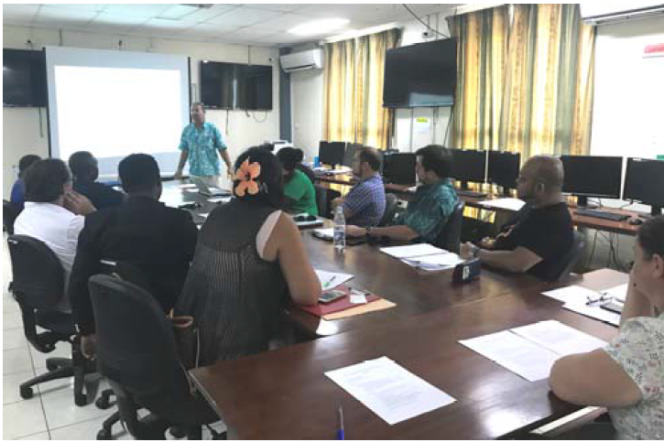

Slide 17
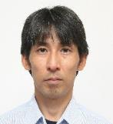
Key Activities under the Bilateral Project
Solomon
 | Output | Example of Key Activities
1 | Capacity development of Honiara City Council | Set up W.G. for Honiara City SWM Planning Formulate Honiara City SWM Plan Develop a landfill operation manual for Ranadi L.F.
2 | Dissemination of Lessons learnt in Honiara City and Gizo Town to Provincial Centers | Develop training material Conduct W.S. for Provincial Centers organized by MECDM and HCC
3 | Specifying Economic Measurement for sustainable waste management in Solomon Island | Conduct pre-feasibility study on CDL Conduct study on various Economic Instruments applicable for Solomon (Plastic Ban, User-pay, Levy, Reduce Taxation, Gate Fee at Ranadi L.F.)

Slide 18
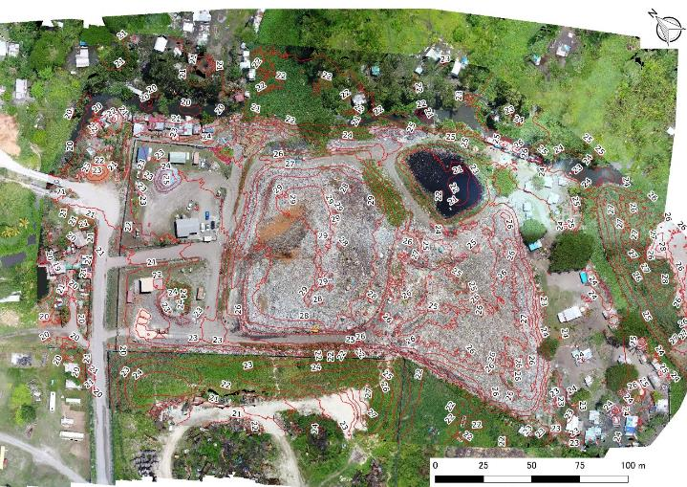
J-PRISM

Slide 19
Key Activities under the Bilateral Project
Fiji
 | Output | Example of Key Activities
1 | Promotion of Evidence-based policy by the initiative of Department of Local Government (DLG) | Conduct baseline survey and identify boundary of each municipal gov. Organize series of inter municipal governments workshop led by DOL Formulate SWM Plans for each municipal government
2 | Pilot study on regional 3R+Return concept | Consult and identify scope of the study with Department of Environment (DOE) based on their needs (ex. Landfill audit, statistical analysis of material/goods, industry) Conduct the study Propose recommendation for 3R+Return activities for Fiji

Slide 20
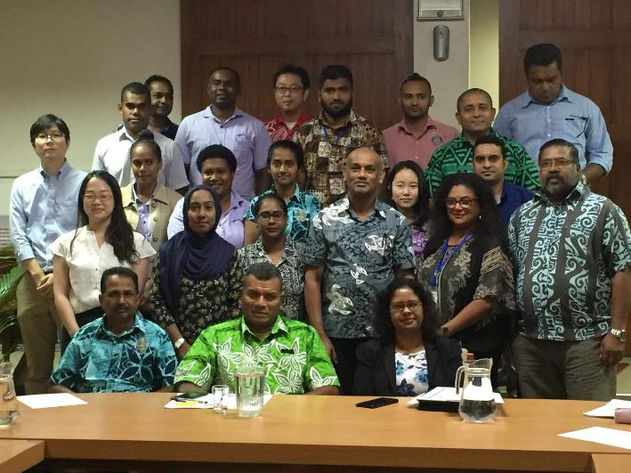

Slide 21
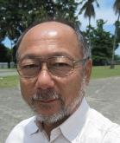

Key Activities under the Bilateral Project
PNG
 | Output | Example of Key Activities
1 | Institutional Capacity Development through Development of a National Policy, Strategy and Implementation Plan | Collect and analyze data from LGs Organize series of consultation W.S. to develop National Strategy
2 | Capacity development of Urban Local Level Governments (ULLGs) on Planning Skill | Develop NCDC/ULLGs Cooperation Programme (MOU–Goroka, Kokopo) Organize series of W.S. for ULLGs Conduct SWM baseline survey and waste flow analysis of ULLGs (ex. Kokopo)
3 | Implementation of National Capital District Waste Management Plan (2016-2025) | Install a weighbridge to Baruni L.F. Instruct data management of incoming waste at Baruni L.F. Develop NCD WM Implementation Plan (yearly)

Slide 22
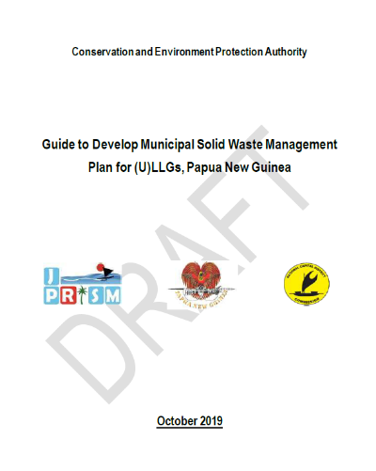
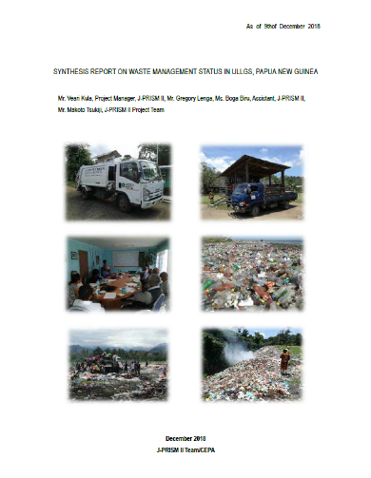
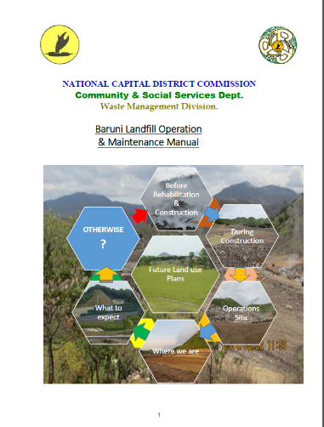

Slide 23



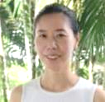
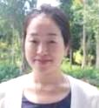

Key Activities under Regional Project (For all countries)
Regional Project Purpose:
“Implementation of the Cleaner Pacific 2025 on SWM is timely monitored and supported based on Pacific to Pacific cooperation.”
Output 1
Output 2
Monitoring mechanism for solid waste management in line with Cleaner Pacific 2025 is strengthened.
Regional cooperation within the Pacific is organized and promoted by utilizing regional human resource and sharing lessons learnt.
Output 3
Output 4
Regional capacity of disaster waste management is strengthened.
Practical and sustainable 3R+Return system is enhanced.

Slide 24
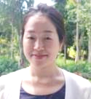
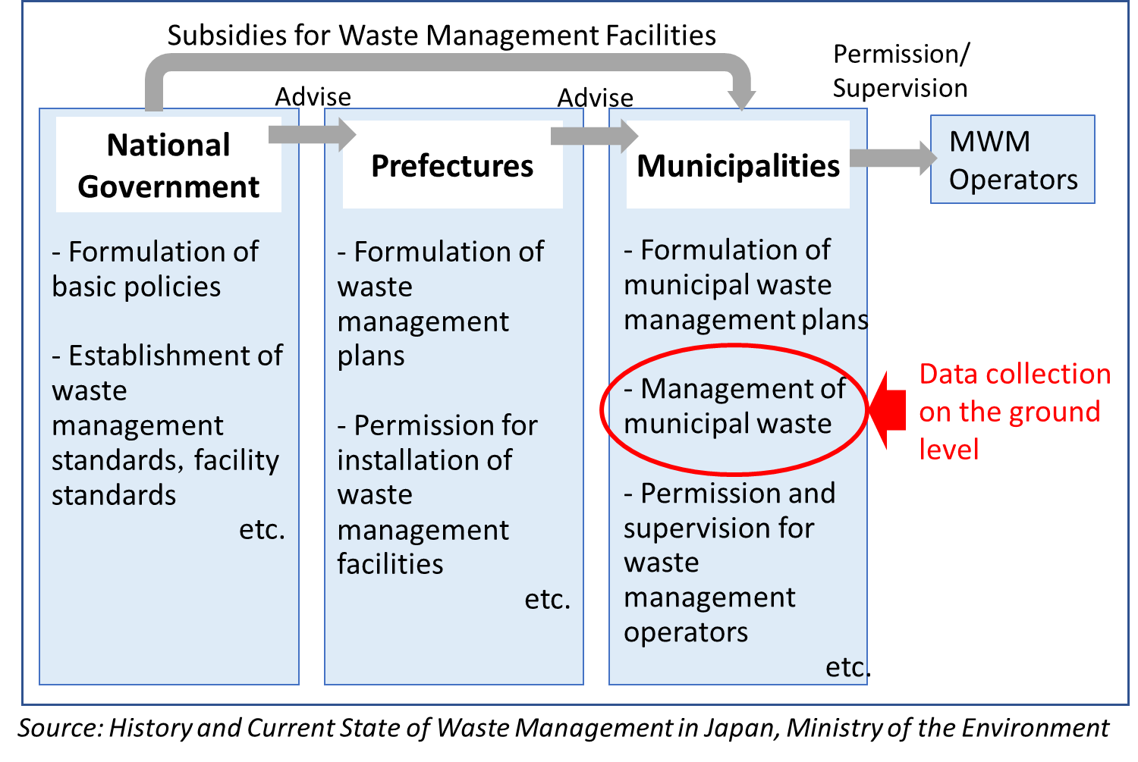
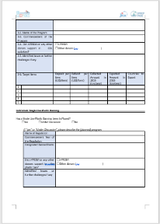
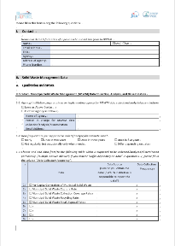
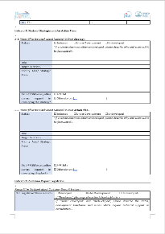
Output 1: strengthen regional monitoring mechanism and data collection.
Started Regional Monitoring by 14 performance indicators in line with CP2025
Will conduct “Regional Training on Waste Flow Analysis and National Data Management” in 2020
Evidence based decision making

Slide 25
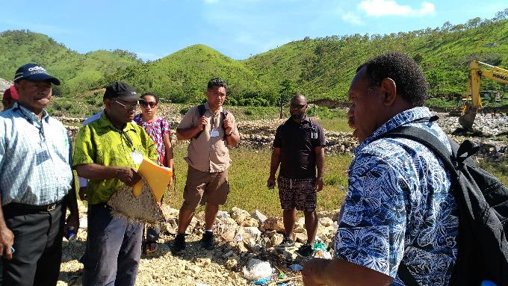
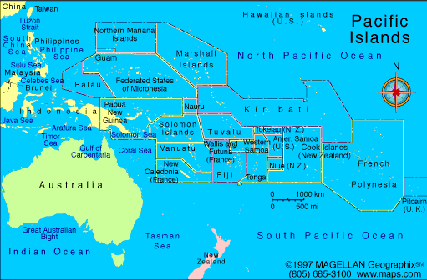
Output 2: promote regional cooperation through human resource exchange and lessons learnt sharing
Plan and organize regional trainings catering to PIC’s needs
Develop learning materials
Share good practice in PICs
Facilitate Needs-Resources matching between PICs
Landfill Management, Oct 2017, PNG
Regional Training
Sub-Regional Training
Study Visit
Trainer Dispatch
Landfill Management, Feb. 2018, Palau
Upcoming Regional Training!
“Sub-Regional Training on Proper Maintenance of Garbage Collection Vehicle and Heavy Machinery”
23-26 June 2020
In Kosrae State
for FSM, RMI, Palau

Slide 26
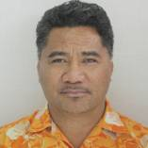
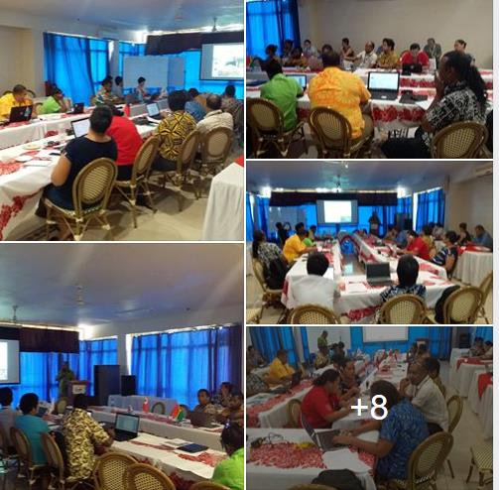
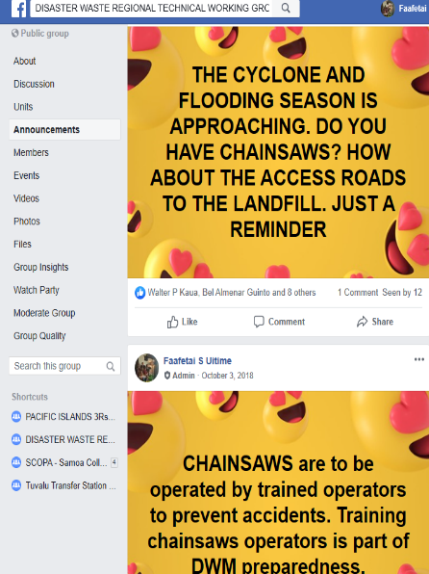
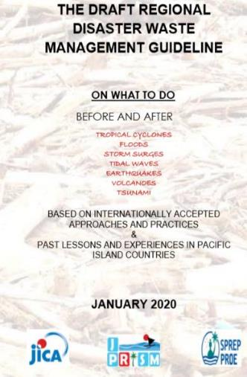
Output 3: enhance regional capacity of disaster waste management.
Develop the Pacific Regional DWM Guideline - to be launched during the CPRT 2020.
Promote public awareness and support of the Pacific Regional DWM Guideline – a number of workshops conducted in Samoa (2018), Palau (2019) and Vanuatu (2019).
Support the development of National DWM Contingency Plans in PICs – 2020 (Fiji, Samoa, Solomon Is, Vanuatu and Tonga). Countries will need in order for future DWM assistance to be provided when disasters strike.
Coordinate and promote the Regional Technical DWM Working Group functions in line with its TOR – on going communication with the countries through the Group Facebook Website

Slide 27

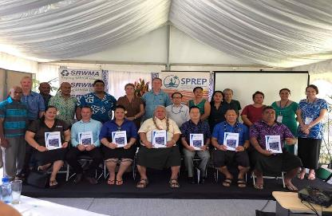
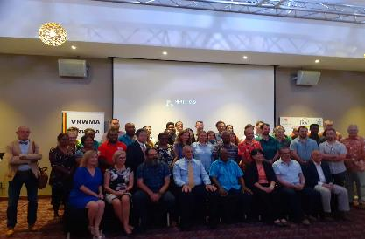
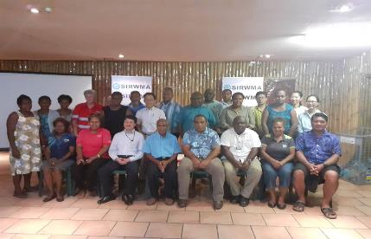
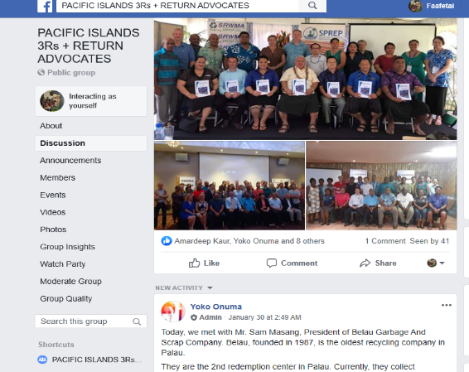
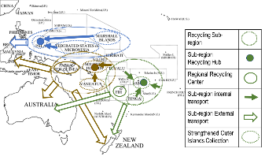
Output 4: enhance practical and sustainable 3R+Return system
Support for Recyclers Association
Supported establishment and activities of Regional Recyclers association – SA, VU and SI, considering in Tonga, Fiji, PNG, and Micronesia Region
Support of Recyclers Association with strategy development
SAMOA – 2018
VANUATU– 2019
SOLOMON – 2019
FIJI
TONGA
PNG
Basic Survey and Concept Development
3R+Return Survey is ongoing in SA, VU, TO, SI

Slide 28
Thank you

