Slide 1
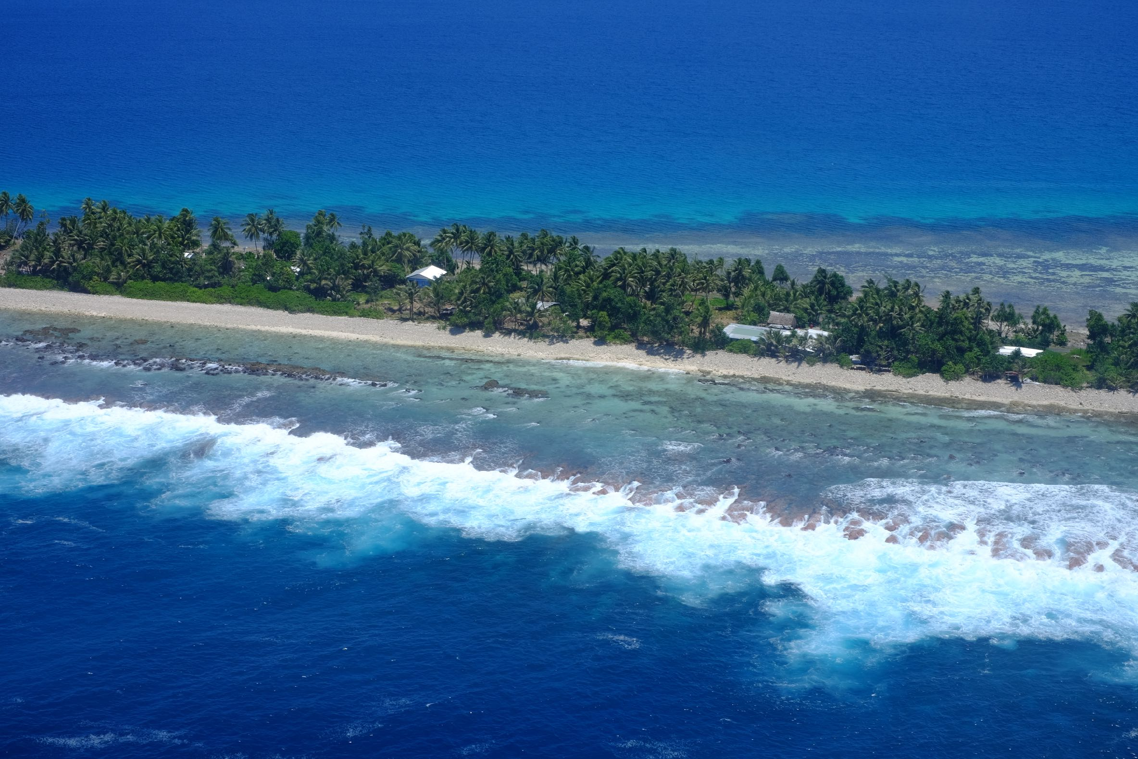



Slide 2
How much waste have we generated today?

Slide 3
How long did you spend in the shower this morning?

Slide 4
< 1 min

Slide 5
< 2 min

Slide 6
< 5 min

Slide 7
< 10 min

Slide 8
< 15 min

Slide 9
< 20 min

Slide 10


Slide 11
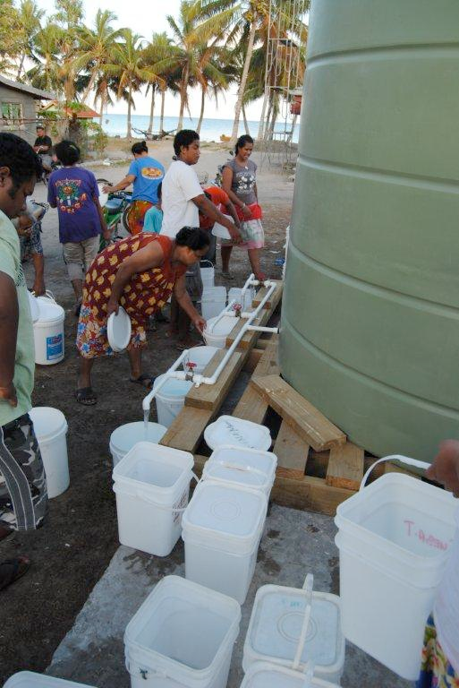
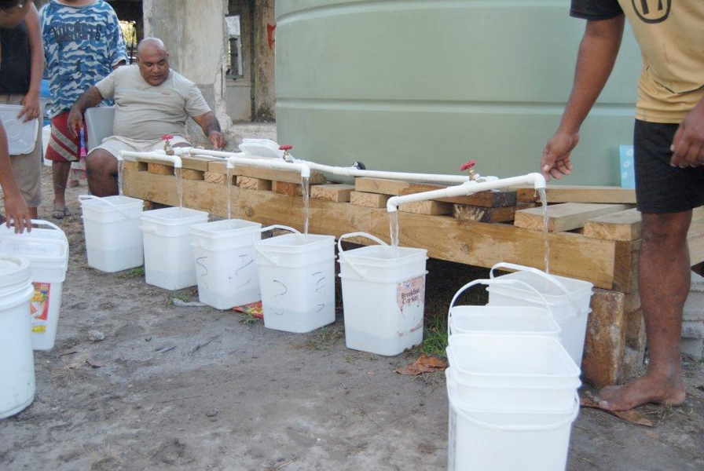
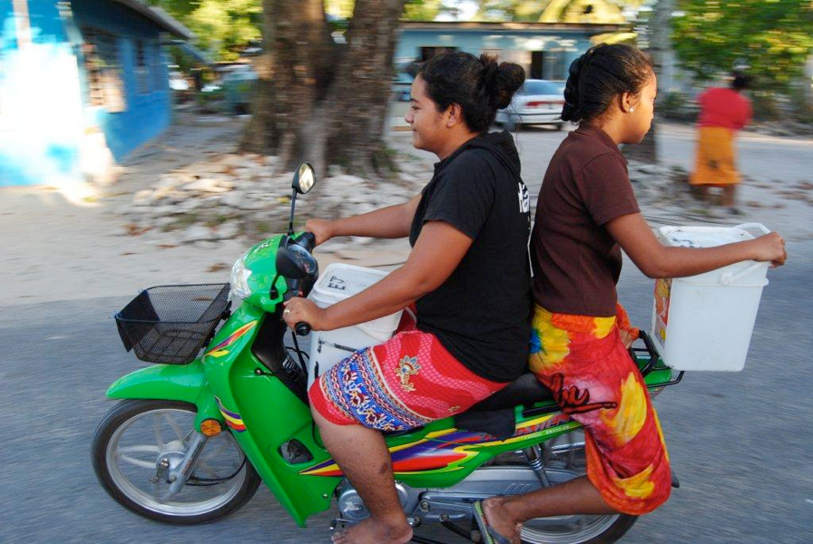

Slide 12
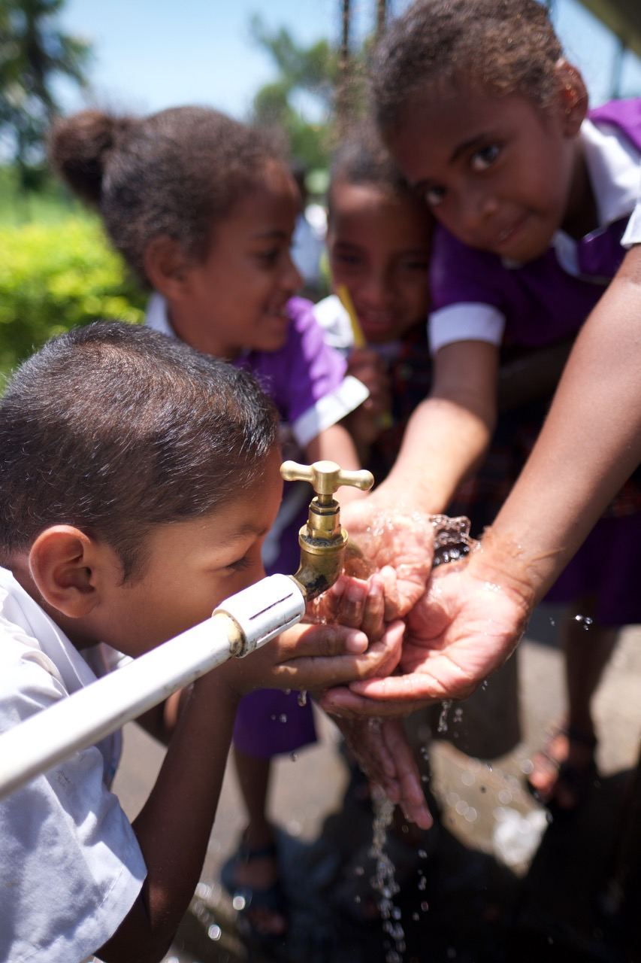
Disaster & Community Resilience Programme

Slide 13
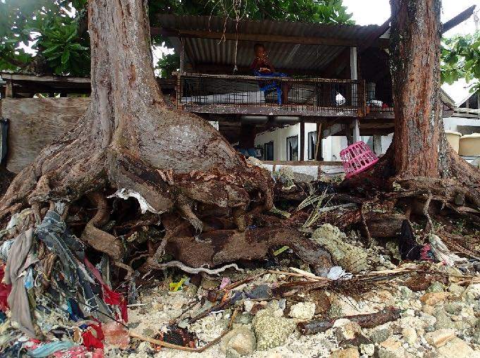
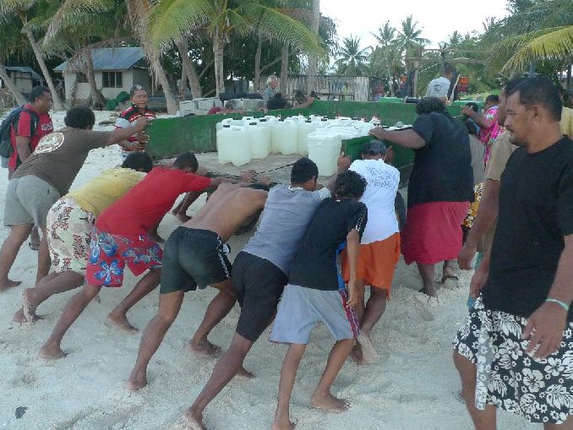
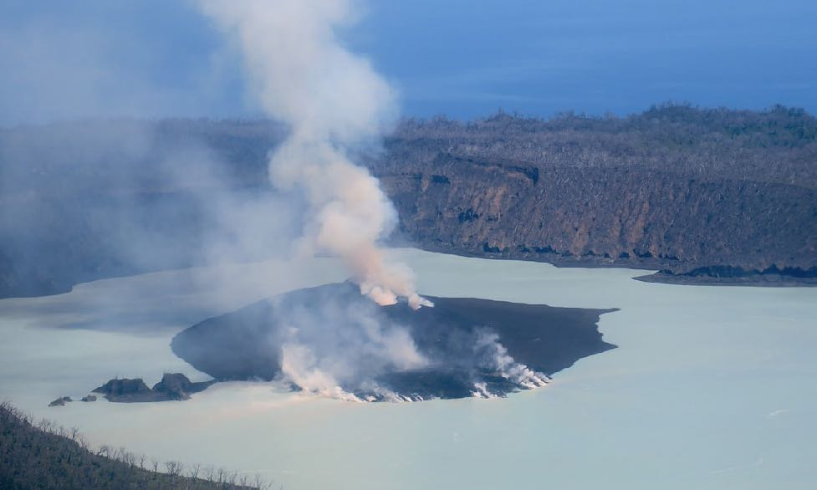
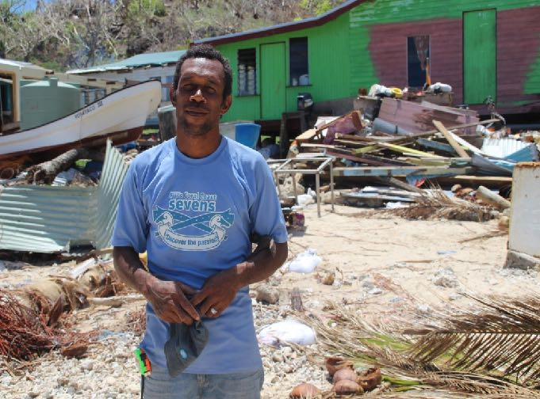
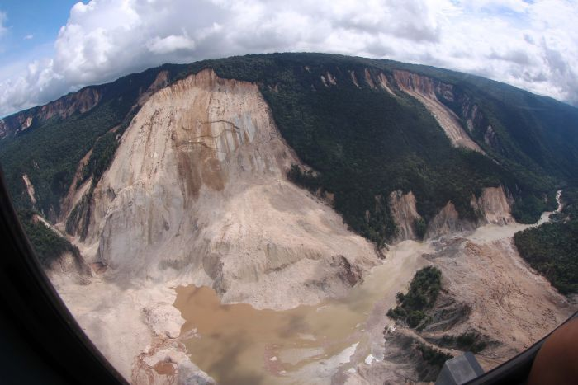
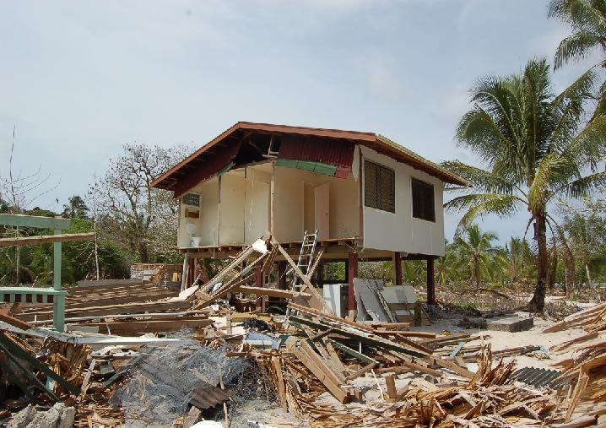
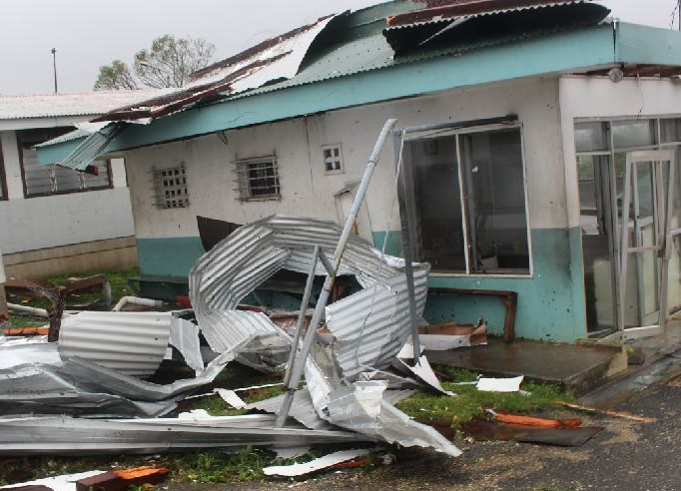
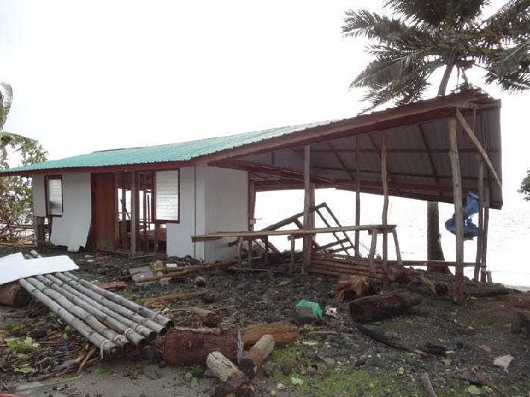
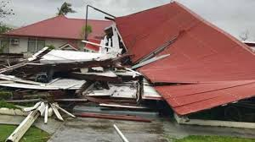
Notes:
Disaster cost/statistics
In the past 8 years, the effects of natural disasters has cost our region some 1.9billion USD. This shows the severe affect both disaster and climate change has on our region and outlines the critical need to ensure we work towards sustainable development outcomes whilst reducing our vulnerability and risk into the future.
All of these disasters above have occurred since 2011
The vulnerability of each country in this region varies and can vary greatly for populations within countries as local and national areas have specific environmental, social and economic challenges that result in varying capacities to both reduce vulnerability and recover from disaster. It is for these reasons that we need to galvanise support for the implementation of the Framework for Resilient Development in the Pacific.
Image captions
RMI inundation
Tuvalu Drought
Ambae Volcano Eruption 2017 Vanuatu
Cyclone Winston, Village_Headman_Cikobia_TC Winston 2016
PNG Earthquake and landslide 2018
Solomon Islands Flooding 2014
Cyclone Pam, Vanuatu 2015
Typhoon Bopha, Palau
Tropical Cyclone Gita, Tonga 2018

Slide 14
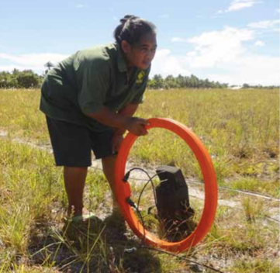
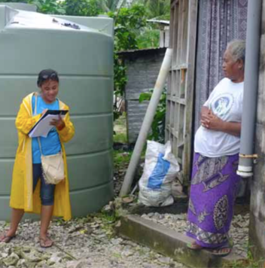
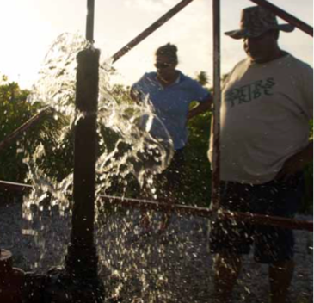
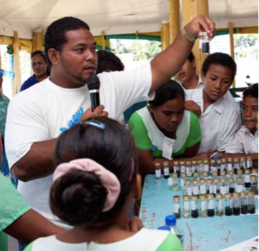
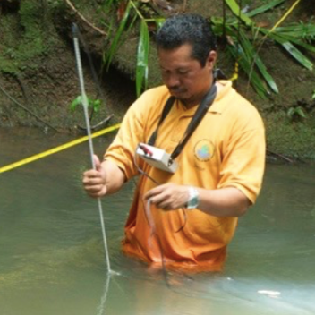
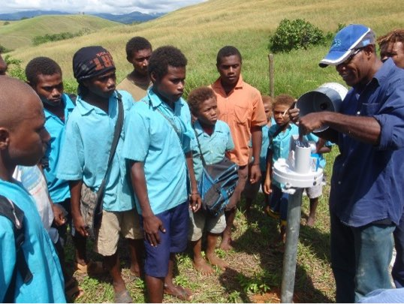
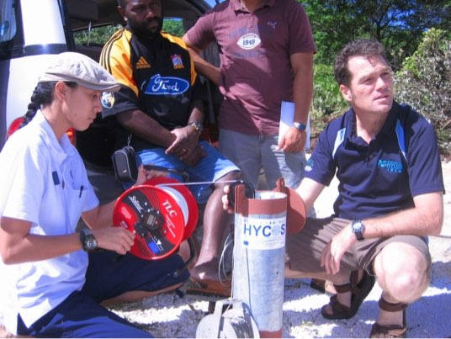
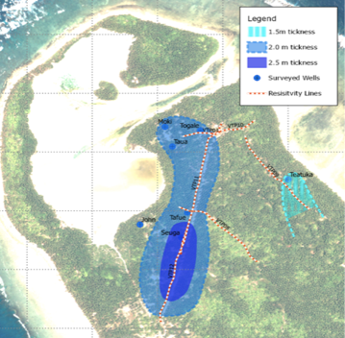
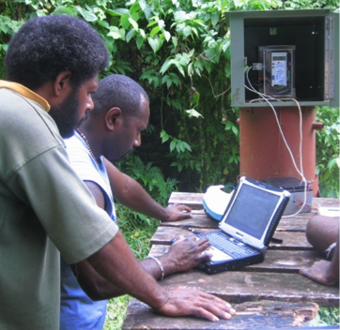
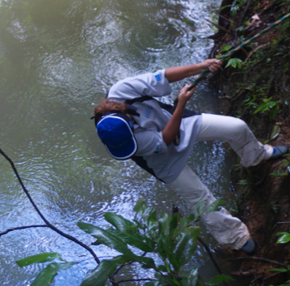
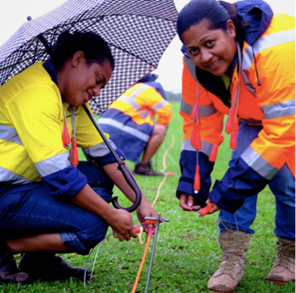
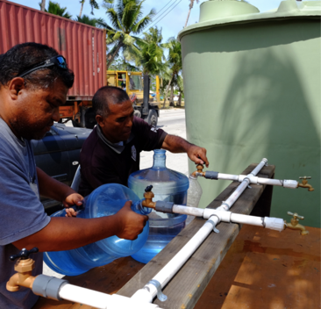

Slide 15


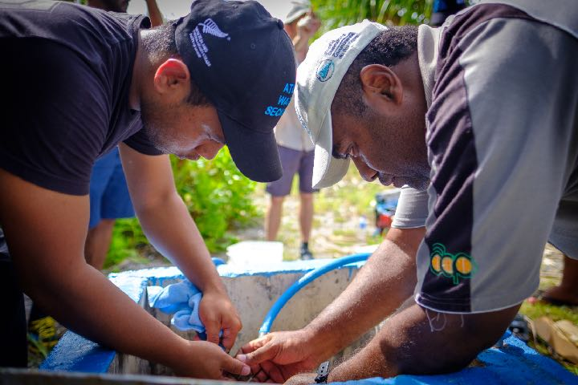
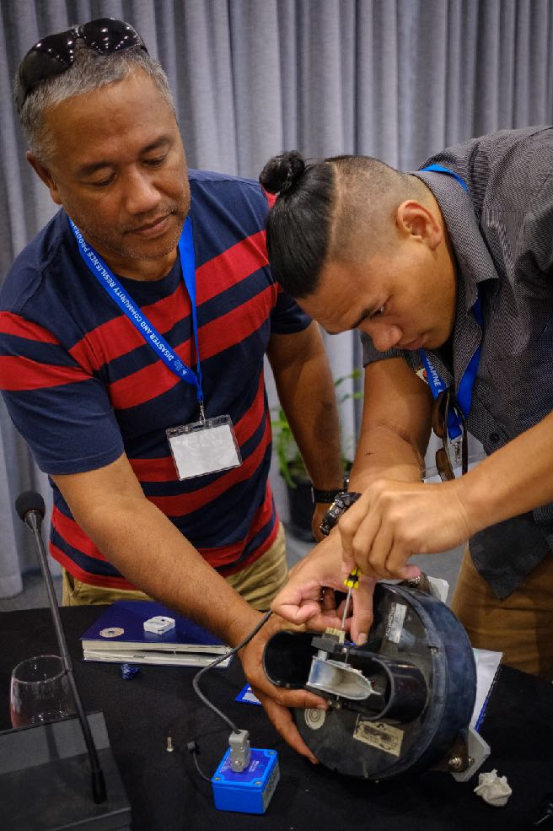
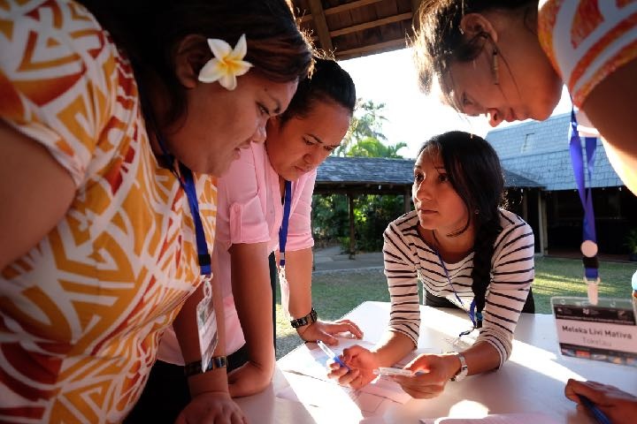
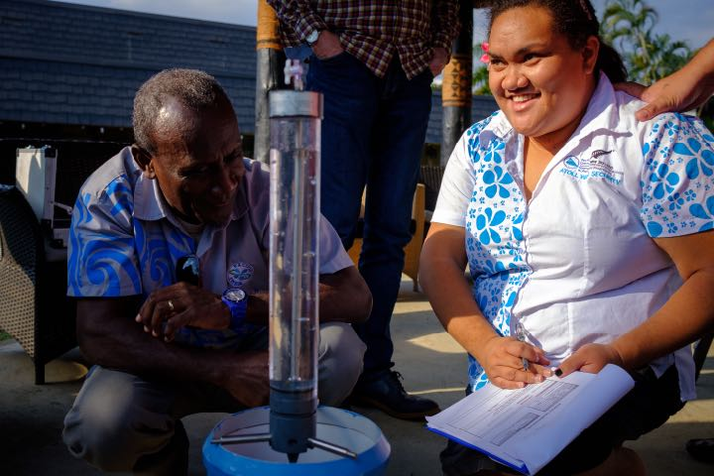
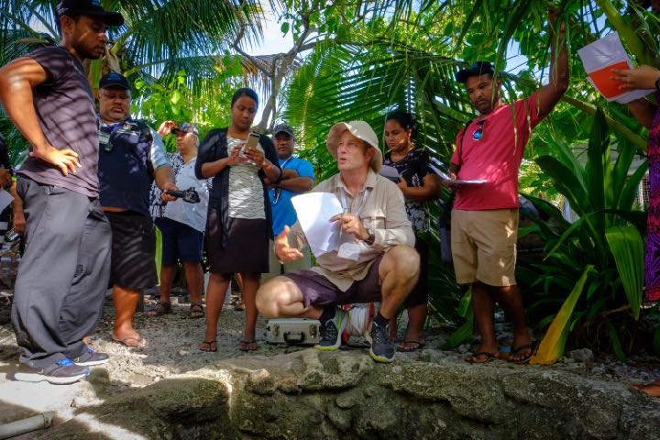
Pacific Partnership for Atoll Water Security
Notes:
The Pacific Partnership for Atoll Water Security is an example of atoll nations already working together to address the water-related impacts of climate change.
Supported by SPC in partnership with New Zealand, the partnership is linking Kiribati, RMI and Tuvalu, along with Tokelau and the Cooks, to better anticipate, respond to and withstand the impacts of drought on drinking water.

Slide 16
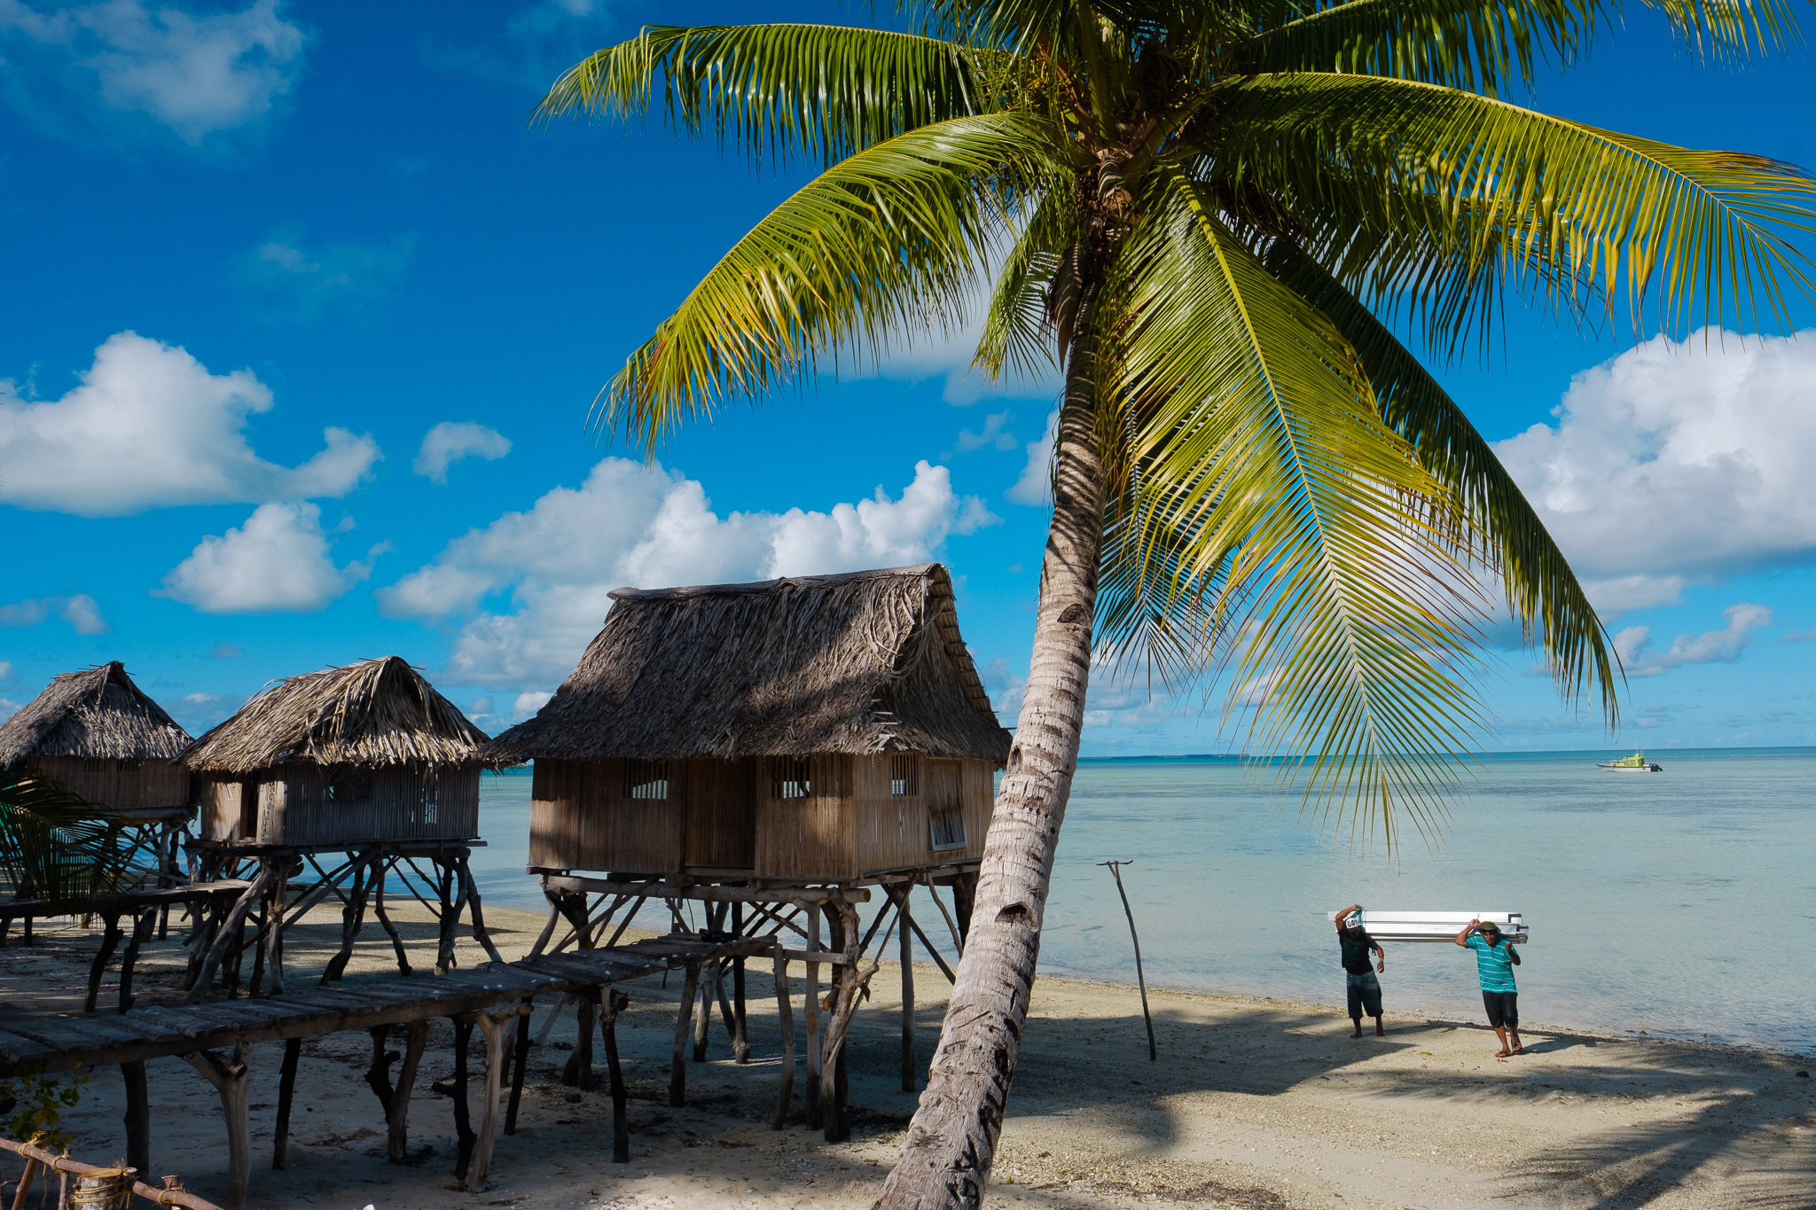

Slide 17
Who manages wastewater in the Pacific?

Slide 18
Water
Infrastructure
Environment
Resources
Land
Water
Planning
Resources
Utilities
Disaster
Education
Health
Management

Slide 19


The Pacific is world’s least urbanised SDG subregion
80%
62%
58%
55%
40%
36%
23%
Central and Southern Asia
Eastern and South-Eastern Asia
Latin America and the Caribbean
Northern Africa and Western Asia
Sub-Saharan Africa
Oceania
World
% of urban population of the world and selected SDG sub-regions
JMP data available at washdata.org, and the report: Progress on household drinking water, sanitation and hygiene 2000-2017. Special focus on inequalities: UNICEF and WHO, 2019.
Notes:
Even SIDS as a whole are 62% urbanised.

Slide 20
Planning
Water Resources
Infrastructure
Environment
Finance
Education
Health
Water
Utilities
Disaster Management

Slide 21


Slide 22
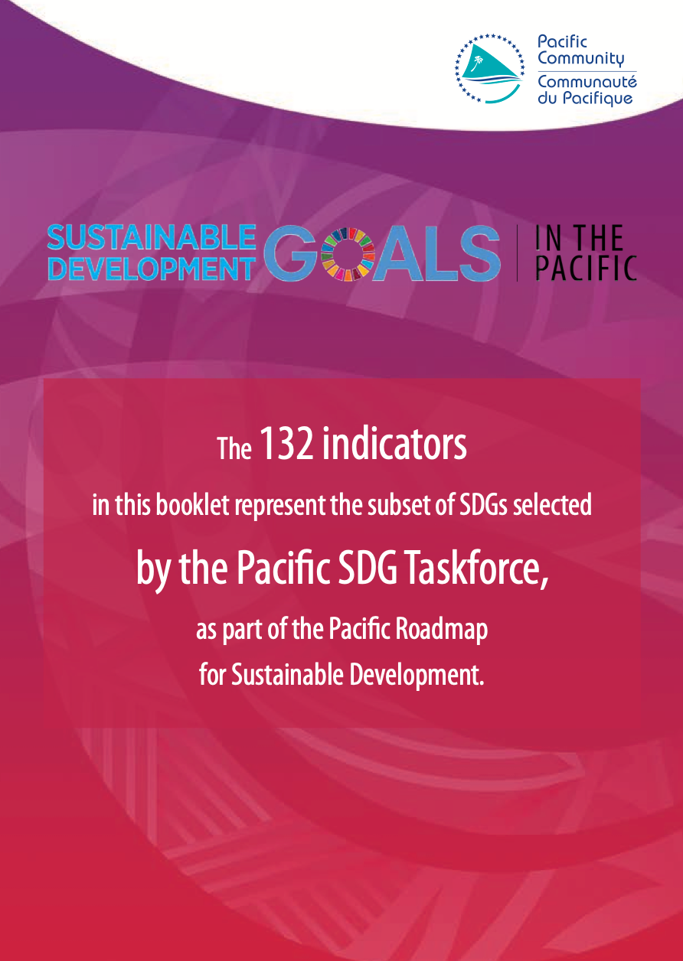
Pacific Headline Indicators
 | Target | Indicator
6.1 | Achieve universal and equitable access to safe and affordable drinking water for all | 6.1.1 Proportion of population using safely managed drinking water services
6.2 | Achieve access to adequate and equitable sanitation and hygiene for all and end open defecation, paying special attention to the needs of women and girls and those in vulnerable situations | 6.2.1 Proportion of population using safely managed sanitation services, including a hand-washing facility with soap and water
6.3 |  | 6.3.1 Proportion of wastewater safely treated
 |  | 6.3.2 Proportion of bodies of water with good ambient water quality

Slide 23
          6.3 Improve water quality by reducing pollution, eliminating dumping and minimizing release of hazardous chemicals and materials, halving the proportion of untreated wastewater and substantially increasing recycling and safe reuse globally

Slide 24
Pacific SDG subregion has lowest sanitation coverage
84%
87%
88%
73%
61%
31%
30%
Central and Southern Asia
Eastern and South-Eastern Asia
Latin America and the Caribbean
Northern Africa and Western Asia
Sub-Saharan Africa
Oceania
World
Percentage of population using at least basic sanitation services in 2017, by region (%)
JMP data available at washdata.org, and the report: Progress on household drinking water, sanitation and hygiene 2000-2017. Special focus on inequalities: UNICEF and WHO, 2019.
Notes:
Between 2000 and 2017, 2.1 billion people gained basic sanitation services, and coverage of at least basic sanitation services increased in almost all SDG regions. The greatest increase was recorded in Central and Southern Asia, where coverage more than doubled from 25% to 61%, and the number of people with basic services tripled from 384 million to 1.2 billion. Eastern and South-Eastern Asia increased coverage by nearly a quarter. In Oceania, coverage decreased by 7% due to a decline in Papua New Guinea.

Slide 25
The Pacific is the only region in the world going backward in securing access to basic sanitation
36%
24%
17%
14%
10%
8%
Oceania
Central and Southern Asia
Eastern and South-Eastern Asia
Latin America and the Caribbean
Northern Africa and Western Asia
Sub-Saharan Africa
Oceania
World
-7%
Percentage point change of population using at least basic sanitation services between 2000 and 2017, by region (%)
JMP data available at washdata.org, and the report: Progress on household drinking water, sanitation and hygiene 2000-2017. Special focus on inequalities: UNICEF and WHO, 2019.
Notes:
Between 2000 and 2017, 2.1 billion people gained basic sanitation services, and coverage of at least basic sanitation services increased in almost all SDG regions. The greatest increase was recorded in Central and Southern Asia, where coverage more than doubled from 25% to 61%, and the number of people with basic services tripled from 384 million to 1.2 billion. Eastern and South-Eastern Asia increased coverage by nearly a quarter. In Oceania, coverage decreased by 7% due to a decline in Papua New Guinea.

Slide 26
Coverage levels are stagnant or dropping
Sanitation
Water
100%
100%
89
81
68
59
51
Population coverage, %
48
31
31
0%
0%
2000
2015
2000
2015

Slide 27
First Pacific countries to report show about half of wastewater is subject to secondary treatment
4.1%
47%
48%
50%
American Samoa
Papua New Guinea
Samoa
Proportion of wastewater treated at plants providing at least secondary treatment
JMP data available at washdata.org, and the report: Progress on household drinking water, sanitation and hygiene 2000-2017. Special focus on inequalities: UNICEF and WHO, 2019.

Slide 28

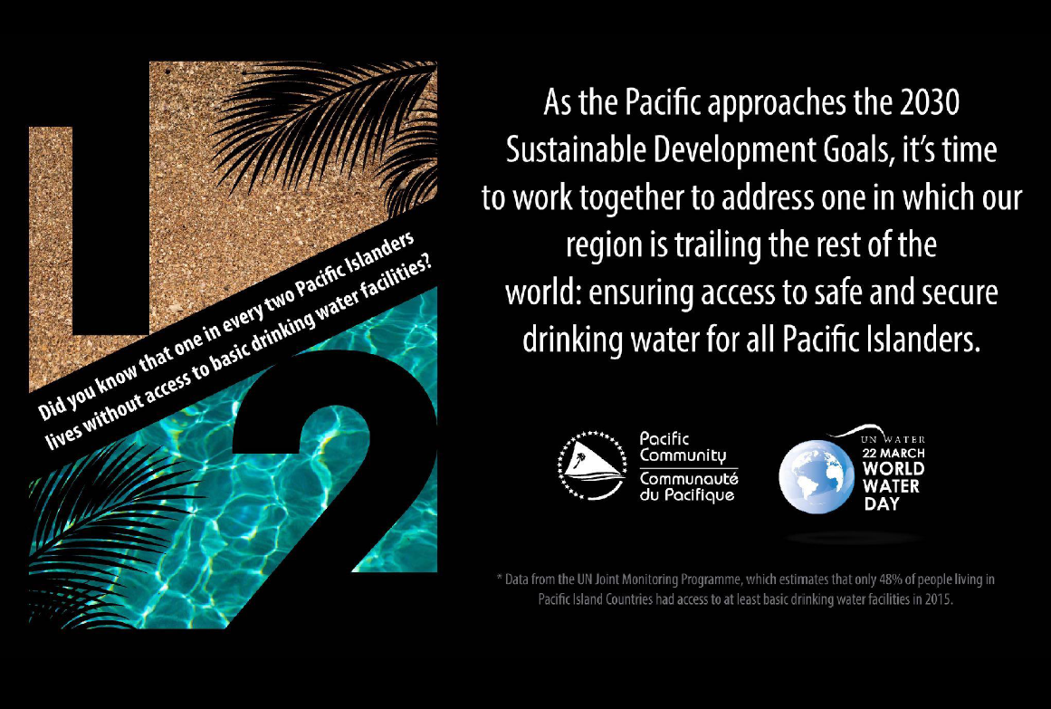
Notes:
Everyone needs water to survive and an environment to live in that is free of human waste. It is a human right.
But not everyone in the Pacific enjoys this right – especially not every child.
In fact, only half the Pacific population has access to basic water supply and even less so for sanitation with only 1/3 of Pacific islanders having access to basic toilets.
Being here today shows that we understand the importance of realizing this right. UNICEF, WHO and SPC aim to work with you and other ministers in the Pacific to meet the needs of children and their families to have water and live in a clean and safe environment.
Our commitment is in line with the SDG 6 targets for drinking water, sanitation and hygiene (6.1 and 6.2):
By 2030, achieve universal and equitable access to safe and affordable drinking water for all;
By 2030, achieve access to adequate and equitable sanitation and hygiene for all and end open defecation, paying special attention to the needs of women and girls and those in vulnerable situations.

Slide 29
Target waste streams include hazardous wastes (specifically asbestos, E-waste, and healthcare waste), solid wastes (specifically recyclables, organic waste, food packaging waste, plastic waste, disaster waste and bulky waste), and related solid wastes found in waste water (pollution effluents from poor waste management)

Slide 30
Target waste streams include hazardous wastes (specifically asbestos, E-waste, and healthcare waste), solid wastes (specifically recyclables, organic waste, food packaging waste, plastic waste, disaster waste and bulky waste), and related solid wastes found in waste water (pollution effluents from poor waste management)

Slide 31
A preliminary waste water pilot study will be developed to measure pollutant loads from point sources such as storm water drains or waste collection/disposal sites.

Slide 32
A preliminary waste water pilot study will be developed to measure pollutant loads from point sources such as storm water drains or waste collection/disposal sites.

Slide 33
A preliminary waste water pilot study will be developed to measure pollutant loads from point sources such as storm water drains or waste collection/disposal sites.

Slide 34
A preliminary waste water pilot study will be developed to measure pollutant loads from point sources such as storm water drains or waste collection/disposal sites.

Slide 35
A preliminary waste water pilot study will be developed to measure pollutant loads from point sources such as storm water drains or waste collection/disposal sites.

Slide 36
KRA 3.10: Undertake preliminary pilot study with a focus on point source pollutant loads of wastewater to assist countries in understanding the consequences of poor management on receiving environments.

Slide 37
KRA 3.10: Undertake preliminary pilot study with a focus on point source pollutant loads of wastewater to assist countries in understanding the consequences of poor management on receiving environments.

Slide 38
KRA 3.10: Undertake preliminary pilot study with a focus on point source pollutant loads of wastewater to assist countries in understanding the consequences of poor management on receiving environments.

Slide 39
This pilot study will need to add value/directly support the implementation of activities in the project…

Slide 40
This pilot study will need to add value/directly support the implementation of activities in the project…

Slide 41
This pilot study will need to add value/directly support the implementation of activities in the project…

Slide 42

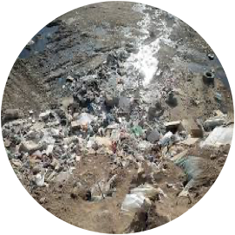
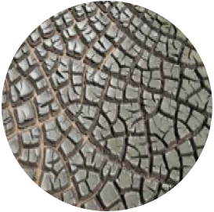
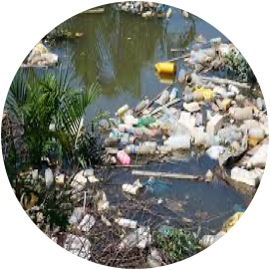
Potential waste-stream focus:
          Animal organic wastes
          Leachate from landfills
          Sewage sludge
          Stormwater & marine debris

Slide 43
Next steps
Formalisation of SPREP agreement
Recruitment of TA
Pilot design
Regional hotspot analysis
Country implementation

Slide 44
daveh@spc.int
+679 9983059

Slide 45
Tampara masika!

