Slide 1
PacWastePlus Programme
Steering Committee Meeting – Day 2

Slide 2
Session 1
Introduction
Session Facilitator: Walter Pulogo (Tuvalu)

Slide 3

Prayer

Slide 4
Opening Remarks
Ms. Andreja Vidal (European Union’s Delegation to the Pacific)

Slide 5
Welcome
Dr. Vicki Hall (SPREP)

Slide 6
Roundtable
Welcome
All

Slide 7
Meeting Agenda
Time | Session | Facilitator
10:20 – 12:30 | Session 2: Programme Update PWP update USP Update SPC Update | Bradley Nolan (SPREP) Isoa (USP) David Hebblethwaite (SPC)
12:30 – 13:30 | Lunch
13:30 – 15:30 | Session 3: In-Country Project Design Facilitated Discussion Overview of process and administration | PWP Technical Officers (SPREP) Bradley Nolan (SPREP)
15:30 – 15:50 | Afternoon Tea
15:50 – 16:45 | Session 4: Project Administration Year 2 workplan General Business | PWP Team All
17:45 – 18:45 | Cocktail Function

Slide 8

Official Photograph

Slide 9

Morning Tea

Slide 10
Session 2
Programme Update
Session Facilitator: Veari (Papua New Guinea)

Slide 11
Responses to Questions from
Country Presentations
Bradley Nolan (SPREP)

Slide 12
Question | Response
Process of requesting assistance (funding and technical) from the project | In-country Projects will be the focus of Wednesday’s session Technical support – no formal process – just reach out and we will work with you to get an outcome
Support for PacWastePlus National Inception Workshop | Should be undertaken in upcoming Mission visits
Support for National Steering Committee | National Committees are an opportunity for Countries to have active and ongoing consultation with their regulated communities. Committees should be formed and managed by Countries, PWP can attend and assist, but we will not be “close” enough to manage. Consider how NEAP can be used If you have a Recycling Association, can they me mobilised in this space?

Slide 13
Question | Response
Assistance to develop Country Project Design | This is the purpose of mission trips. Those countries receiving missions after Easter should discuss with PWP PMU during Talanoa sessions tomorrow how best they want to engage.
Carry-over activities from previous projects such as PacWaste | A small number of approved activities are included in PacWastePlus, we will discuss these in the next session
Lack of skills or trained personals to carry out awareness to community level. | PacWastePlus has resource to activate to increase skills capacity (KRA 4). Engage with the Capacity Needs Assessment to ensure your needs are included, and we will work to determine how best PacWastePlus can assist with Capacity Building across the numerous priorities that will be identified. Look to build required Capacity Building into your in-country projects.

Slide 14
Question | Response
Lack of participation from community level. | Look to utilise your NEAP to understand this issue. Seek assistance form PMU on how to assess, understand, and respond to these issues (KRA 1)
No data base collection in place to track effectiveness of the program | Monitoring and evaluation is a key activity to be built into all PWP actions (regional and in-country). Addressing this issue in interventions is required. Sharing information though project reports, and ensuring learning shared to all participating countries is a key outcome sought. Inform Database can and should be used for this purpose.
Clarification needed on financing e.g. allocation of budget etc. | In-country project investment is US$300,000 Legislative support US$30,000 Exchanges US$5,000 per year We strongly recommend focusing on the ‘tasks you would like to work on’ and the PMU will assist with how to get the best value from PWP project funding

Slide 15
Question | Response
Sustainability | Terminology and intent will be discussed during Wednesday’s session
Government contribution needs to be clarified | PacWastePlus is a Programme designed by countries, to assist with Country activity. PWP is not a “SPREP” Programme, SPREP is the implementation partner of the EU and Countries. Regional activities will be managed by PMU, and all possible assistance to be provided to Countries, but local Implementation to communities should be managed by Country Officers. Where Local implementation staff are required, these costs should be included in the in-country projects, and Contracts will be developed seeking assistance EU is unable to pay government staff salaries (EDF funding rules)
Legal implications on lack of complying to agreement | In-country projects will have monitoring & evaluation requirements, PMU will work to assist and ensure as much as possible that PWP funded interventions do not fail. MoU to be developed with Countries and shared with NAO and Leadership. Country commitments confirmed through SPREP Leadership and PIFS Leaders meetings. Non delivery may jeopardise future EU funding support

Slide 16
Question | Response
More clarification on PacWaste Plus Projects coverage and clear implementation timeline based on Island Priorities as most islands have similar waste priorities | Confirmation of immediate timelines to be clarified today and tomorrow. In-country project delivery timelines to be determined through the project development processes.
More clarification on KRA 1 in relation to collate and review country existing data on waste through conducting survey and study. Does PWP recognize previous studies and surveys at the national as baseline? | Any and all data available to countries should be shared with PWP PMU. We will be engaging data analyst following waste data collection processes to assess all data over time to provide detailed feedback and opportunities to all countries. All data is valuable and should be made available to PMU All historical data should be uploaded to Inform country portals to ensure utilised in PWP work. Available data is required to justify in-country project request.

Slide 17
Question | Response
PWP PMU to provide clarification and update on work with the University of the South Pacific to assess existing accredited and vocational waste courses and commence development of new courses to fill gaps. | USP will present on their planned work to deliver this outcome during today’s session.
Provide more clarification on National Project Committee. Should the country develop a ToR for thee Committee or the PMU will do that | The National Waste Committee is a recommendation for countries. The Committees provide a consultative opportunity for waste management in general (not only a PWP committee). Design and ToR will be for each Country to decide based on their individual needs, legislative environment, and whether an existing committee may be able to provide this suggested service.

Slide 18

More Questions

Slide 19
PMU Programme update
Bradley Nolan (SPREP)

Slide 20
Programme
Governance
European Union
Project Steering Committee
(annual meetings)
Project Donor
1 representative from each Country (15)
1 representative from PIFS
1 representative from SPC
1 representative from USP
1 representative from EU
1 representative from SPREP
National Committees
PacWastePlus
Project Management Unit
Research Advisory Group
Established and managed by each Country
6 Tertiary Institution Experts on the issues addressed by PacWaste Plus
Technical Advisory Panels
Project Working Party
(quarterly meetings)
Hazardous Waste TAP
Solid Waste TAP
Women on Waste (WOW) TAP
1 representative from PIFS
1 representative from SPC
1 representative from USP
1 representative from EU
1 representative from SPREP
Other PacWaste Plus staff as required
Notes:
All stablished except for TAPs (were looking to utilise CPRT, but will seek to form separate groups after advice from WMPC officers)
National Committees – Up to each country – seek comments on if any have done so, or are willing to do so once the in-country projects commence.

Slide 21
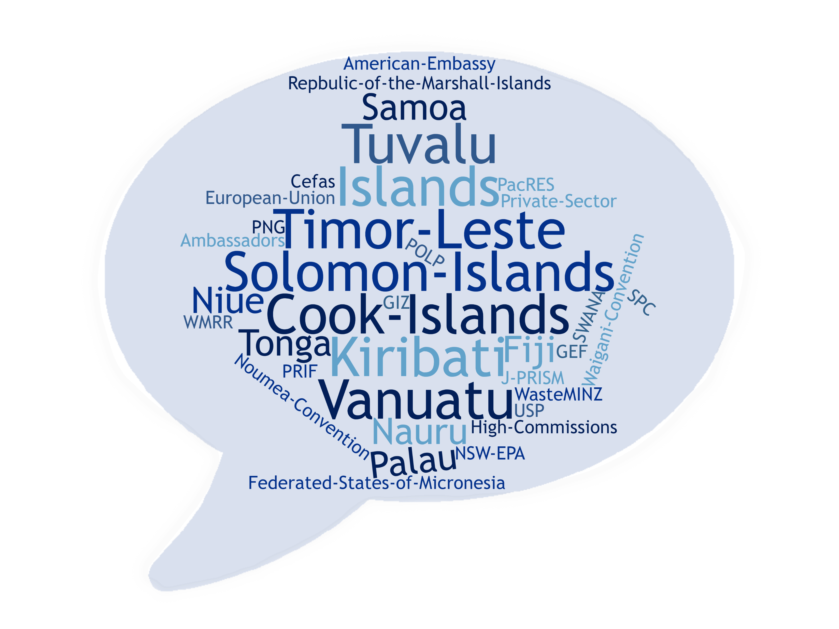
Project
Consultation
Republic
Notes:
Advocacy
Hosting the PacWastePlus inception meeting
Negotiating project alignment with PRIF Recycling Hub Study
Negotiating project alignment with GEF ISLANDS waste management project
Negotiating project alignment with the Australian Government funded Pacific Ocean Litter Project (POLP)
Project support for the Greening of the Pacific Games 2019
Supporting Plasticity Pacific
Supporting Pacific Environment Forum & SPREP Meeting

Slide 22


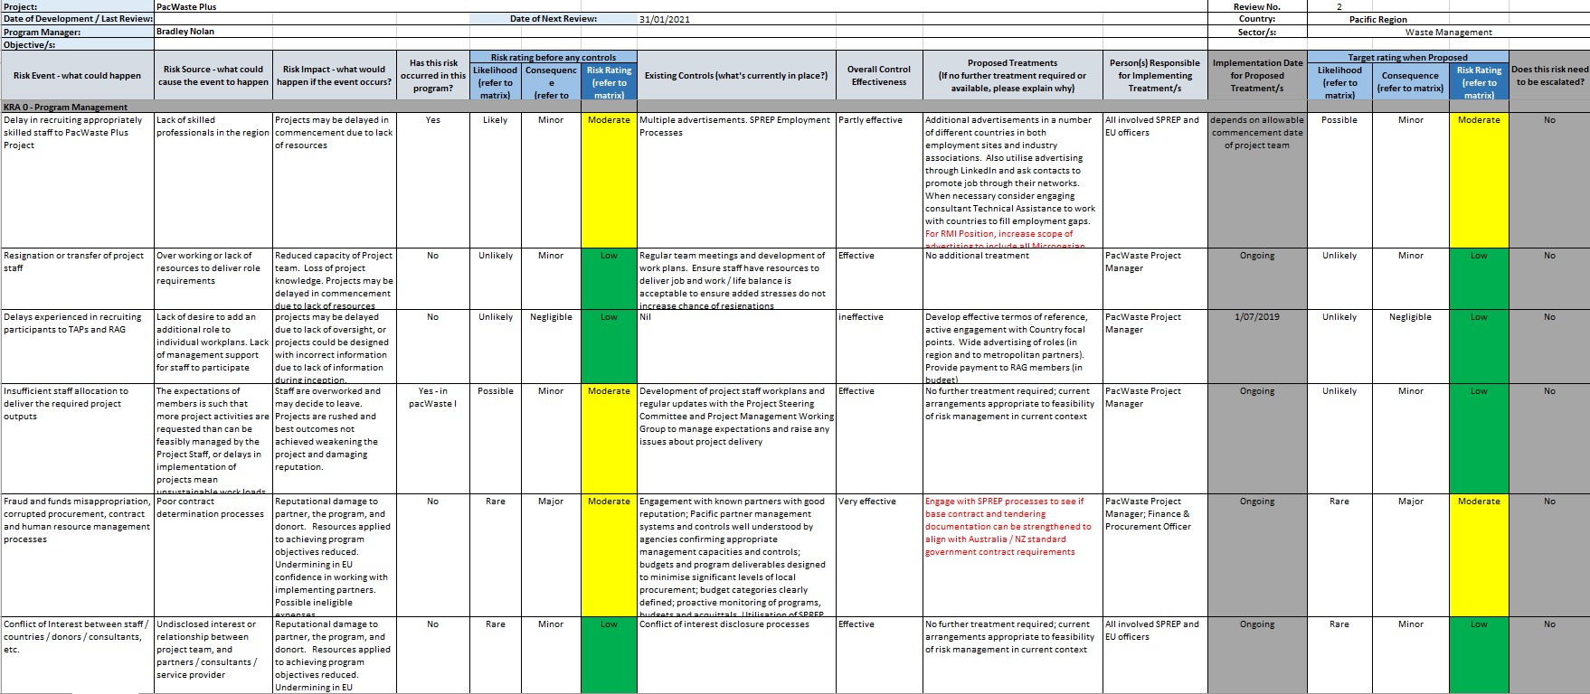
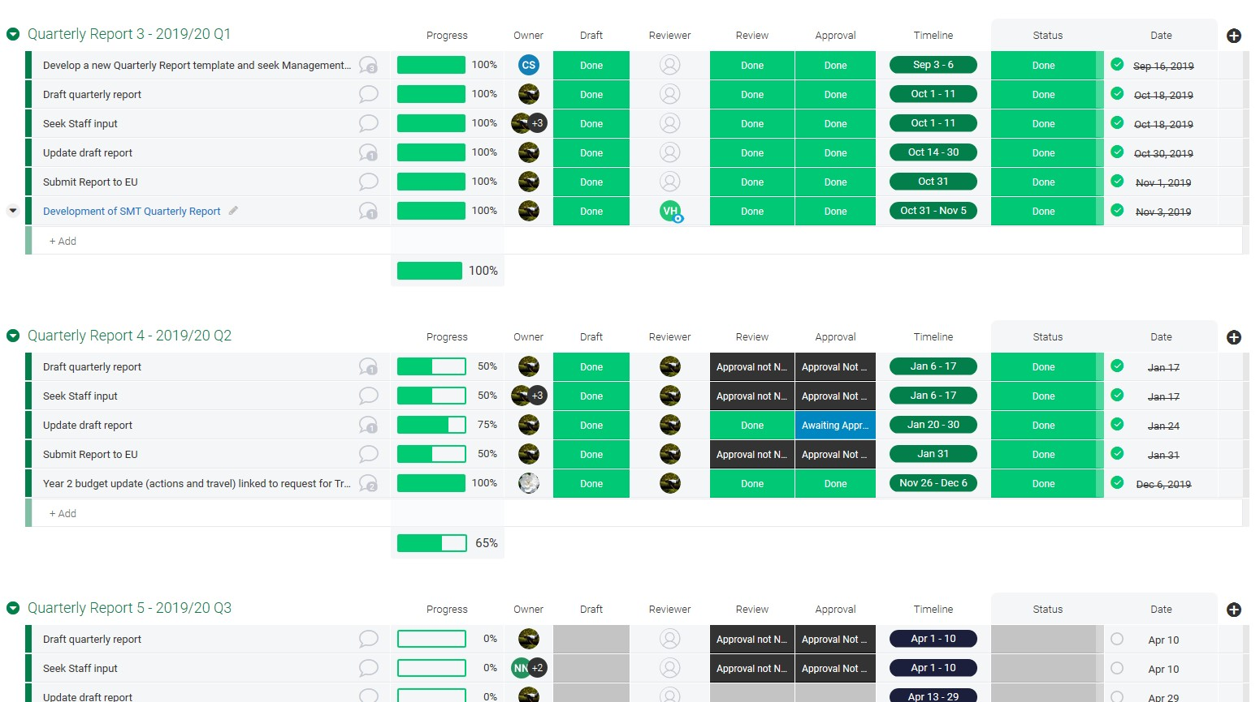


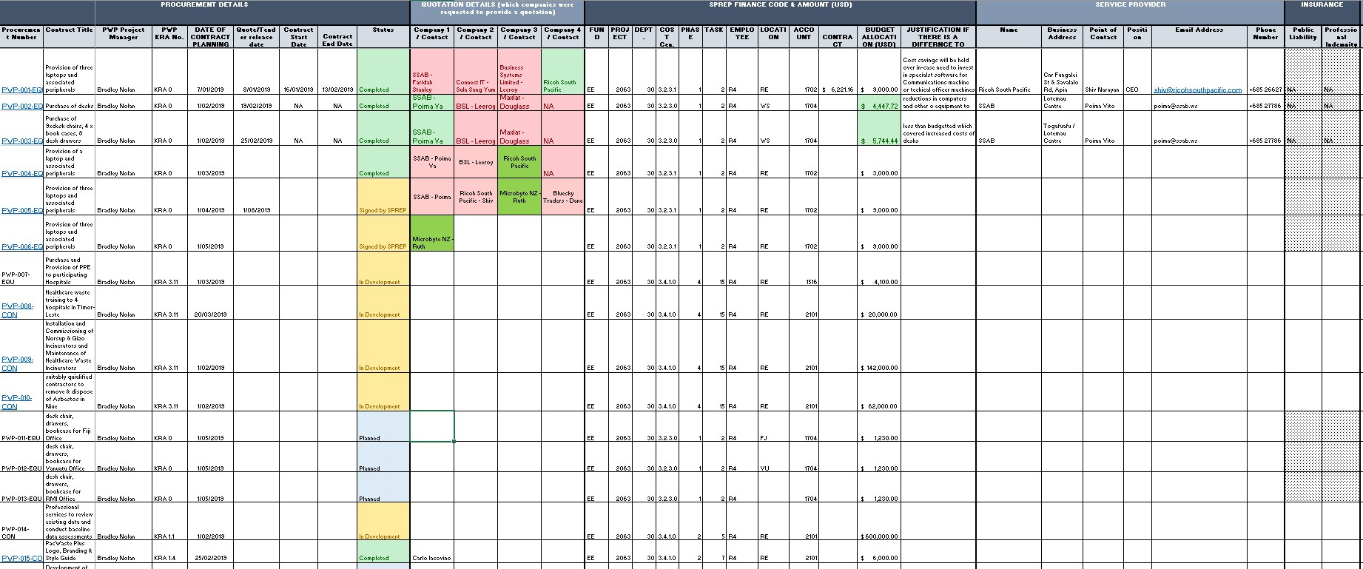
Programme Planning
Notes:
Monitoring and evaluation plan
Procurement plan
Knowledge management plan
Reporting schedule
Risk Management Plan
GESI
Communications / logo / branding

Slide 23
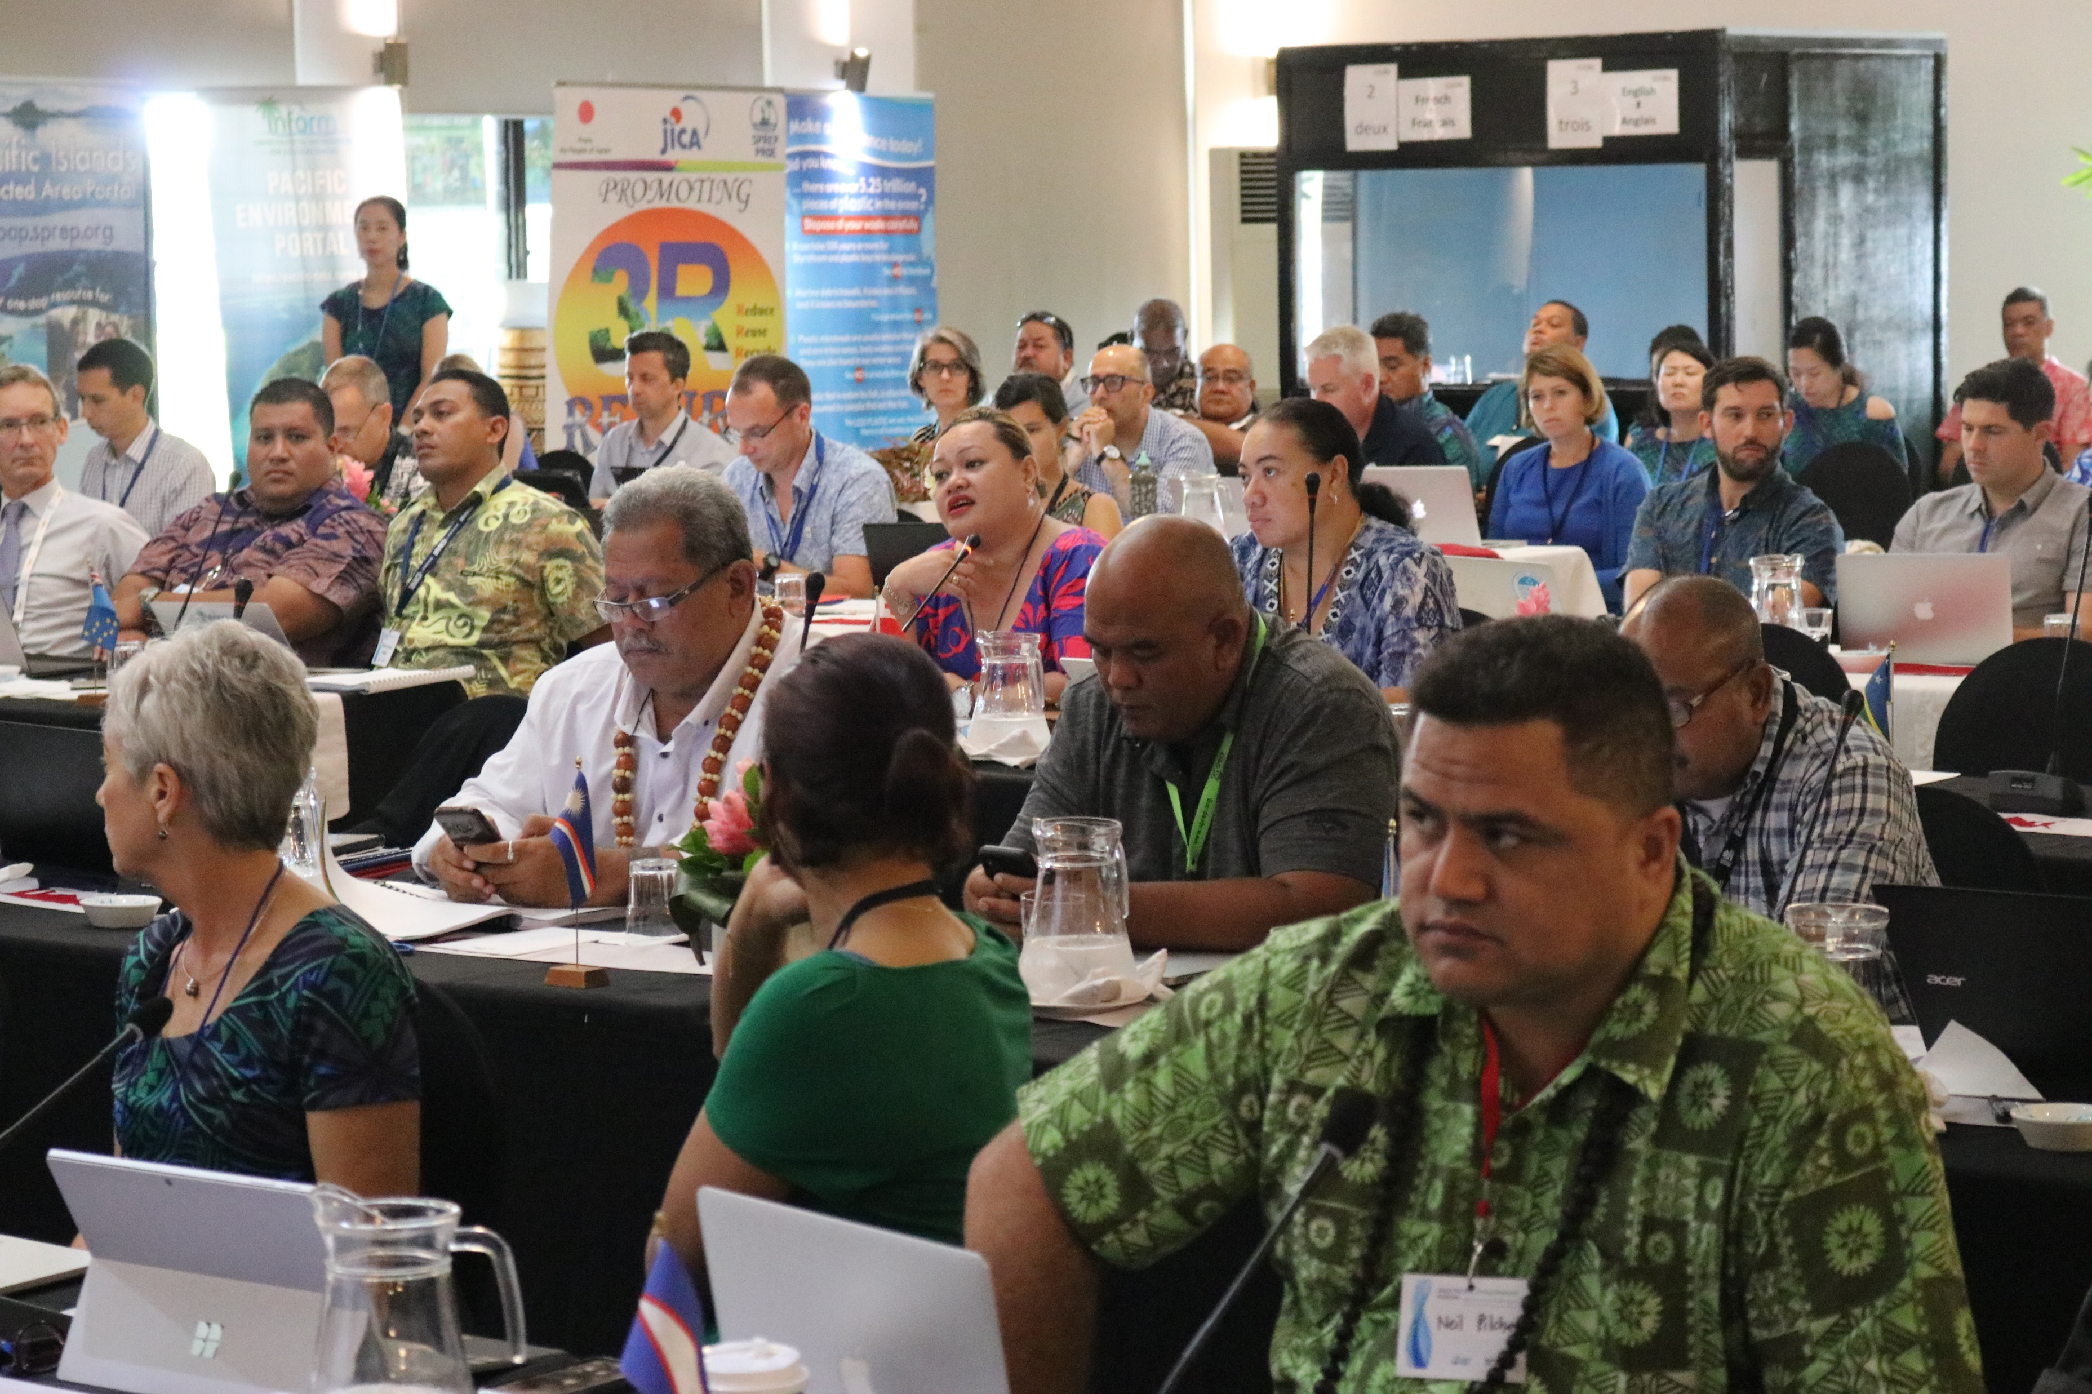
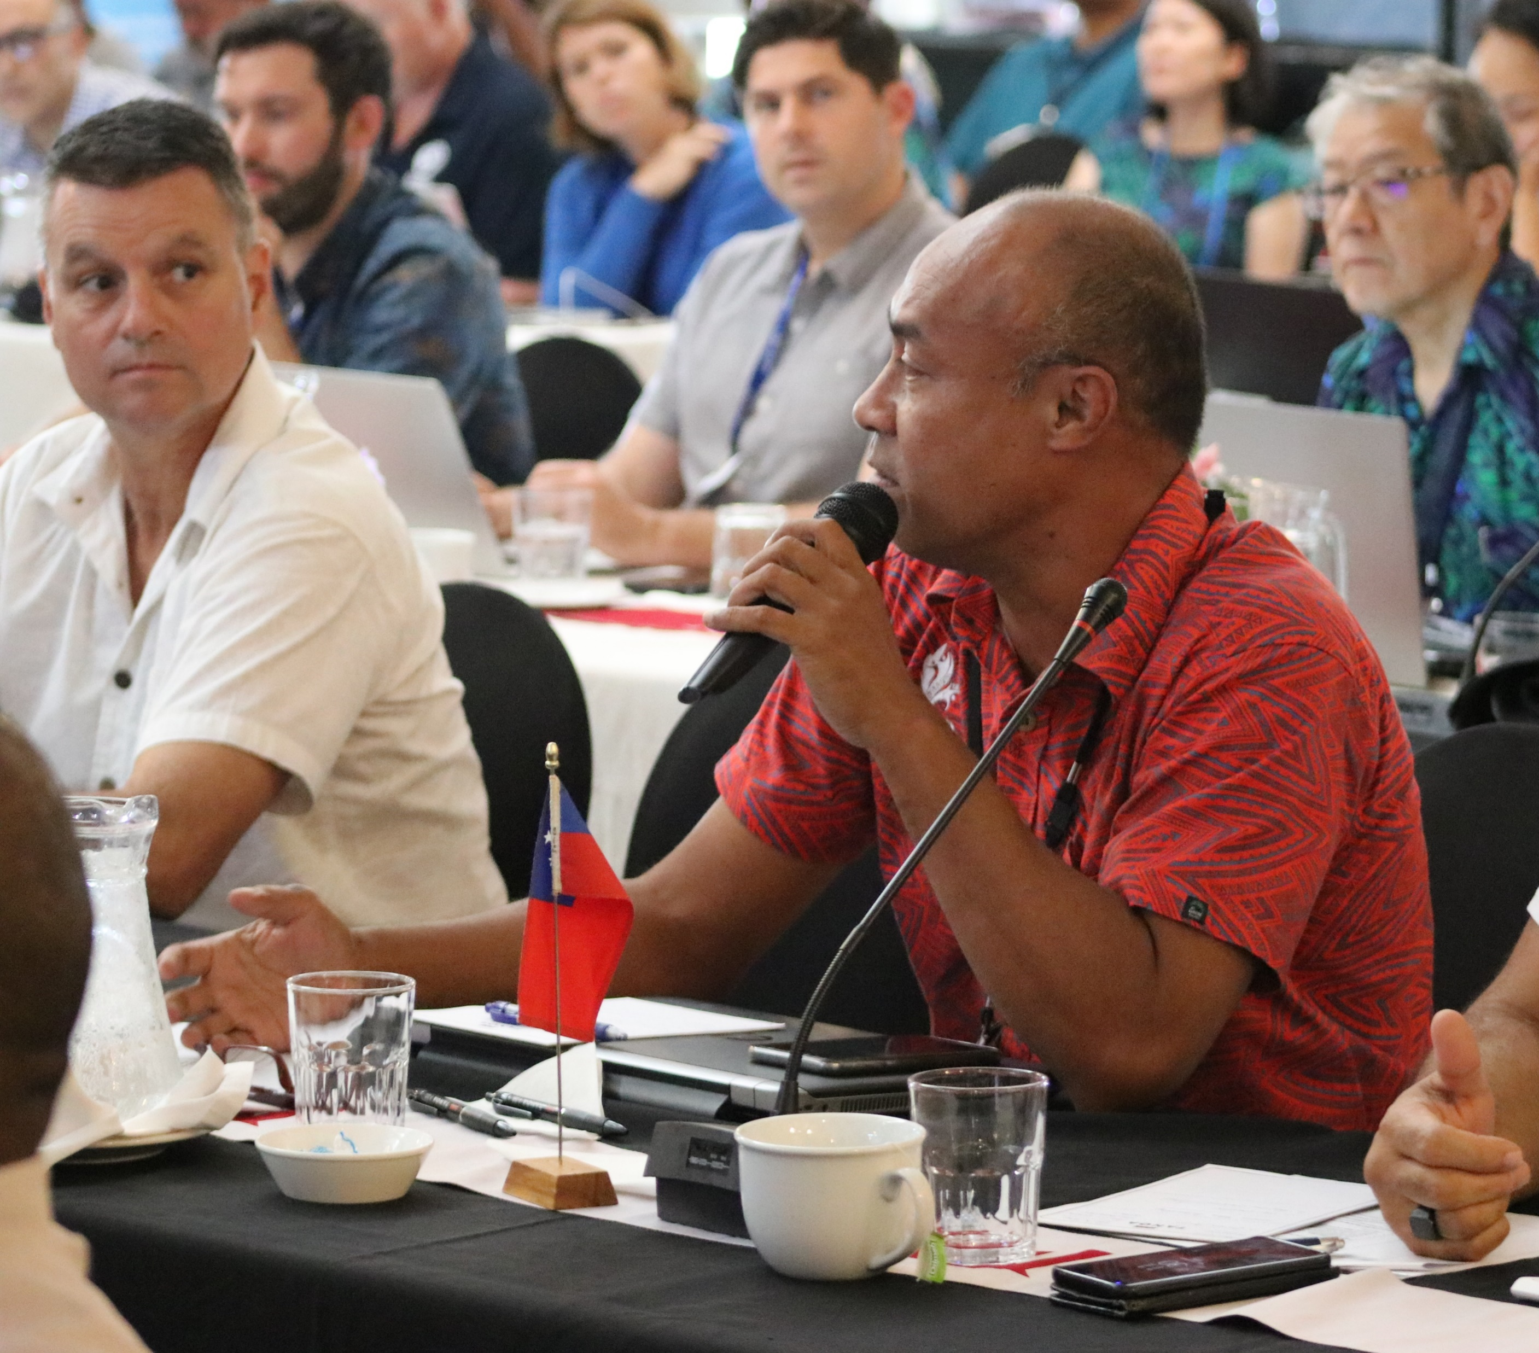
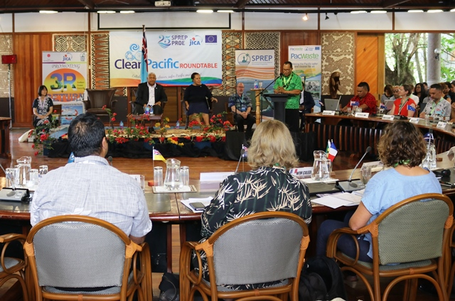
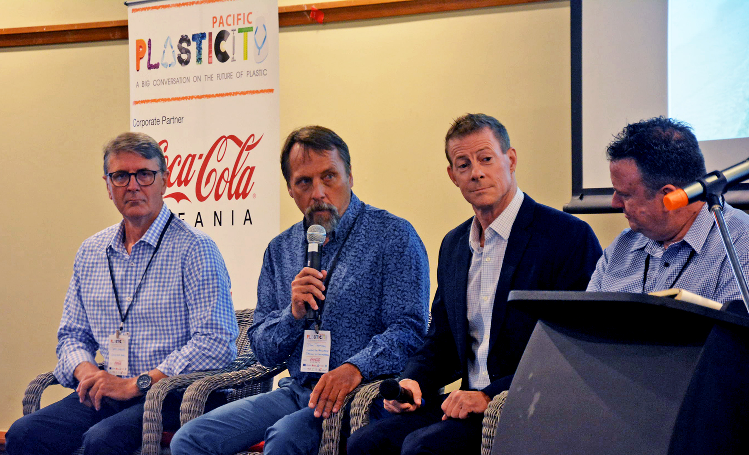
Supported Events
Notes:
CPRT 2018
SPREP Meeting 2019
Pacific Environment Forum
Pacific Islands Environment Conference
Plasticity Fiji
CLiP (Vanuatu & Solomon Islands)

Slide 24
Year 1 Financial Report
2/7/18 – 1/7/19
Activity | Y1 Budget | Y1 Actual | Y1 Variance
KRA 0 – PWP Project Management & Governance | 859,840 | 188,007 | 671,833
KRA 1 – Data & Information | 504,020 | 71,563 | 432,457
KRA 2 – Policies & Regulation | 2,500 | 2,255 | 245
KRA 3 – Infrastructure & Partnerships | 93,600 | - | 93,600
KRA 4 – Human Capacity | 162,700 | - | 162,700
Administration | 113,586 | 18,329 | 95,257
TOTAL | 1,736,246 | 280,154 | 1,456,092
Notes:
KRA 0 – Actual costs include Staff, Office, PMU travel Costs, Inception Meeting and Comms & Visibility
KRA 1 – Actual costs include 2018 CPRT assistance
KRA 2 – Actuals costs include attendance and advocacy at the Plasticity Conference
KRA’s 3 & 4 – No activities, though budget was to cater for completion of PacWaste Activities (KRA 3), Needs Assessment and Stage 1 of the Vocational & Tertiary Engagement with USP.

Slide 25
Procurement Update
Regional Activities (Active Tender Processes)
Legislative Review & Assessment of Environmental and Waste Legislative Environment.
Baseline data assessment through Waste Audits for FSM, RMI, NR and VU
Baseline data assessment through Waste Audits for NU, PG, SB and TL
Situational Analysis of Human Rights Issues in the Waste Mgmt Sector
National Capacity Needs Assessment for Waste
Technical Assistance
Completion of PacWaste Activities
Healthcare Waste Training for Timor-Leste
Healthcare Incinerator Repair and Maintenance
Niue Asbestos Pilot Project completion

Slide 26
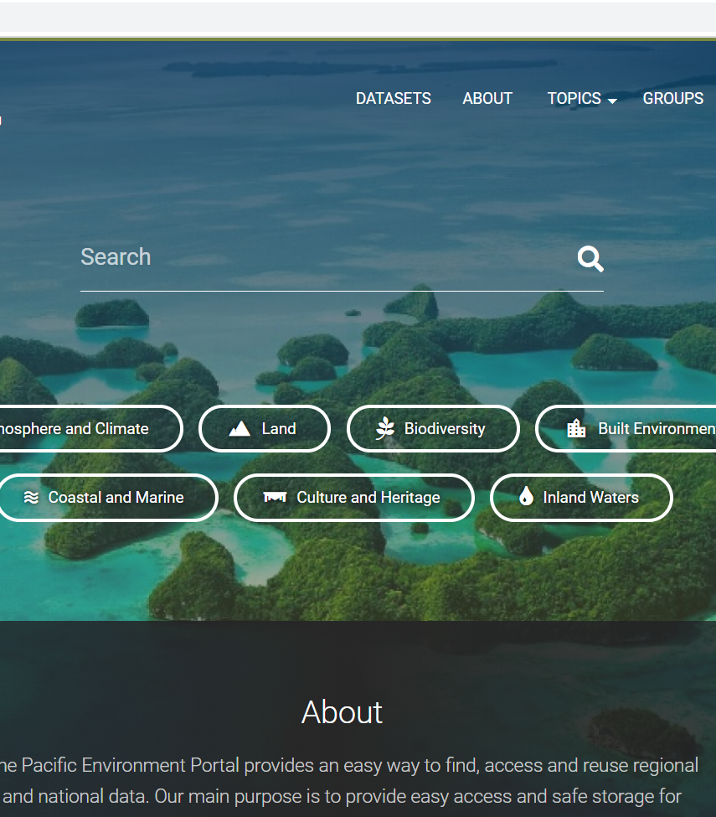
Inform Data Portals
Ensured all portals operational and able to receive waste information.
Contracted consultant to develop the Timor-Leste portal
Developing relationship to commence planning and delivery of Inform user sessions in each country.
Inform initially funded through GEF-6 project support

Slide 27

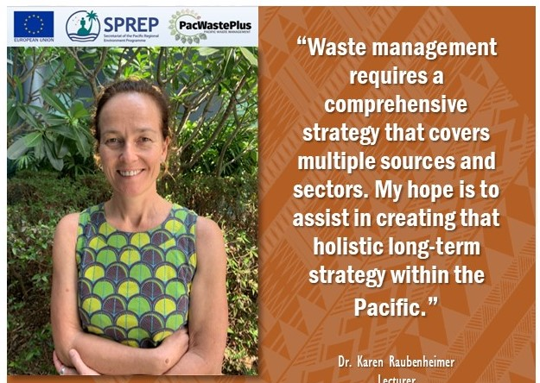

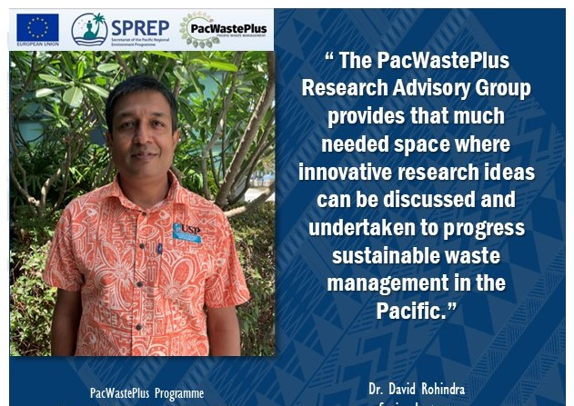
Research Advisory Group

Slide 28
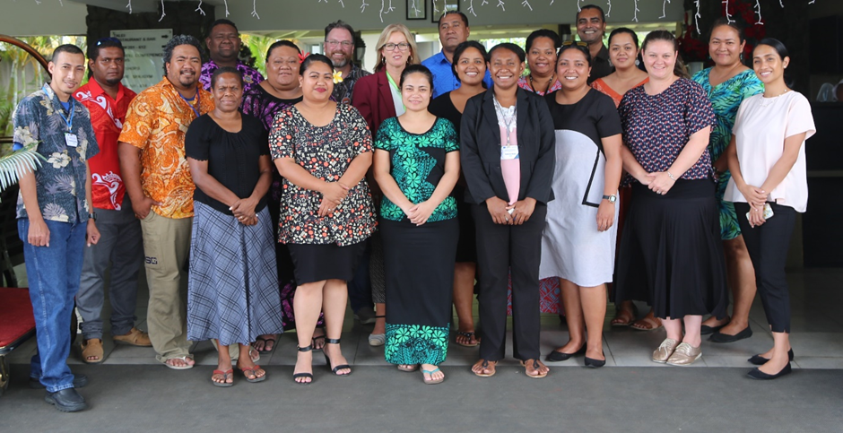
National Education & Awareness Plans
Two capacity trainings provided on NEAPs
Countries have been provided with NEAP development toolkit
Encourage countries to consider meaningful education and awareness activities into proposed country investment concepts.
Notes:
Follow ups with countries are currently on-going to evaluate progress of country NEAPs development
Feedback from countries will shape a model regional education and awareness raising plan which will guide national delivery of relevant country programmes.

Slide 29
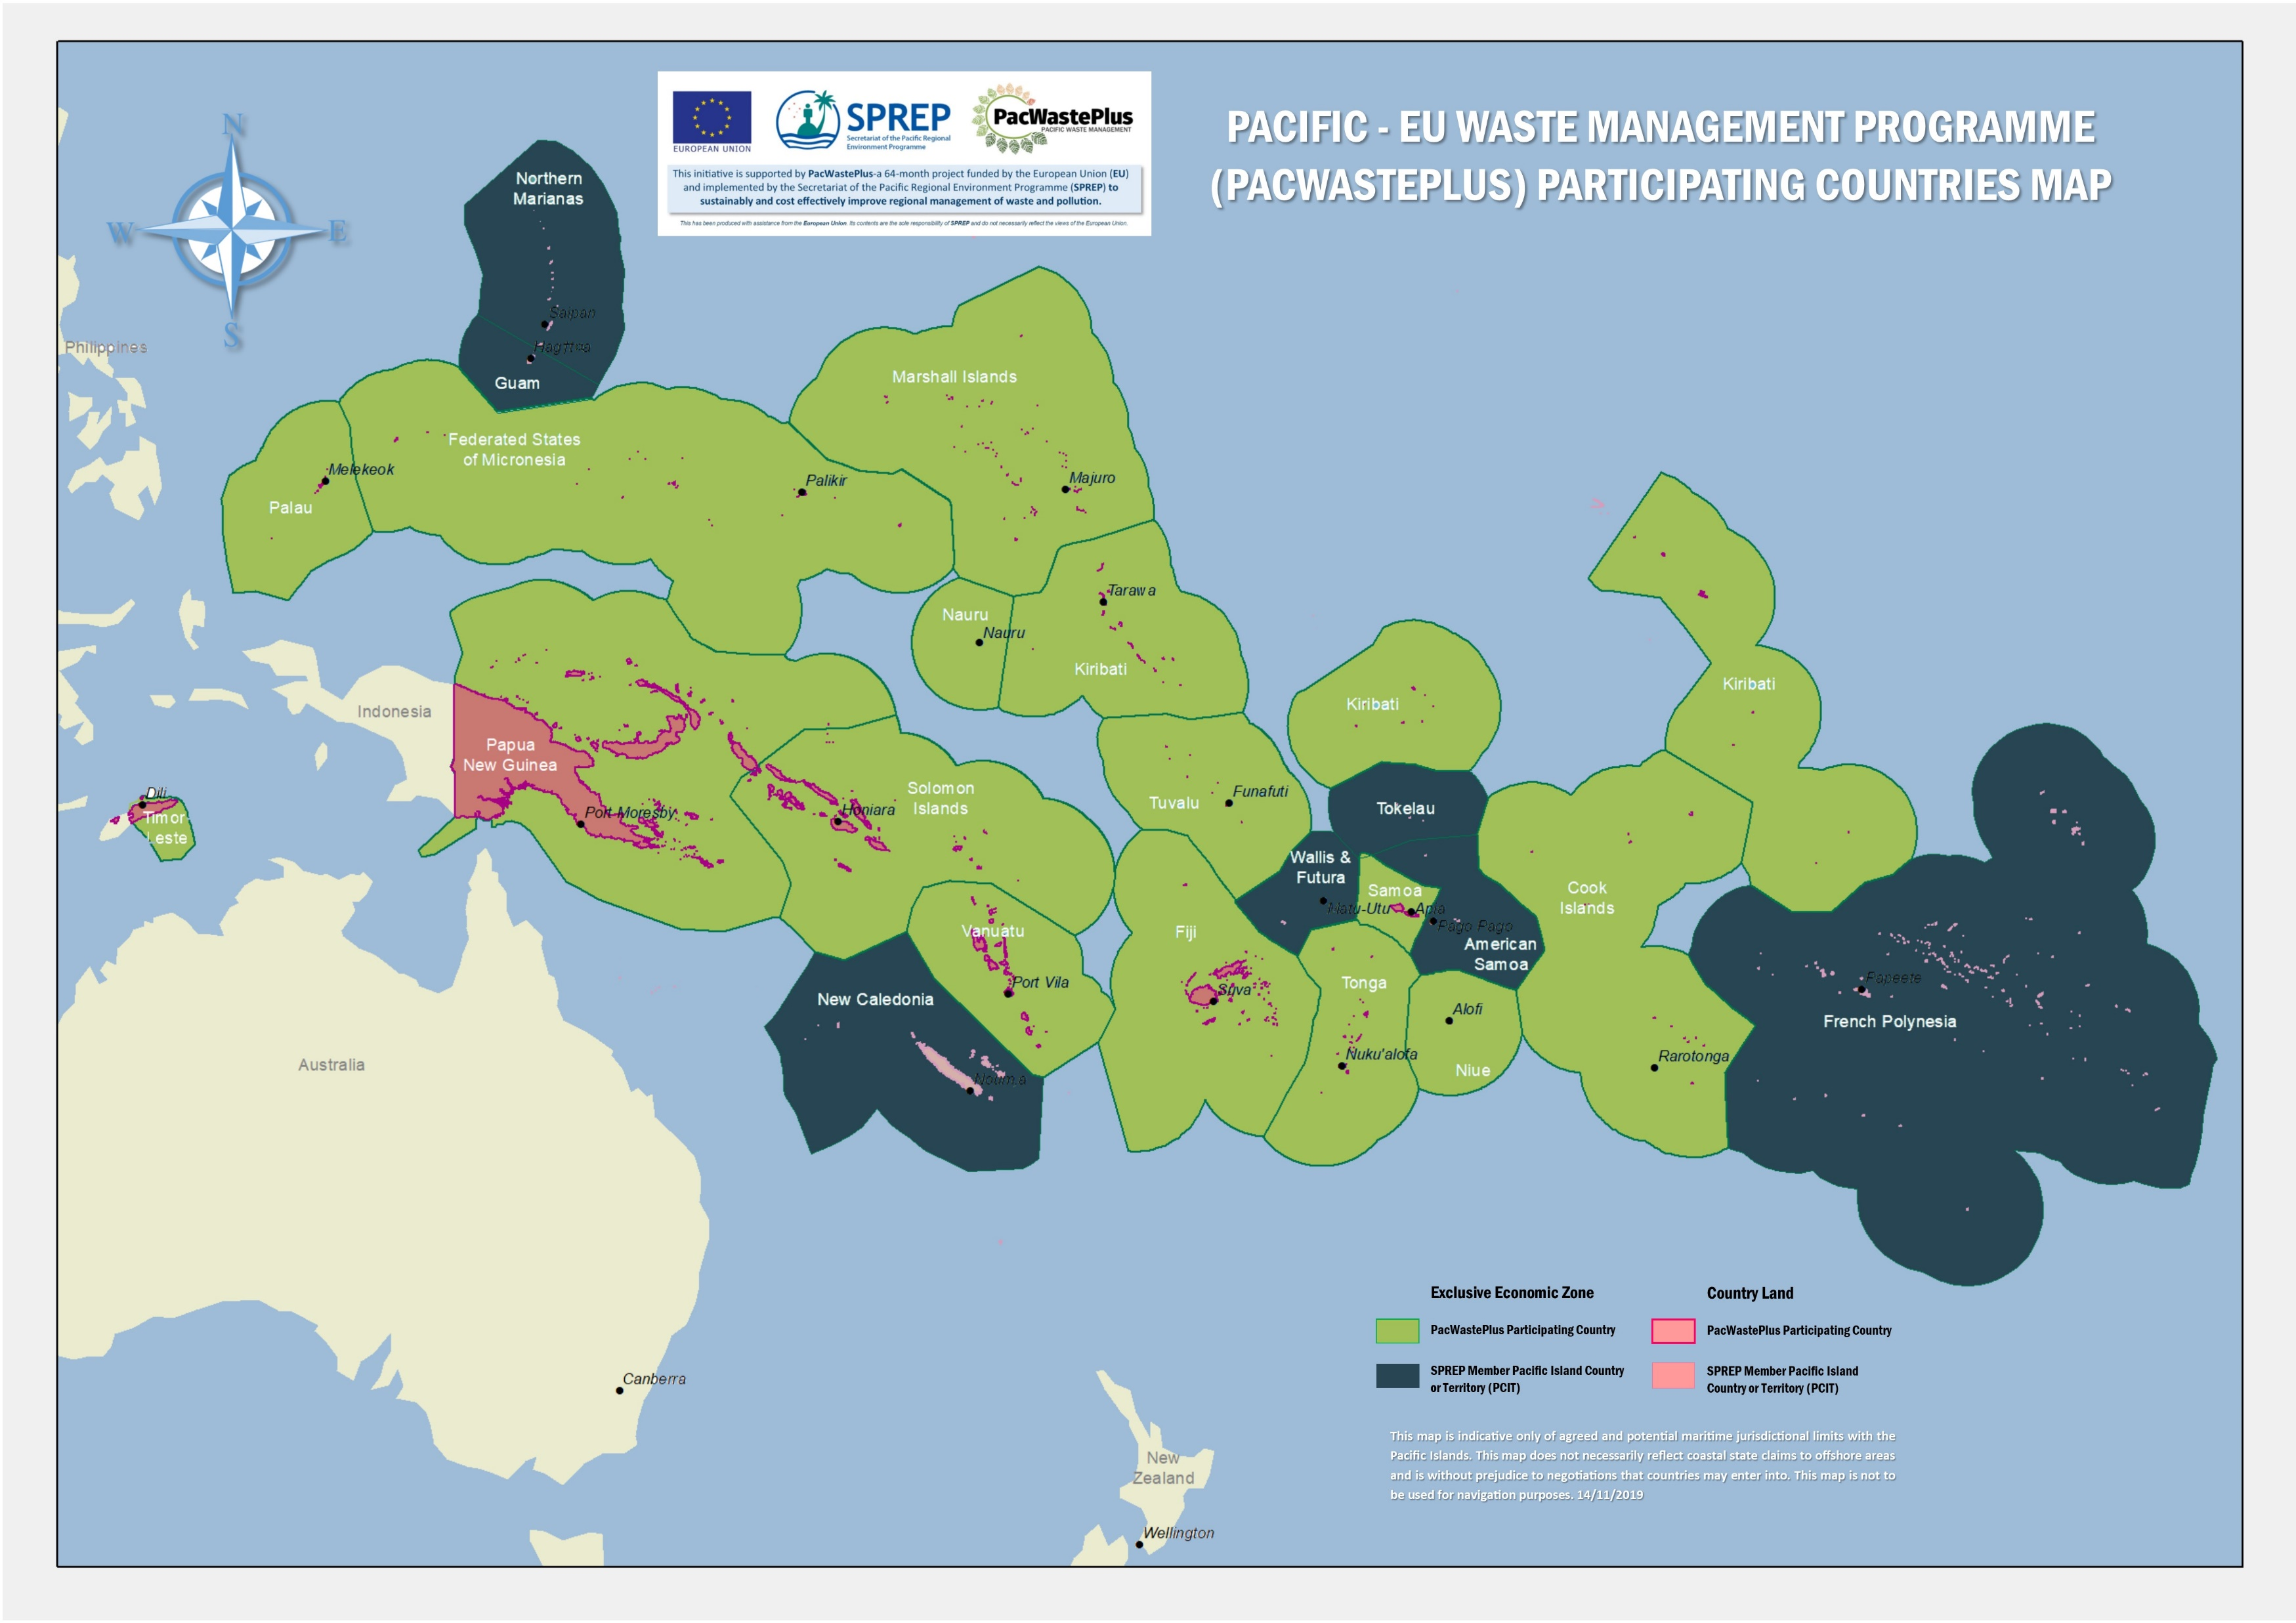


Country Meetings & Visits
Notes:
Over the past 12 months missions have been carried out to the following countries:
Fiji (country meeting, PIFS EDF 11 Steering Committee, EU meetings)
Timor-Leste (Project establishment mission and review of PacWaste actions)
Vanuatu (Country meeting, Disaster Waste Workshops, Project development)
Samoa (Country meetings, E-waste Forum, various SPREP events)
Solomon Islands (CLiP project, country meeting)
Papua New Guinea (National Policy / Strategy development)
Australia (Mission with Solomon Islands and Vanuatu staff)
Guam (meetings with Palau, FSM & RMI staff)

Slide 30
Summary
Inception Phase completed
PMU established
Country project identification process established
Regional baseline data gathering underway
Country project missions underway
Two capacity building workshops for developing National Education and Awareness Plans (NEAPs) conducted (May 2019 and November 2019).

Slide 31

All

Slide 32

KRA 4.3 Update – Training & Capacity
Dr Isoa Korovulavula (USP)

Slide 33

KRA 3.10 Update – Waste Water
David Hebblethwaite (SPC)

Slide 34
All

Slide 35

Lunchtime

Slide 36
Session 3
Reflection & Opportunities
Session Facilitator: PWP Team

Slide 37
Recap on Country presentations
Lance Richman (SPREP)
Hilary Boyes (SPREP)
Sainimili Bulai (SPREP)

Slide 38

Problem Wastes

Slide 39
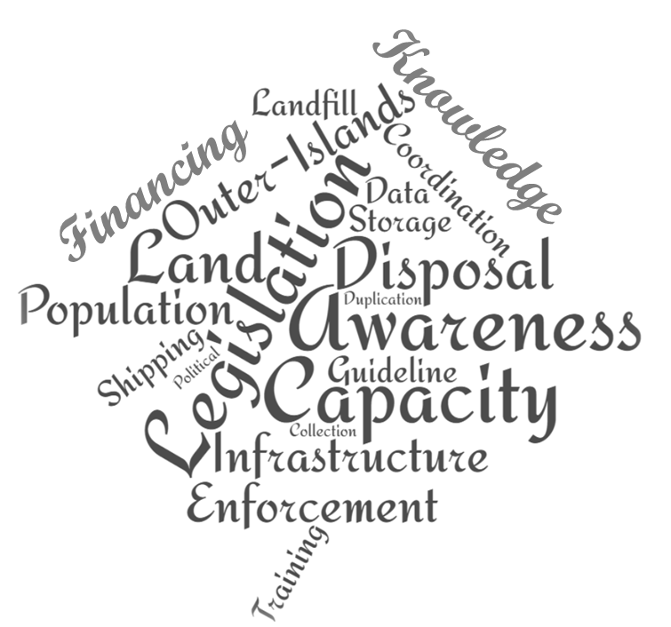
Challenges

Slide 40

Solutions

Slide 41





Country Meetings
& Visits
TBD
TBD

Slide 42


Country Meetings
& Visits
TBD
TBD

Slide 43
All

Slide 44

Afternoon Tea

Slide 45
Session 4
Year 2 Programme
Session Facilitator: Bradley Nolan (SPREP)

Slide 46
Year 2 Project Activity
Bradley Nolan (SPREP)
Lance Richman (SPREP)
Sainimili Bulai (SPREP)
Hilary Boyes (SPREP)
Nitish Narayan (SPREP)
Sela Simamao (SPREP)

Slide 47

KRA 0 - Governance

Slide 48
Governance
European Union
Project Steering Committee
Regular contact
Approve country projects
Participate in actions and support as required
National Committees
PacWastePlus
Project Management Unit
Research Advisory Group
Technical Advisory Panels
(Solid Waste, Hazardous Waste, WOW)
Project Working Party

Slide 49
Governance
European Union
Project Steering Committee
Annual Meeting – recommending Meeting to be held in March or April 2021
Bi-monthly newsletter
Active engagement with project activities
Regular contact with Focal Point and project participants
National Committees
PacWastePlus
Project Management Unit
Research Advisory Group
Technical Advisory Panels
(Solid Waste, Hazardous Waste, WOW)
Project Working Party

Slide 50
Governance
European Union
Project Steering Committee
Involved in project review and supporting comments.
Will review major report outputs as required
Provide advice on possible research requirements
No formal meeting planned
National Committees
PacWastePlus
Project Management Unit
Research Advisory Group
Technical Advisory Panels
(Solid Waste, Hazardous Waste, WOW)
Project Working Party

Slide 51
Governance
European Union
Project Steering Committee
Quarterly meetings to review programme activity and provide guidance on actions
Remote meetings planned for 2020
National Committees
PacWastePlus
Project Management Unit
Research Advisory Group
Technical Advisory Panels
(Solid Waste, Hazardous Waste, WOW)
Project Working Party

Slide 52
Governance
European Union
Project Steering Committee
To be created
Involved in project review and supporting comments.
Will review major report outputs
No formal meetings planned
National Committees
PacWastePlus
Project Management Unit
Research Advisory Group
Technical Advisory Panels
(Solid Waste, Hazardous Waste, WOW)
Project Working Party

Slide 53
Governance
European Union
Project Steering Committee
Responsibility of each country in management of their in-country project and broader PWP engagement.
PWP staff can be involved if requested.
National Committees
PacWastePlus
Project Management Unit
Research Advisory Group
Technical Advisory Panels
(Solid Waste, Hazardous Waste, WOW)
Project Working Party

Slide 54
Communications & Visibility
Engage with countries and partners on creating more programme visibility-PWP Newsletter (The Connection)
Social media presence
Development of PWP collaterals dedicated website
Videos
Develop country profiles
Identify potential social marketing campaigns
Implementation of activities aligned to the Communications and Visibility plan
Support implementation of Country National Education & Awareness Plans
Notes:
Regional Comms
NEAPs

Slide 55
Procurement
In the Pipeline
Portal Set Up for Timor-Leste
Development of Decision Support Tool
Literature Review on impacts of Lined & Unlined landfills.
Literature Review and Assessment of small-scale waste technology options
Technical Assistance (Support development of Samoa’s Waste Mgmt Regulation – Waste Deposit)
Stock-take of Waste Mgmt Vocational and Tertiary Courses in the Pacific (Stage 1 of Engagement with USP)

Slide 56
Year 2
Project Budget
2/7/19 – 1/7/2020
Activity | Y2 Budget
KRA 0 – PWP Project Management & Governance | 1,264,266
KRA 1 – Data & Information | 715,000
KRA 2 – Policies & Regulation | 299,480
KRA 3 – Infrastructure & Partnerships | 453,100
KRA 4 – Human Capacity | 245,000
Administration | 208,379
TOTAL | 3,185,225 USD
Notes:
KRA 0 Budget includes : Staff , Office , PMU Travel Costs ; Steering Committee Meeting, Working Group Meeting, Technical Advisory Panels.
KRA 1 Budget : Waste Audits, Human Rights Assessment, Environmental Portal set up for Timor-Leste, Data Specialist to consolidate audit findings, deliver 2nd NEAP workshop, related workshop costs, PWP website, collateral discussed from NEAPs, RAG Meeting costs
KRA 2 Budget : Regional Legislative review, assistance with national legislation for 1 country (Samoa), Travel & Workshop costs for Advocacy
KRA 3 Budget : TA, 3 Research based activities, SPC partnership, Completion of PacWaste activities
KRA 4 Budget : Needs Assessment, Capacity Building Activities, Stage 1 Vocational Engagement, Capacity building exchanges.

Slide 57

KRA 1 – Data & Education

Slide 58
Baseline Data Collection
Waste Audits
Legislative Assessment
Capacity Needs Analysis
Learning Stocktake
Human Rights & Social Inclusion
Regional Data Strategy

Slide 59
Waste Audit preparation
PWP PMU
Appointment of Suitable Consultant
Overall Management
Countries
Waste Audit Approach co-designing
Information on existing public audit information
Nomination of personnel/key government agencies
Notes:
In preparation for the Waste Audits managed by PWP, we seek your assistance in the following areas:
Co -Designing (with the consultant) a Waste Audit approach suitable for your country;
Country decision on priority issues that you would like to address
Information of any existing public audit information or processes that can be linked to the institutional readiness assessment component of the audit process
Nomination of personnel/key government agencies responsible for environment management, waste management, import & export control data and internal audit.

Slide 60

Waste Audits
Collation and Review of existing data on waste and pollution
Establish comprehensive data that will assist in national policy intervention
Build in country capacity
provides a data collection framework
Household
Per capita Waste generation
Per household waste generation
Landfill
Materials not usually found in household bins
Commercial
Waste Generation
Waste Composition
Customs
Composition of waste disposal
Weights & volume of waste generated by materials
Comparative Sampling of different facilities
Import & Export Data

Slide 61

Environmental Data Portal
Establish
Set Up Timor-Leste Environmental Portal
Identical to national portals set up under the Inform Project
Training
Refresher Training on Environmental Portal Use
Refresher training opportunities for government officials on the use of the portal and expanding current proficient users from in country focal Inform project units to include Waste Management focal points.
Use
Data Input
Government Officials to utilise the environmental data portal platform for uploading, storing of waste data.

Slide 62

Human Rights Situational Analysis
Human Rights = considering gender, age, less abled (disability), cultural sensitivity, vulnerable and marginalized groups
PWP seeks to:
  Understand how human rights are currently considered
  Provide guidance on how we can better consider human rights in project development and implementation
Notes:
We are seeking to gain a comprehensive understanding of how issues of human rights, equality and cultural awareness (including traditional knowledge) are currently being considered and incorporated into waste and environmental programme management.
For example – Are there ways waste projects could negatively affect a portion of the population more than others – e.g., does a plastics ban affect woman more than men?
Is there a way we can ensure waste projects provide equal opportunities for marginal groups – e.g., are there students at special schools who could be part of training to dismantle e waste?
When we are engaging with a community, are we speaking with all interested parties – not excluding those who have a different religion, nationality, gender, race?

Slide 63
Human Rights Situational
How will the analysis be conducted?
Online survey:
Involving ministries, government agencies, industry groups and community leaders
Timing: Within next few months
Outcome: provide feedback on opportunities for Human Rights we can all address (or capitalize on) when designing in-country projects
We need your help to nominate and introduce the project to the various country contacts to ensure smooth delivery of the project.
Notes:
we will liaise with you regarding members of your communities who should complete the survey
The PacWastePlus programme seeks to gain a comprehensive understanding of how issues of human rights, equality and cultural awareness (including traditional knowledge) are currently being considered and incorporated into waste and environmental programme management.
The outcome of the analysis is then to provide guidance on how human rights issues can be strengthened through the activities implemented by the PacWaste Plus Programme.
Human Rights (gender, age, disability, cultural sensitivity) issues will focus on the different members of the community including men, women, youth, the less abled (disabled), vulnerable and marginalized and cultural groups.

Slide 64

KRA 2 – Legislation & Policy

Slide 65


Legislative Review & Assessment
What do we want to know?
Where does that take us?

Slide 66
Legislative Review & Assessment
Undertake a comprehensive assessment
How each participating country regulates the eight target waste streams
Options for organising the legal and institutional infrastructure governing wastes

Slide 67
Legislative Review & Assessment
What do we get out of all this?
Defined Key Actions - supported by an appropriate legislative structure
Options Papers for each country
Provided by May of 2020, four months from now!

Slide 68
Legislative Review & Assessment
In-country consultations University of Melbourne (UoM)
We need your help!
  Provide details of appropriate staff to engage
  To allow UoM to meet with appropriate officers
Your active engagement and support for this work is appreciated.

Slide 69
Country Specific Assistance
Each participating country can access up-to US$30,000 technical assistance to address legislative / policy / strategy work necessary to progress waste management and the objectives of PacWastePlus.
All other countries have the ability (and are encouraged) to think about the support they may need to progress activity and support in-country projects.
Notes:
Samoa has requested assistance with the drafting of guidance notes for the development of their Waste Levy (Sustainable Financing mechanism)

Slide 70
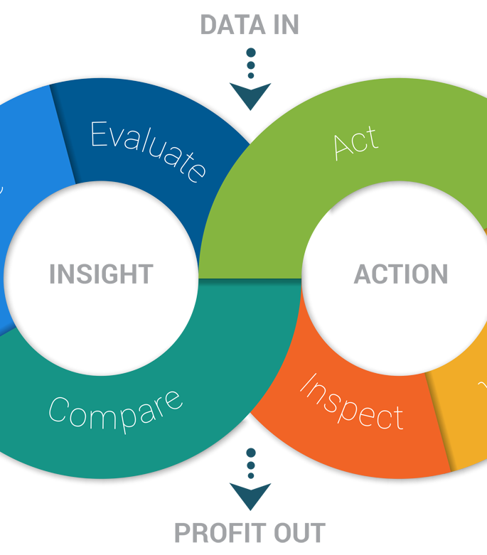
KRA 3 – On-Ground Action

Slide 71
Complete PacWaste Actions
Healthcare Training in Timor-Leste (Contract being signed)
Incinerator repairs
  Norsup (Vanuatu) – contract negotiation
  Gizo (Solomon Islands) – discussions with UNICEF for support
  Tarawa (Kiribati) – contract negotiation
  Palau – contract negotiation
  Honiara (Solomon Islands) – contract negotiation
  Helena Goldie (Solomon Islands) – contract negotiation
  Tonga – contract negotiation
Asbestos clean-up in Niue (mission trip in February 2020 to address)

Slide 72
In Country Projects (US$300,000)
Priority Waste Stream
How is the project resolving the issue?
Project Proposal for endorsement
What is the appropriate project intervention?
What is the core issue
to be addressed?
Preparatory Works:
  Consultation with relevant stakeholders
  Alignment to National Priority
  State of Readiness
  Project compliments current ongoing initiative
  Sustainability of the project

Slide 73

KRA 4 – Human Capacity

Slide 74
Capacity Needs Assessment
Establish a minimum standard for governance, management and enforcement for each of the priority waste streams
Assess the current activities and capacity against these standards
Report on needs and immediate opportunities for project activity
Tenders under assessment at present

Slide 75
Capacity Building
Complete
Complete the Capacity Needs Assessment
Complete
Complete Stage 1 of Training Stocktake
Undertake
Undertake a gap analysis to determine opportunities and needs
Develop
Develop a training register (in partnership with other Regional Programmes) and commence delivery
Work
Work with USP to commence development of vocational and tertiary courses to ‘fill gaps’

Slide 76
Regional vocation & tertiary waste management programme
1 – Stock take
Identify available tertiary & vocational courses.
2 – Gap Analysis
Determine need & priority topics for waste management courses.
3 – Course Development
Develop training programme(s) based on outcomes of assessments.

Slide 77

Capacity Building opportunities
Capacity building provided through consultant visits and PWP missions
Identification of immediate training opportunities that can be delivered
Support for country exchanges
Support for the implementation of National Education & Awareness Plans
Notes:
Findings from upcoming national capacity needs assessment will include trainings on governance, enforcement and compliance
Tailored delivery of practical training programmes in solid waste and disaster waste management, prioritised based on need and budget limitations
short-term contracts will procure technical expertise to deliver specialised training using a variety of delivery modalities (short-term training, school education and Pacific-Pacific Twinning). Exchanges between countries e.g – Samoa priority E-waste/Cook islands priority E-Waste – countries can utilize this to for in country experience sharing
need for skill development and capacity building, particularly around influencing and communication skills, as well as structuring and developing NEAPs.

Slide 78
Feb – June 2020 Mission Schedule
Date | Country of Visit | PWP Officers Visiting
February 1 - 8 | Vanuatu | Bradley Nolan/Hilary Boyes/Michael Taiki
February 24 - 28 | Niue | Bradley Nolan/Sela Simamao/Vira Atalifo/Lance Richman
March 2-6 | Nauru | Bradley Nolan/Lance Richman
March 1-6 | Papua New Guinea | Hilary Boyes/Michael Taiki
March 14 -20 | Republic of Marshall Island | Bradley Nolan/Lance Richman
March 21 – Apr 5 | Kiribati | Bradley Nolan/Lance Richman
March 21 -28 | Solomon Islands | Sainimili Bulai /Michael Taiki
March 21 – 28 | Tuvalu | Hilary Boyes/Nitish Narayan/Vira Atalifo
April 1 -9 | Cook Islands | Hilary Boyes/Michael Taiki
April 20 -24 | Fiji | Sainimili Bulai/ Lance Richman
April 27 – May 1 | Timor-Leste | Bradley Nolan/Lance Richman
April 25 – May 8 | Federated State of Micronesia | Sainimili Bulai/ Bradley Nolan
May 2 – 8 | Tonga | TBC based on confirmed dates
May 9 – 15 | Palau | Bradley Nolan/Hilary Boyes

Slide 79
2020 workplan at a Glance
Governance & Events
Working Party
Working Party
TAP & RAG review Projects
Working Party
Working Party
Steering Committee
NC Conference
PIFS Leaders
SPREP Meeting
CPRT
PIFS EDF 11
Q Report
Q Report
Annual Report
Q Report
Q Report
Jan | Feb | Mar | Apr | May | Jun | Jul | Aug | Sep | Oct | Nov | Dec
Support
In-country Project Design
In-country Project Delivery
Initial Phase
Workshop
In-country Design
Pre-concept
Complete & submit
EU Assessment
Project commencement, procurement of initial services, establish M&E plans & reporting systems
Confirmed Mission Trips to assist project design
Missions to be determined based on projects
Procurement
Legislative Review Consultancy
Collate and distribute outcomes
Develop and commence delivery of Project(s) procurement Plans
Waste Audits
Human Rights & Social Inclusion
Capacity Needs Assessment
Training Stocktake
PacWaste Incinerator Repairs
PacWaste Asbestos Niue
Development of Regional Projects

Slide 80
Steering Committee Endorsements
Year 2 Budget
  Endorse Budget
Year 2 Work plan
  Endorse work activity
PWP Mission Assistance
  Endorse mission shedule
  Agree to assist with PWP mission clearance
  Agree to prepare for PWP mission with project pre-development
Consultant Mission Assistance (clearance, early engagement & in country support)
  Legislative Assessment
  Waste Audits (including identification on in-country audit teams)
  Human Rights Situational Analysis
  Capacity Needs Analysis
  Training Stocktake

Slide 81
Steering Committee Endorsements
Agree to Sign an MoU or LoA confirming country projects and activity to be implemented.
Agree to use the approved PWP Branding and Logo Guidelines
Agree to complete and build NEAP actions into In-country delivery plans
Agree to programme identified Monitoring & Evaluation activities

Slide 82
STEERing committee General Business
All

Slide 83
Overview of In-country Project Application
Bradley Nolan (SPREP)

Slide 84
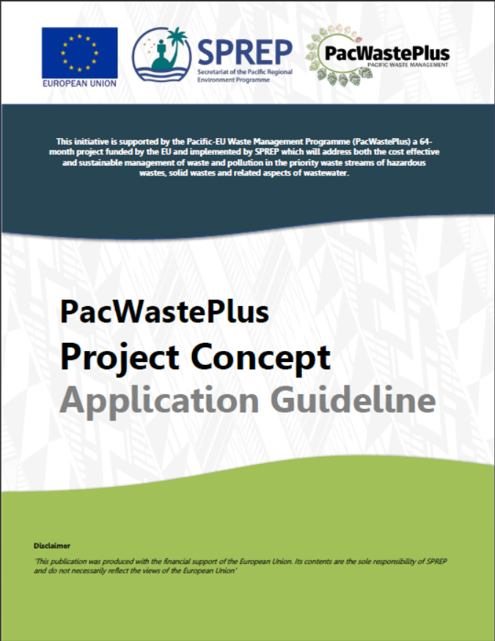
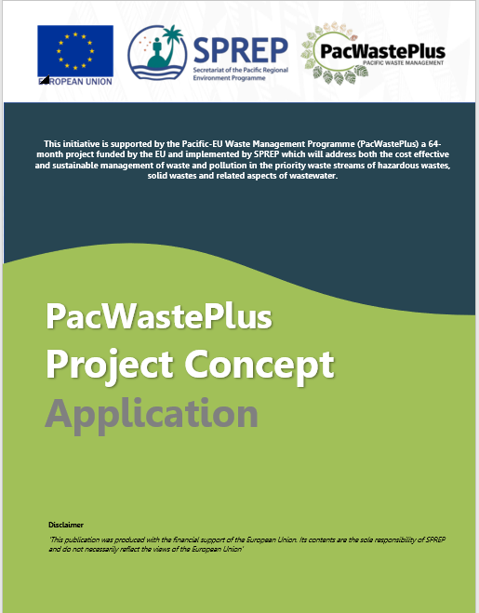
Project Development
To assist countries to develop projects that will receive approval by the EU, a project application process has been developed. The design essentially assist the thought process on how to design and communicate the project activities.

Slide 85
Project Applications
PWP will invest $300,000 USD in projects that address at least one of the programme’s KRAs.
Country may submit multiple projects provided that the total funding for these projects are within the allocated funding of USD $300,000.
Countries are requested to submit project proposals to be approved by the EU for the implementations of these projects by June 2020.
To assist member countries, PWP PMU has developed and Application Guideline.

Slide 86
Eligible In-Country Projects
Assist countries in solid waste management through the implementation of prevention and reduction programmes that promote schemes to minimise the waste generated from imported products and nearly expiring perishable products.
Assist countries in disaster waste management through preparedness, response, recovery and reconstruction to assist countries in dealing with the generation of large volumes of waste.

Slide 87
Eligible In-Country Projects
Assist countries in implementing legislation that enables best practice in waste management.
Provide support to manage waste and pollution sustainably through the implementation of preferred sustainable financing options.
Implement feasible resource recovery initiatives with private sector involvement.
Support countries to continue to roll out existing programmes to dispose of legacy and hazardous wastes and remediate contaminated sites (asbestos, healthcare waste and E-waste)

Slide 88
Eligible In-Country Projects
Improve and/or construct appropriate small-scale waste management infrastructure to facilitate good practice in waste management
Develop and implement agreements and incentives for private sector participation in waste management
Support atoll nations export some wastes to (regional) recycling hubs
Implement programmes to assist PACPs to build national and local capacities in designing bankable projects

Slide 89
Assessment of In-Country Projects
The European Union has established assessment criteria to assist with determining appropriate PPW investment in projects.
The intent of tomorrow’s workshops is to work through the project development process and discuss the eligibility and assessment criteria.

Slide 90

The Project Application should:
Prove the project will provide significant waste management results for the country, and has considered the who, what, when, why and how to ensure success and sustainability.

Slide 91
Project Development Timeline
Steering Committee Meeting
Talanoa sessions
Bilateral discussions
In country work
12 Feb – 30 April
In-country Development
Submit Pre-concept
1 – 10 May
PWP Missions Continue
10-12 February
PWP Missions & remote Support
Review by TAPs and RAG
Comments provided
Proposal Completion
11 May – 11 June
Update proposals with feedback
Submit 12 June
Access TA support if needed
PWP Assessment

Slide 92


