Slide 1
PacWastePlus Programme
Steering Committee Meeting – Day 3

Slide 2
Session 1
Welcome
Session Facilitator: Bradley Nolan (SPREP)

Slide 3
Bilateral Agenda
Time | Session | Bilaterals (15 mins each)
8:30 – 10:00 | Session 1: Application Guideline / Bilaterals Overview of process | 9:45 – Cook Islands 10:30 – Nauru 10:45 – Palau 11:00 – Papua New Guinea 11:15 – Republic of Marshall Islands 11:30 – Tuvalu 11:45 – Solomon Islands 12:00 – Timor-Leste 12:15 - Tonga
10:00 – 10:30 | Morning tea
10:30 – 12:30 | Session 2: Country Examples / Bilaterals Facilitated Discussion
12:30 – 13:30 | Lunch
13:30 – 15:00 | Session 3: Talanoa Small group discussions
15:00 – 15:30 | Afternoon tea
15:30 – 17:00 | Session 3: Talanoa (continued) Small group discussions
17:00 – 17.15 | Session 4: Wrap Up and Forward Wrap Up and Way Forward
Notes:
Hilary

Slide 4

Prayer

Slide 5
Session 1
Application Guideline
Session Facilitators: PWP Technical Team

Slide 6
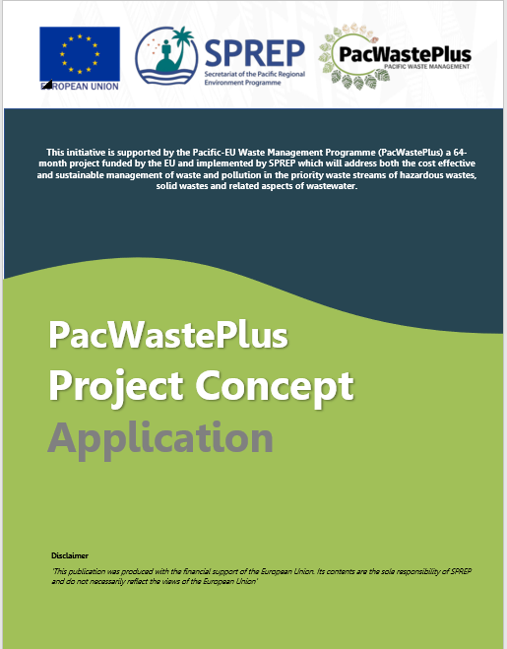

In Country Project
Notes:
Hilary?
TEAM – hand out application guideline
Yesterday we introduced the Project Concept Application
We went through the
- Eligible In-Country Projects
- Eligibility Criteria
- Assessment Considerations
- Project Development Timeline
*Refer to application guideline
This guideline will assist you as we design, develop and communicate projects – to receive approval by the EU
In this session we will go through these guidelines together to work through the process, clarify unfamiliar concepts and demonstrate the details of what is expected, and answer questions as they crop up
This session is for you to start thinking about your project and talk it through with the group to start thinking about the information you have and what is needed
The more feedback we have here the more valuable the session will be…

Slide 7
Priority Waste Areas
Recyclables
E-Waste
Asbestos
Bulky Waste
Disaster Waste
Health Care Waste
Organic
Waste Water
Notes:
Hilary
Projects to fit with 8 priority areas
Ask group if anyone has any project(s) brewing and write them up on whiteboard
so we can use them as examples as we are speaking for the next few slides
get at least one example for each waste stream even if not one a country is focusing on

Slide 8

Assessment Criteria
Needs Based Prioritisation
Complementarity
Cost Efficiency
Sustainability
Regional Applicability
Reduced Environmental Harm
Adaptation
Gender-sensitive and rights based approach
Key Result Areas
Notes:
Hilary and Sai?
We spoke briefly yesterday about the Assessment Criteria and discussed that Projects will be assessed against these eight factors
Lets start today by going through those criteria in more detail to describe why they are important and how your projects can ensure they are all considered
Go through each term – define the term and then ask the room how it applies to a project design. Have good examples up our sleeves
I.e., for sustainability - I would say something like “we are all familiar with the word “sustainability” - it can be an encompassing term for lots of aspects – financial sustainability, environmental sustainability etc. For PWP we are using the term as a way to ensure projects will be self sustaining at the end of a project, so it’s not relying on any part of the project money or support and will continue on it’s own long term into the future.
So when we are thinking about the design of the project we keep in mind what is needed to ensure this happens – is it a sustainable financing method, or an agreement/contract with users of a new facility, or is part of the project a market assessment to ensure there are buyers for the end product“
I would then ask – can anyone give me an example of a project would be sustainable or NOT sustainable?
(I would have one up my sleeve just in case)
Needs Based Prioratisation
What’s the need?
What is the supporting data?
Complementarity
Complementarity of initiatives across PacWaste Plus, as well as those being supported by other donors, so that the work can be scaled-up
Cost Efficiency
Ensure the most cost efficient investment of EDF funds that result in positive social and environmental outcomes for the region
Sustainability
The investment will provide ongoing outcomes for countries, rather than a single point in time resolution, and/or provide sustainable funding to continue the intervention into the future.
Regional Applicability
Projects that have the ability to be applied in other countries (based on outcomes and learnings) will be prioritised.
Reduced Environmental Harm
Projects provide positive environmental outcomes
Adaptation
Projects that assist in adapting to new systems and adapting to a changing climate will be prioritised.
Gender Sensitive & rights-based approach
Projects adopt a gender-sensitive and rights-based approach in design and delivery
KRAs

Slide 9
In Country Project
Notes:
Sai???
Go through application slowly
*everyone turn to page 12
touch on primary KRA
secondary KRA
run though an example from whiteboard
Now to page 14
describe “what is an intervention”
run though all 6
use examples
Go to page 17
define core issue
use examples for ways projects can address core issue
Page 18
explain what we mean by how project is relevant to PWP
what are project objectives
Page 18/19 describe the 5 outcomes and how projects can deliver on them
Page 20 describe what we mean by Gender sensitivity and human rights
ETC
ETC
For all relevant parts of application
Other important points to discuss:
Not limited to form
Attachments welcomed and in some case expected

Slide 10

Morning Tea

Slide 11

Facilitated Discussion
Samoa Project Example
Afele (Samoa)
Notes:
Afele/Lance
Objectives
Identify eligible projects
Understand PWP Assessment criteria & Approval process
Introduce Afele

Slide 12

Facilitated Discussion
Vanuatu Project Example
Michael (Vanuatu)
Notes:
Michael/Lance

Slide 13



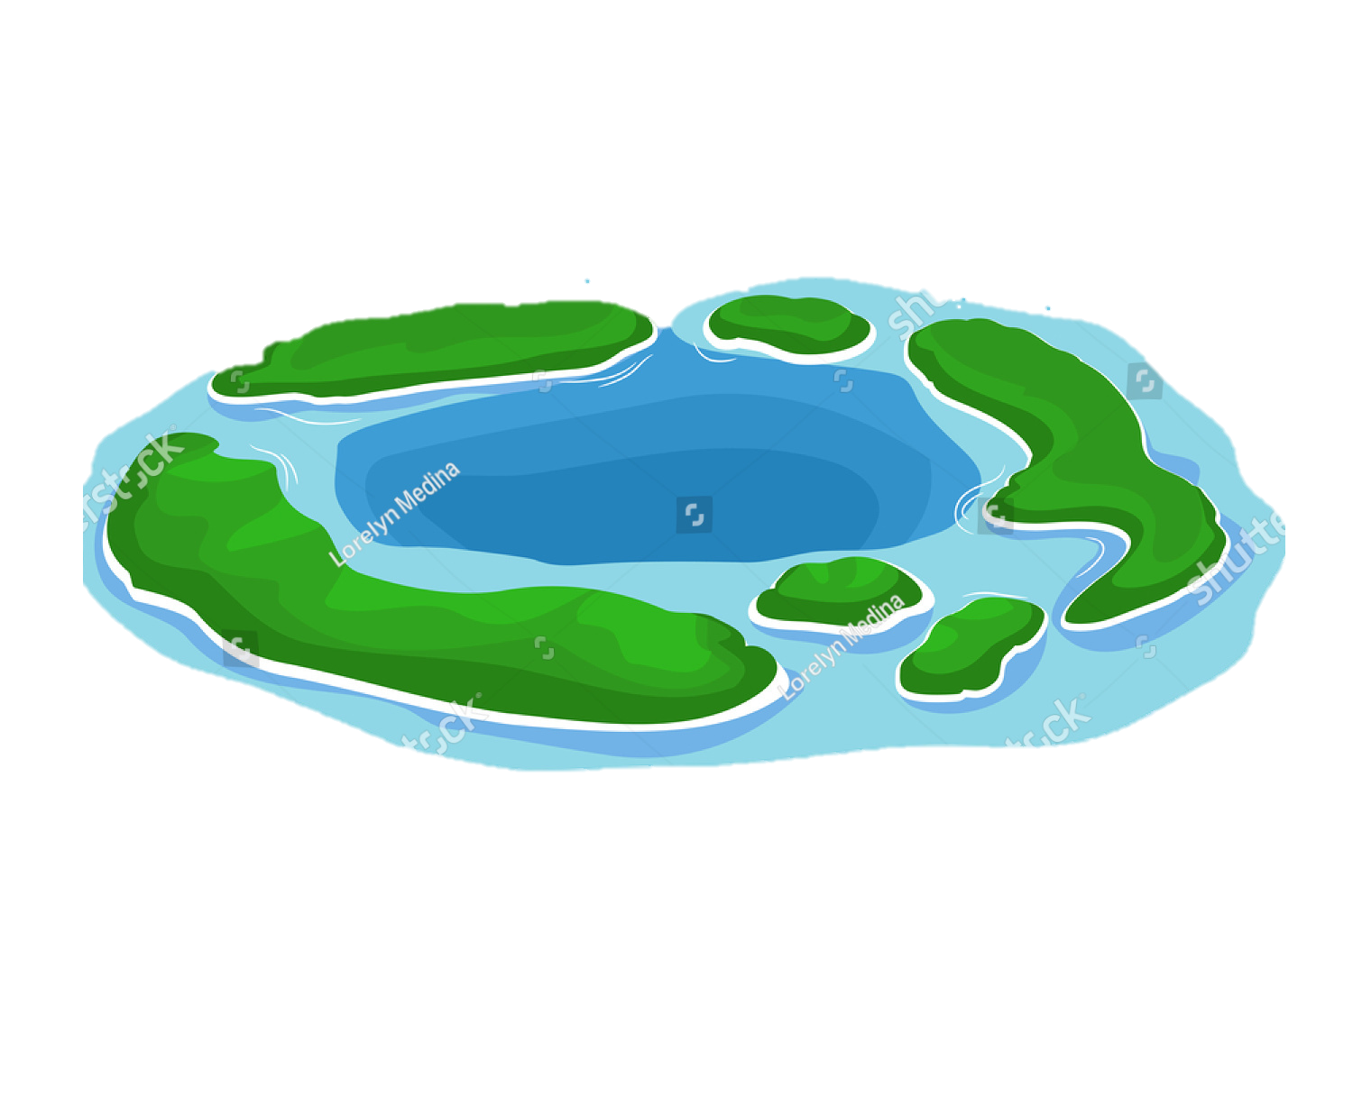
Capital:
Three outer islands:
Notes:
Hilary/Lance
Run through details of example country
Refer Nitish handout
Lance/Hilary facilitate discussion
Goal = Decide the best Project proposal that qualify for funding under PacWastePlus and addresses all of the project assessment criteria.
Facilitated questions:
Waste priority should they focus on
What is the core issue to be solved
What program can be put in place
What would the objectives of that program be
What questions need to be asked, who would be involved and what they would need to do/commit to
What data would help the design of the program
How would it be sustainable
Would a legal framework be needed
What would we need to consider regarding gender and human rights?
How would it be monitored and evaluated

Slide 14
Can’s and Can’t’s
Can Be Funded
Cannot Be Funded
Equipment and minor site works
Consultants and specialists
Resources
Legislation
Venue and catering
Salaries
Administrative expenses
Land purchase
Retrospective funding
Grants
Project management fees
Work on project concept applications
Notes:
Hilary and Sai (one side each?)
Important to touch on what can be funded through this project and what can’t
Team - Refer to Page 4 and 5 to get exact definitions when we are talking about the terms
USE EXAMPLES
Also go through – In kind support and co funding and partnership projects - what they all mean for this project

Slide 15

Lunchtime

Slide 16
Session 3
Talanoa Sessions & Bilateral
Session Facilitator: PWP Technical Team
Notes:
Lance to introduce??
Discussion will focus on the following:
Key Waste Stream focus
Possible projects under each waste streams e.g. compost facility, incinerator, portable chipper, policies etc.
Other additional activities

Slide 17
Talanoa Session 1 (1:30 – 2:15) – 45 mins
Hazardous Waste
Timor-Leste
Cook Islands
Solid Waste
Tonga
Palau
Resource Recovery
Nauru
Tuvalu
Communications & Capacity
Papua New Guinea
Solomon Islands
Marshall Islands
Bilateral
Cook Islands (1:30)
Nauru (1:45)
Samoa (2:00)

Slide 18
Talanoa Session 2 (2:15 – 3:00) – 45 mins
Hazardous Waste
Solomon Islands
Solid Waste
Timor-Leste
Cook Islands
Resource Recovery
Tonga
Palau
Communications & Capacity
Marshall Islands
Nauru
Tuvalu
Papua New Guinea
Bilateral
Palau (2:15)
Papua New Guinea (2:30)
Marshall Islands (2:45)

Slide 19

Afternoon Tea

Slide 20
Session 3
Talanoa Sessions & Bilateral
Session Facilitator: PWP Technical Team
Notes:
Discussion will focus on the following:
Key Waste Stream focus
Possible projects under each waste streams e.g. compost facility, incinerator, portable chipper, policies etc.
Other additional activities

Slide 21
Talanoa Session 3 (3:30 – 4:15) – 45 mins
Hazardous Waste
Nauru
Tuvalu
Solid Waste
Solomon Islands
Resource Recovery
Timor-Leste
Communications & Capacity
Tonga
Palau
Marshall Islands
Cook Islands
Papua New Guinea
Bilateral
Tuvalu (3:30)
Solomon Islands (3:45)
Timor-Leste (4:00)

Slide 22
Talanoa Session 4 (4:15 – 5:00) – 45 mins
Hazardous Waste
Tonga
Palau
Solid Waste
Nauru
Tuvalu
Resource Recovery
Communications & Capacity
Timor-Leste
Cook Islands
Solomon Islands
Marshall Islands
Marshall Islands
Bilateral
Tonga (4:15)

Slide 23
Session 4
Wrap Up and Way Forward
Session Facilitator: Bradley Nolan (SPREP)

Slide 24
Prayer

Slide 25


