Slide 1




PacWaste Plus Steering Committee Meeting
Country Presentation
Tuvalu
Walter P. Kaua
DEPARTMENT OF WASTE MANAGEMENT
2020

Slide 2
PacWaste Plus Steering Committee Meeting
Presentation Outline
Tuvalu Waste Priorities
Waste Management in Tuvalu
Challenges and Limitation
Clarification from PWP PMU
Way forward
2020

Slide 3
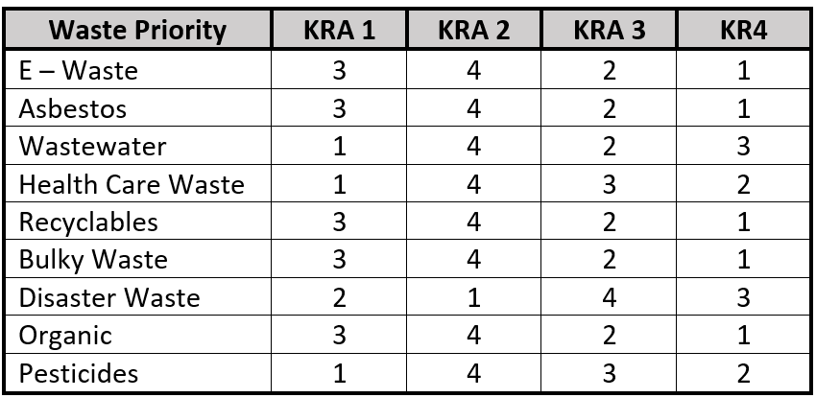
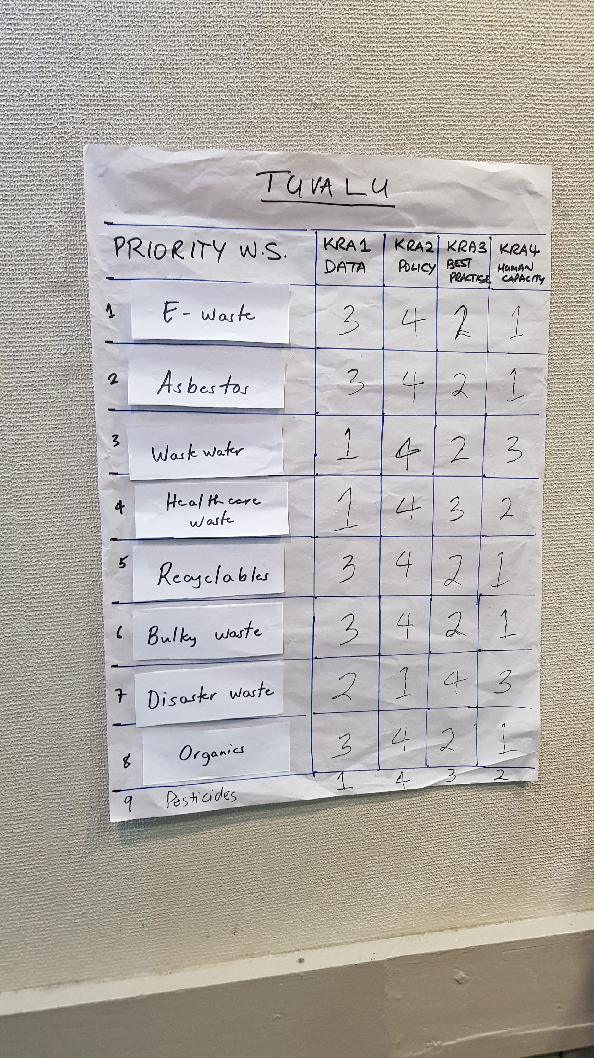
PacWaste Plus Steering Committee Meeting
Tuvalu Waste Priorities
2020

Slide 4
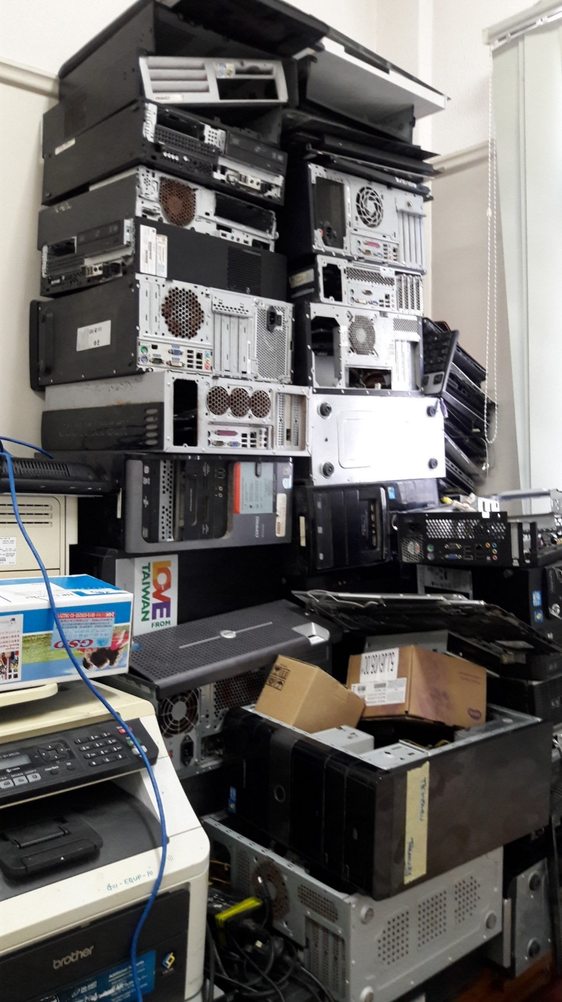
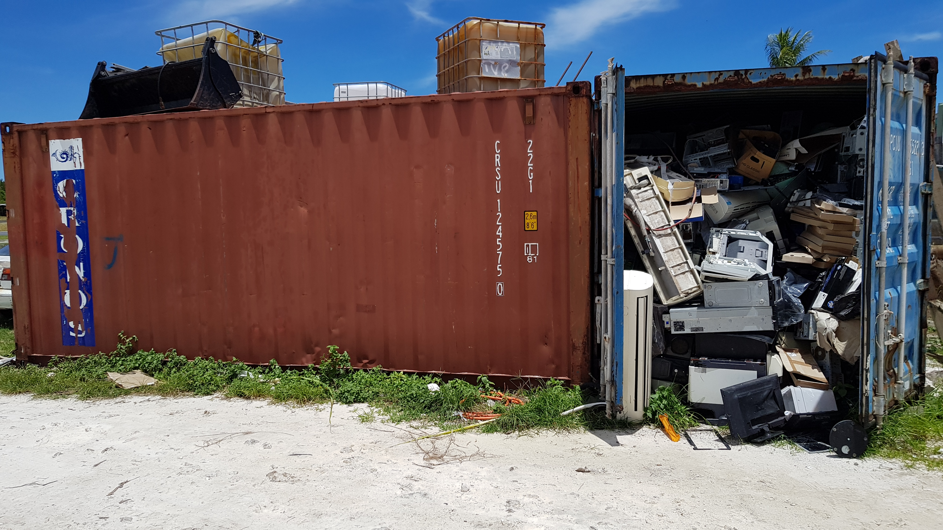
PacWaste Plus Steering Committee Meeting
Waste Management
E – Waste
Volume : Close to 2 Containers full of collected e-waste
Collection : Weekly collection is provided by the DWM, hence private
deliveries is also encouraged
Dismantling : No dismantling process due to lack of capacity and
technical advice
Shipment : Still in negotiation with e-waste recycling companies in New
Zealand and Australia for potential shipment of Tuvalu e-
waste
2020

Slide 5
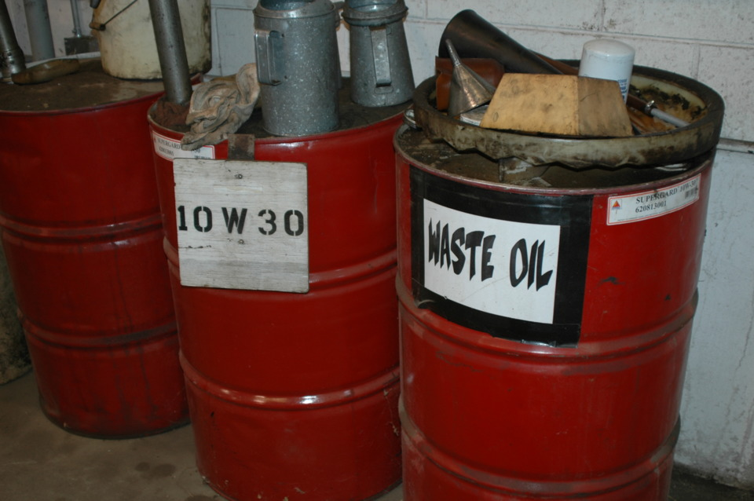
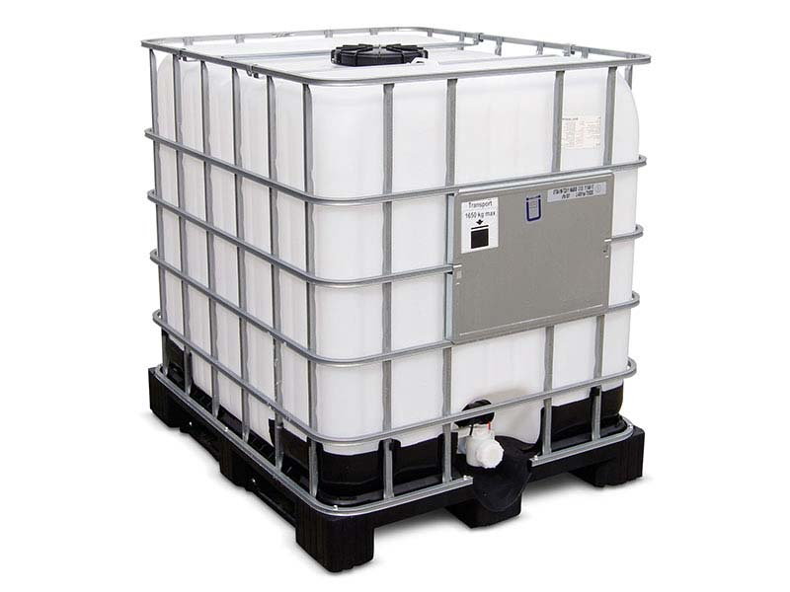
PacWaste Plus Steering Committee Meeting
Waste Management
Waste Oil
Volume : Close to 20,000 litres at the Storage facility
Collection : Open collection, bring in or request for collection
Recycle : Ship to Pacific BlueScope Company in Fiji
Shipment : 4 Shipment in 2017 (20,000 litres)
5 Shipment in 2018 (25,000 litres)
5 Shipment in 2019 (25,000 litres)
2020

Slide 6
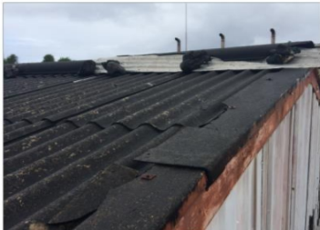
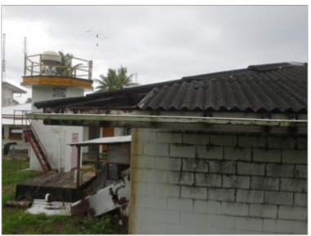
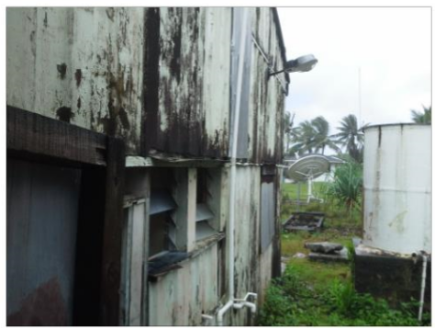
PacWaste Plus Steering Committee Meeting
Waste Management
Asbestos
Volume : Asbestos volume from contaminated sites and buildings have
been identified on Funafuti (not including the outer islands).
Collection : No collection schedule since training for removal, transport
and storage has not conducted yet.
Storage : No specific site or storage facility identify for storage.
Shipment : No shipment or any arrangement made to safely dispose
asbestos
2020

Slide 7
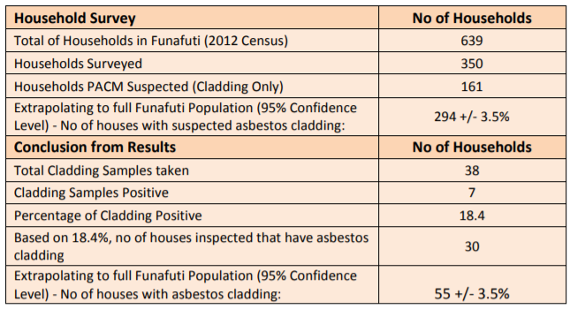
PacWaste Plus Steering Committee Meeting
Waste Management
Asbestos
2020

Slide 8
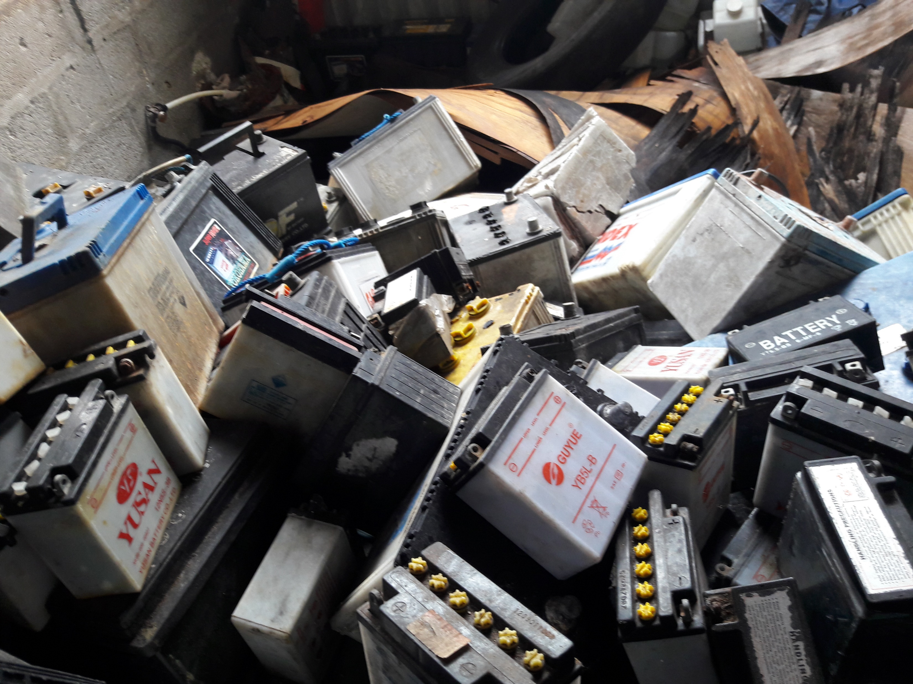
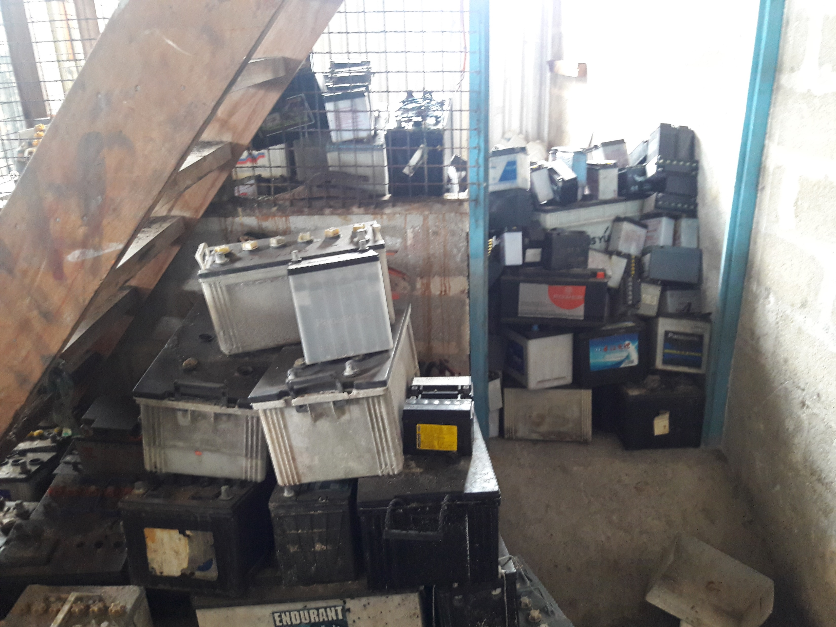
PacWaste Plus Steering Committee Meeting
Waste Management
Used Lead Acid Batteries (uLABs)
Volume : Approximately half a container of uLAB’s
Collection : Weekly collection is provided by the DWM, hence private
deliveries is also encouraged
Packing : Stacks in pallet into a container
Shipment : Successful negotiation were made with the Pacific Batteries
to ship to Fiji
2020

Slide 9
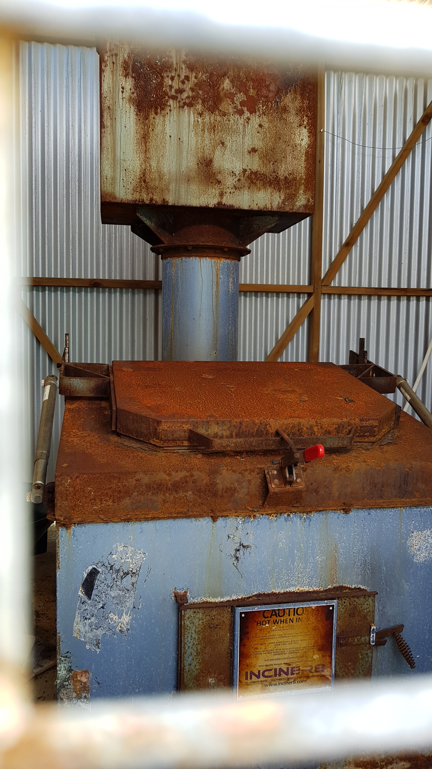
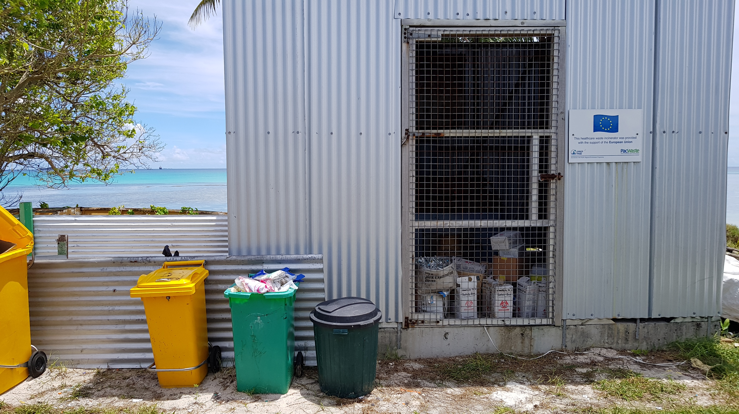
PacWaste Plus Steering Committee Meeting
Waste Management
Health Care Waste
Volume : Average of 1m³ per day
Collection : Provided by the Ministry of Health.
Storage : No proper and safe storage facility available
Incinerate : Currently using the manual process of burning medical
waste since the incinerator procured under PacWaste
Project broke down in 2016
2020

Slide 10
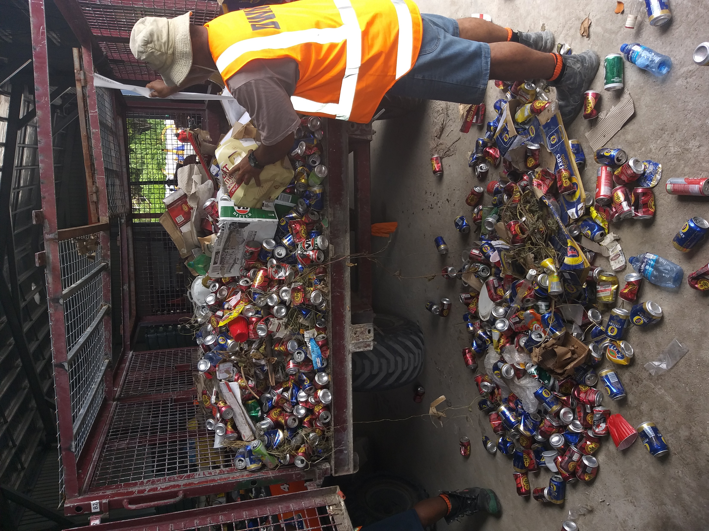
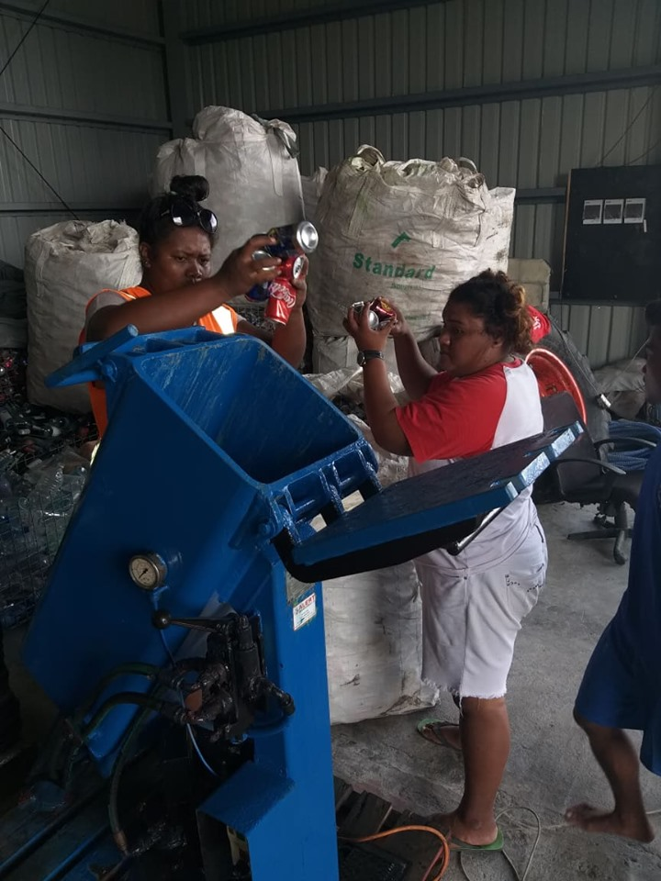
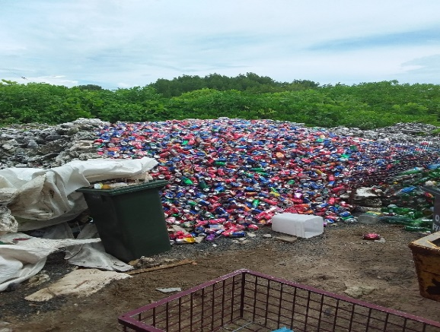
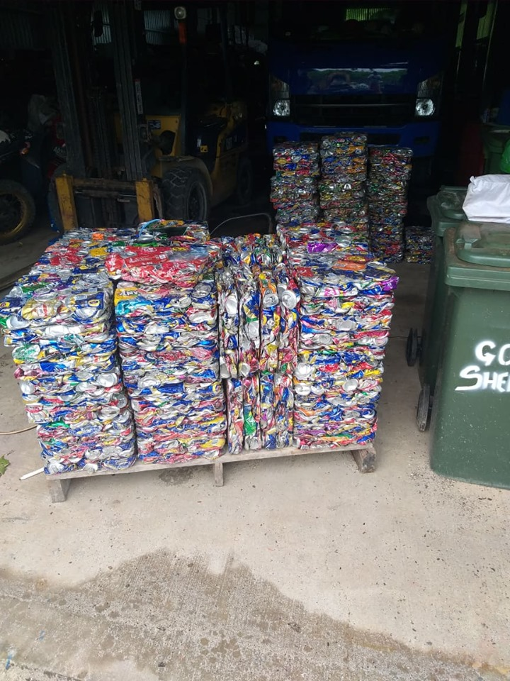
PacWaste Plus Steering Committee Meeting
Waste Management
Recyclables
Volume : Aluminum cans and plastics bottles (1 container)
Collection : Daily collection provided
Storage : Funafuti Transfer and Recycling Station (Recovered)
Recycling : Few potential markets has been identified
2020

Slide 11
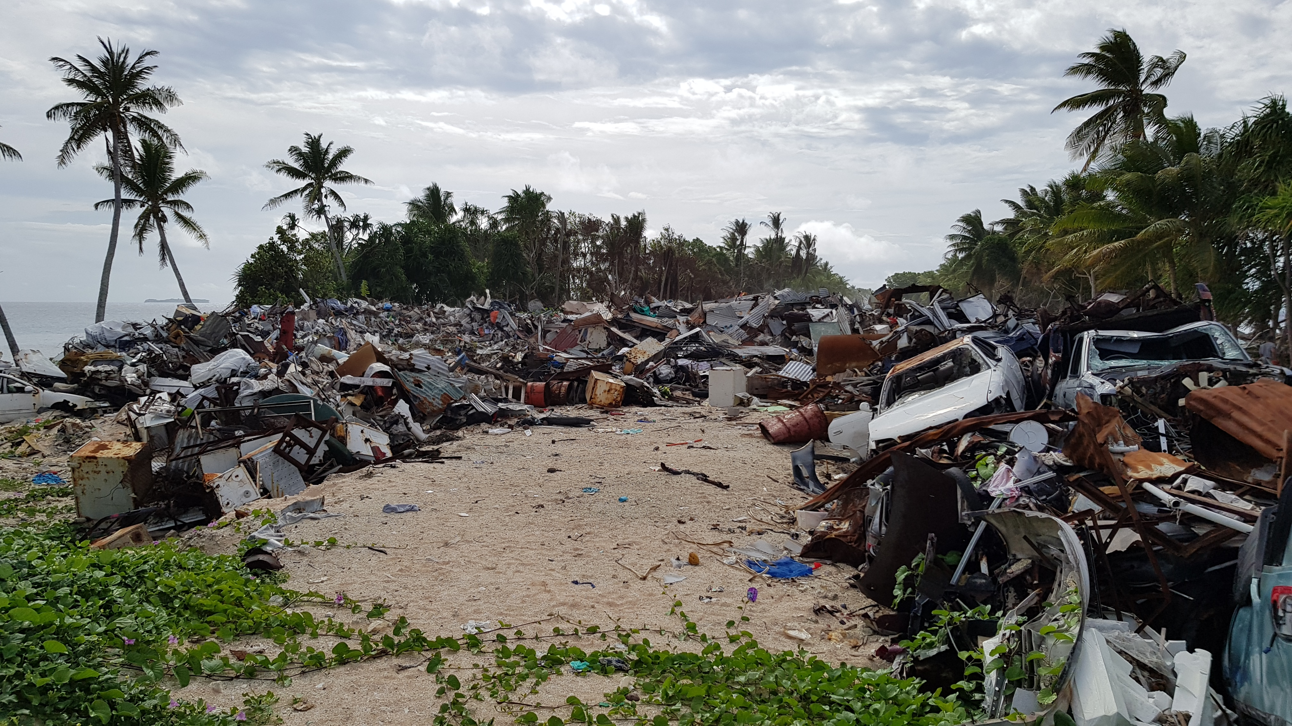
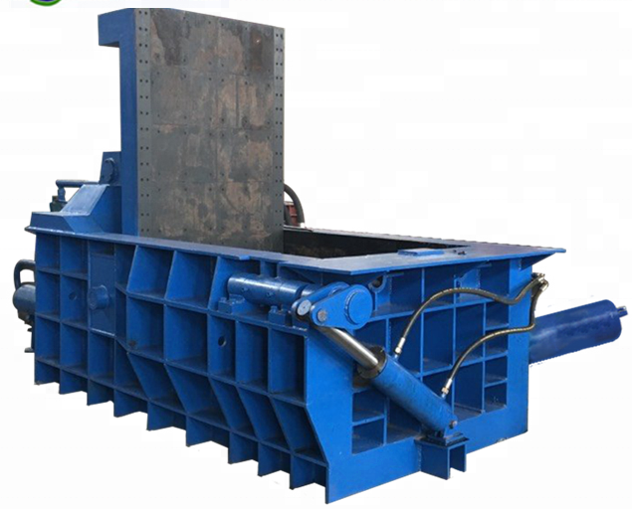
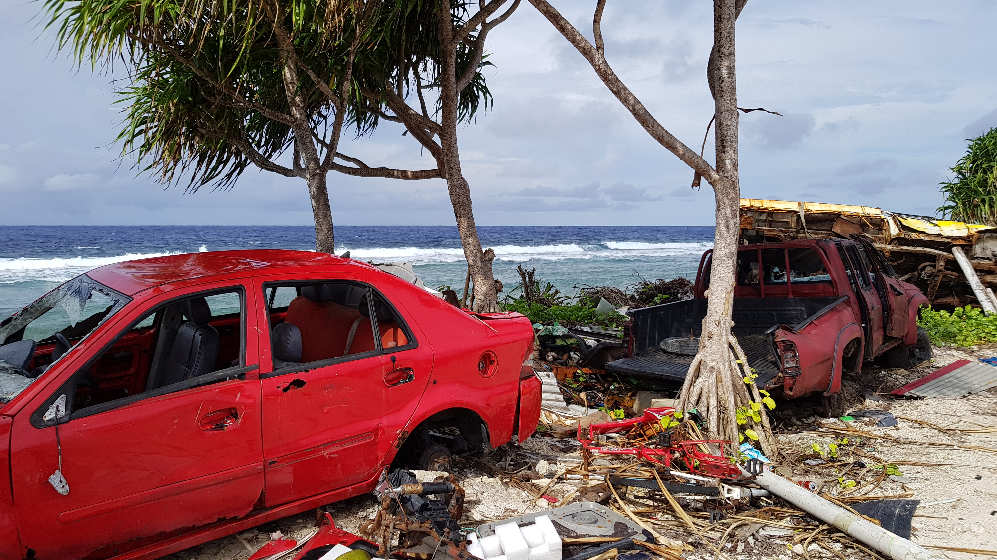
PacWaste Plus Steering Committee Meeting
Waste Management
Bulky waste
Volume : 150m³ of bulky waste at the landfill
Collection : Daily collection provided
Storage : Funafuti Transfer and Recycling Station (Recovered)
Recycling : Few potential markets has been identified in NZ
during our study tour
Equipment: Metal baler, Plasma cutter & Portable generator
donated by World Bank
2020

Slide 12
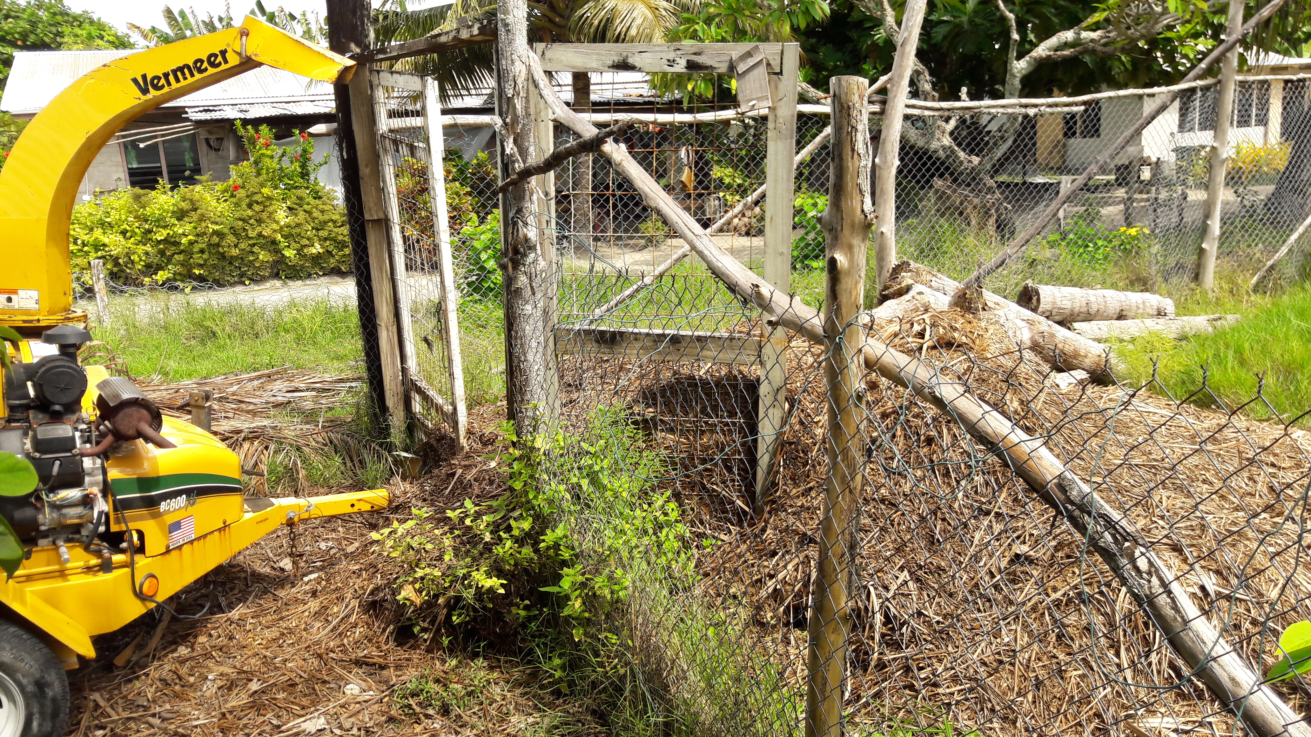
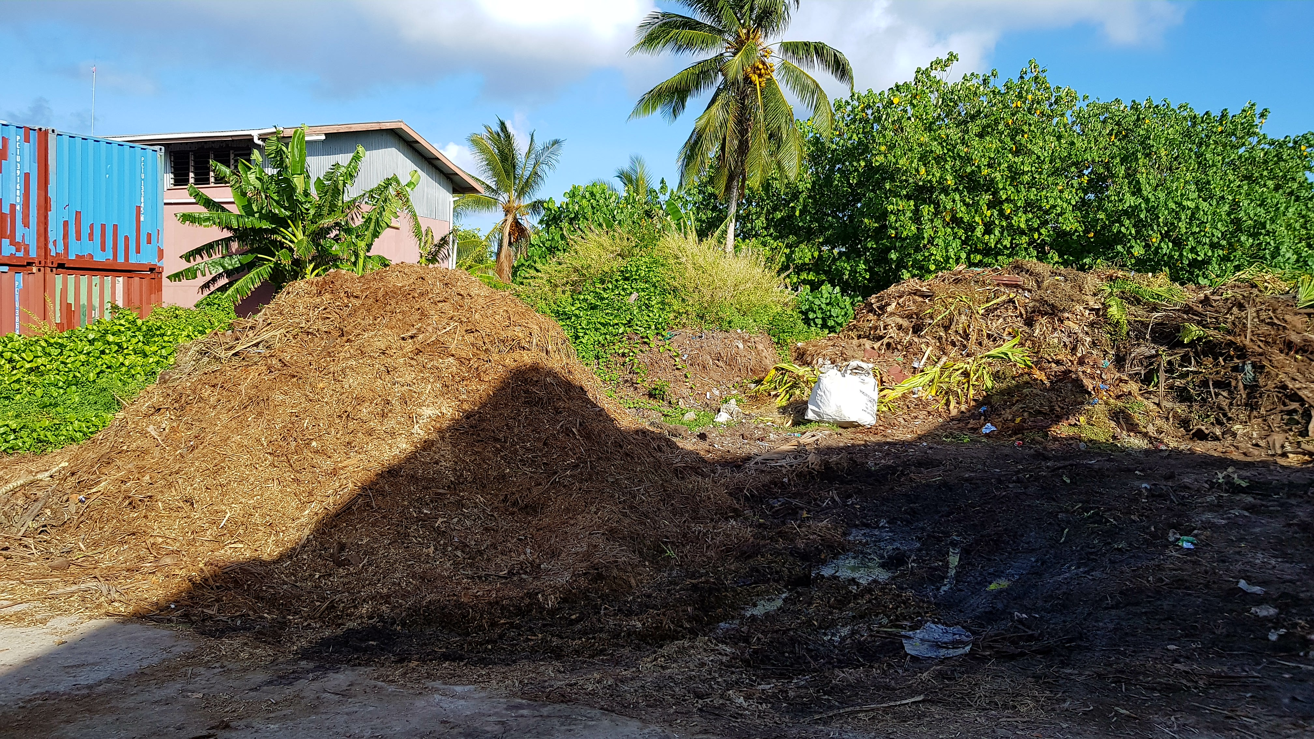
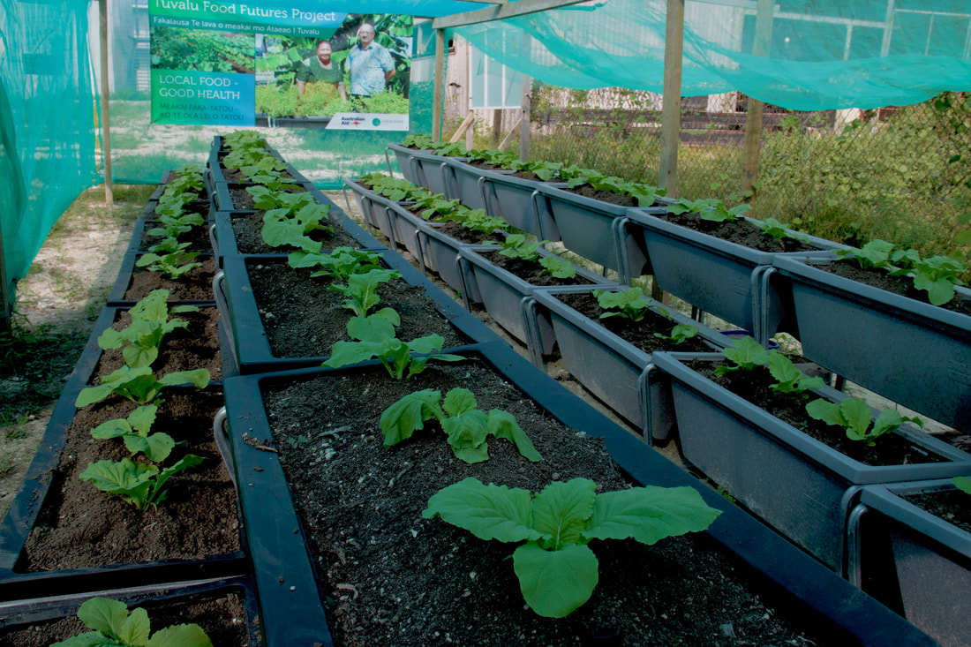
PacWaste Plus Steering Committee Meeting
Waste Management
Green waste
Volume : 60% of the total daily waste generation volume
Collection : Daily collection
Storage : Funafuti Transfer and Recycling Station (composting section)
Recycling : 100% of green waste generated will turn into compost
Equipment: Truck & Wood chipper
Selling of Compost: Sell to the Taiwan Commercial Garden project
and local farmers
2020

Slide 13
PacWaste Plus Steering Committee Meeting
Waste Management
Pesticides
Volume : Not available
Collection : No collection
Storage : Tuvalu Agriculture Department and Taiwan Garden warehouse
Legislation : Waste Management Act 2017
Management : Cabinet endorsed Tuvalu to become party to
Rotterdam Convention in October 2019
2020

Slide 14
PacWaste Plus Steering Committee Meeting
Challenges and Limitation
Human Resource : Lack of human resource to fully implement, manage
and enforce waste management legislations
Limited land space : Very limited land space for waste disposal mainly on Funafuti
Backloading of recyclable wastes : No specific landing-craft for outer islands to return
recyclable wastes
Capacity : Lack of capacity on recycling activities, procedures and safety
measures
Recycling Market : Very challenging to get a good market to cover
shipping cost
Enforcement of Legislation : Not to the point we wanted, public need more awareness and
education programmes on waste legislation
Awareness and Education : Limited time to outer islands and costly
Occupational Safety : Need more ground training and proper equipment
2020

Slide 15
PacWaste Plus Steering Committee Meeting
Clarification from PWP (PMU)
More clarification on PacWaste Plus Projects coverage and clear implementation timeline based on Island Priorities as most islands have similar waste priorities.
More clarification on KRA 1 in relation to collate and review country existing data on waste through conducting survey and study. Does PWP recognize previous studies and surveys at the national as baseline?.
PWP PMU to provide clarification and update on work with the University of the South Pacific to assess existing accredited and vocational waste courses and commence development of new courses to fill gaps.
Provide more clarification on National Project Committee. Should the country develop a ToR for thee Committee or the PMU will do that?.
2020

Slide 16
PacWaste Plus Steering Committee Meeting
Way Forward
Ensure Tuvalu waste priorities are addressed under PWP set timeline
Establish and improve a good coordination among public and private sector towards waste priorities
Establishment of the National Project Committee based on established mandates
Work closely with sub region Project Officer to implement waste priorities towards the expected outcome through allocated timelines.
Utilizing PWP technical and financial support to bring new ideas, methods and approaches to achieve waste management goals in a more sustainable way.
Support mechanisms that coordinate, facilitate and promote local solid waste management efforts.
Improve information quality and reliability for decision making.
Scaling up best practices and initiatives to promote circular economy
2020

Slide 17
PacWaste Plus Steering Committee Meeting
Thank You
&
Fakafetai lasi
2020

