Slide 1

Climate Change, Leadership, Adaptation, and Innovation in the Pacific Islands
Professor Elisabeth Holland
Professor of Climate Change
Director Pacific Centre for the Environment and Sustainable Development
Sarah Hemstock, Aliti Koroi, Carol Emaurois, Prerna Chand, Viliamu Iese, Helene Jacot Des Combes, Joeli Veitayaki, Naushad Yakub, Sarika Chand, Jone Tuiipelehaki, Birtha Togahai, Pelenise Alofa, Jason Alonk, William Arudovo, Rose Godana, Tevita Faka’osi, Abe Aremwa, Tessa Koppert, Tamara Greenstone, Teuleala Manuella, Tapulolou Tuailemafua Sumeet Naidu, Leone Limalevu, Morgan Wairiu, Antoine N'Yeurt, Christopher Ward, Ruci Kurucake, Shivani Pillay, Nasoni Roko, Nirupa Ram-Tokuma, Priya Sharma, Tupe Samani, Sairusi Bosenaqali, Awnesh Singh, Ronil Prasad, Sainimere Veitata, Sachin Nand, Ame Tuisavusavu, Ashmita Devi, Luke Paeniu, John Walenenea, Moses Asitarau, Betty Sigrah

Slide 2
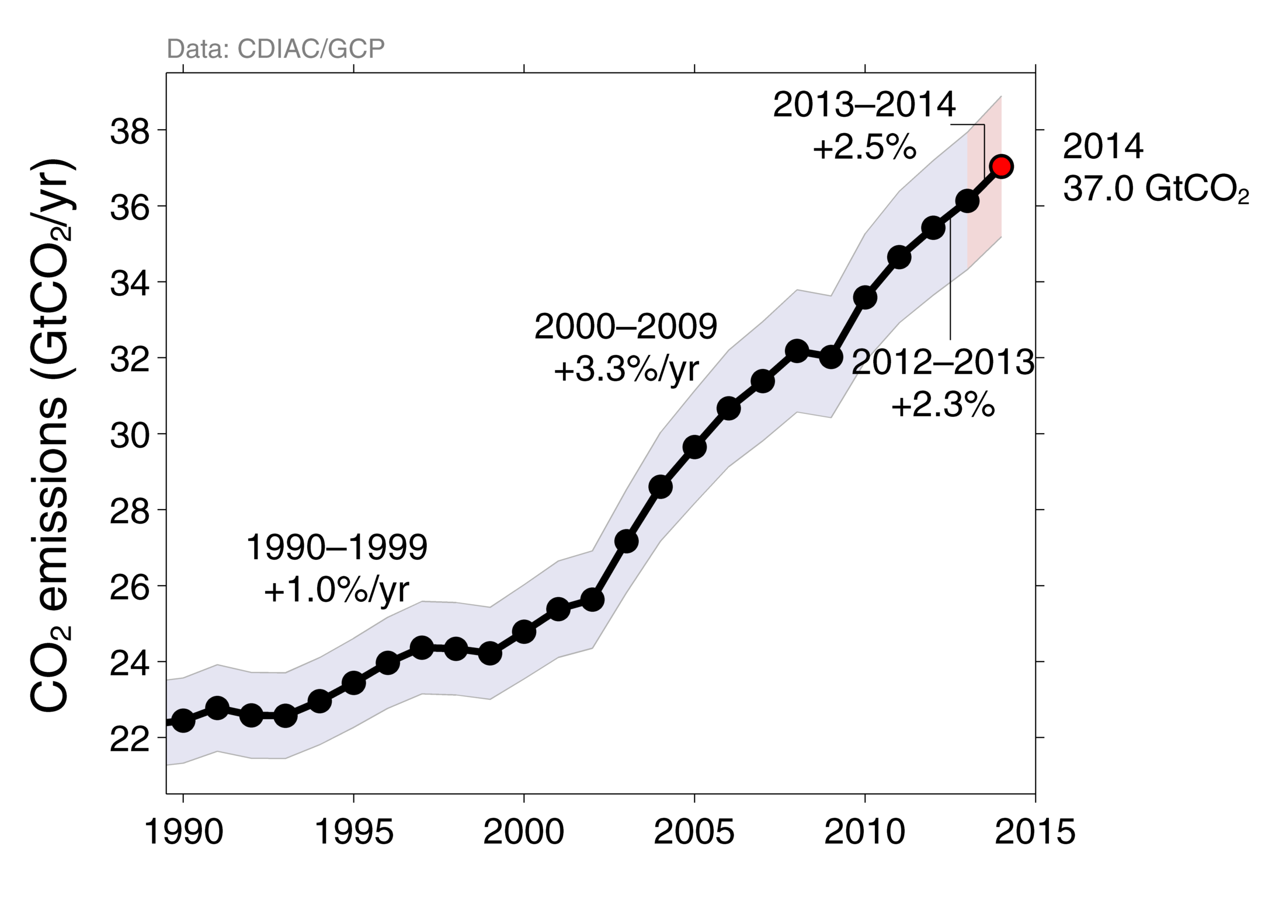
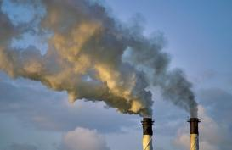
Fossil fuel and Cement Emissions of CO₂
Global fossil fuel and cement emissions: 36.1 ± 1.8 GtCO₂ in 2013, 61% over 1990
Projection for 2014 : 37.0 ± 1.9 GtCO₂, 65% over 1990
Copenhagen
Accords
Kyoto
Protocol
Uncertainty is ±5% for one standard deviation (IPCC “likely” range)
UNFCCC
IPCC report
Estimates for 2011, 2012, and 2013 are preliminary
Source: CDIAC; Le Quéré et al 2014; Global Carbon Budget 2014

Slide 3
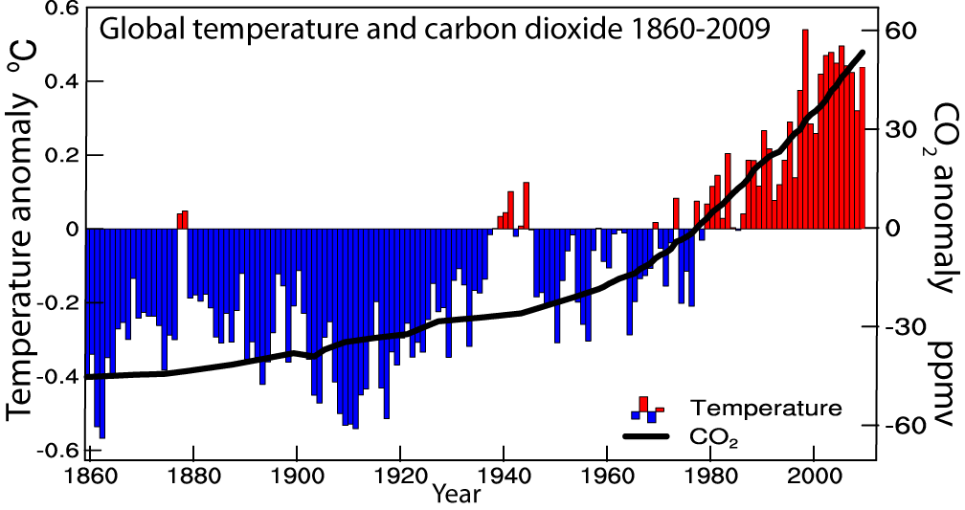
IPCC AR5 Physical Science Basis approved 27 September, 2013 Stockholm, Sweden
Warming in the climate system is unequivocal

Slide 4
Atmospheric CO₂ now exceeds 400 ppm
350
Last Interglacial
Carbon Dioxide (ppmv)
300
Last Ice Age
Ice ages are not random. They are 'forced' (by earth’s orbital clock…. changes in the sunlight received).
250
200
[Adapted from Figure 6.3, ©IPCC 2007: WG1-AR4]
600
500
400
300
200
100
0
Thousands of Years Before Present
Humans are ‘forcing’ the system in a new way. CO₂ increases are mainly due to fossil fuel burning. CO₂ has not been this high in a million years.

Slide 5
What does the Future hold?
Warming to date 0.85 °C
What does the Future Hold?
Warming to 2013: 0.85°C
3.2-5.4 °C
2.0-3.7 °C
1.7-3.2 °C
0.9-2.3 °C
IPCC AR5, Technical Summary , http://www.climatechange2013.org

Slide 6
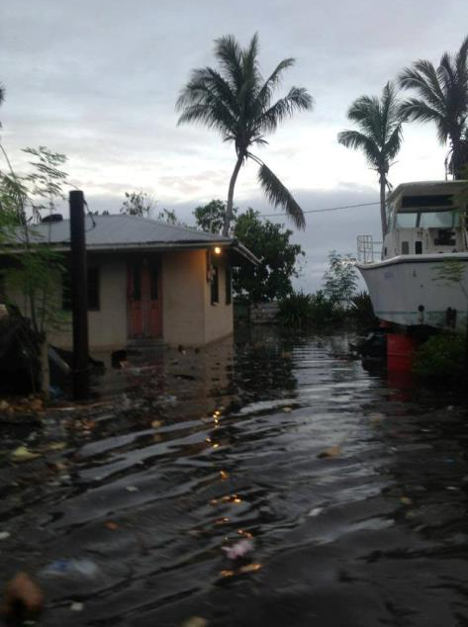
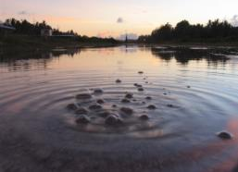
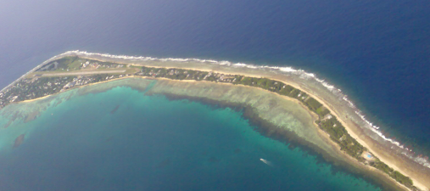
Sea Level Rise
IPCC AR5 WG 1, The Physical Science Basis, Summary for Policy Makers , http://www.climatechange2013.org

Slide 7
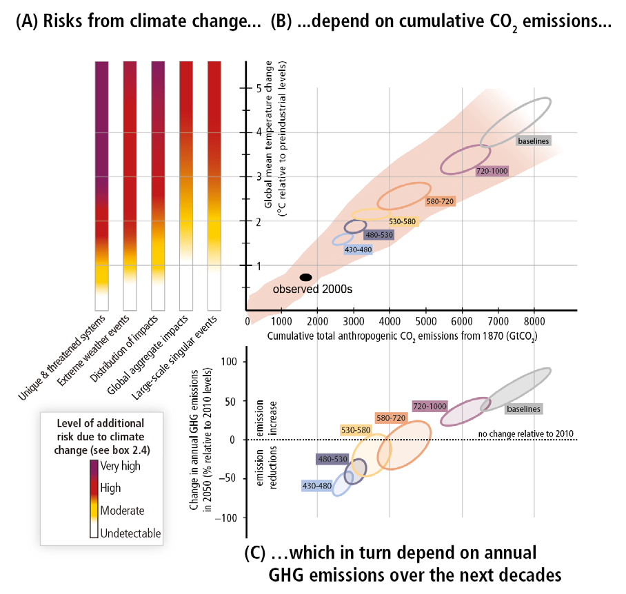
Figure SPM.10,
A reader’s guide
From climate change risks to GHG emissionse

Slide 8
Figure SPM.10,
A reader’s guide
From climate change risks to GHG emissionse
Emissions remaining:
1.5 °C: 275 Gt Carbon dioxide
2 °C: 1000 Gt Carbon dioxide

Slide 9

What are the Solutions?
• Mitigation-shift to renewable energy to reduce emissions.
Sustainable Transport MUST be included.
•Pacific Leadership-building a better tomorrow
• Adaptation- building climate change and disaster resilience today
• Innovation-finding new solutions
Requires unprecedented COLLABORATION from communities to governments and world leaders

Slide 10
MITIGATION
http://www.majurodeclaration.org/
Developed World | Pacific
Australia: 5% emission reduction | FSM: 50% decrease in imported petroleum fuel
Canada: increasing emissions | RMI: A 40% reduction in CO₂ emissions below 2009 levels by 2020; A 20% efficiency improvement in transportation sector fuel use by 2020
EU: 20-30% emission reduction | Solomon Islands: 100% renewable by 2050
New Zealand: 5% emission reduction | Tuvalu: 100% renewable by 2020

Slide 11
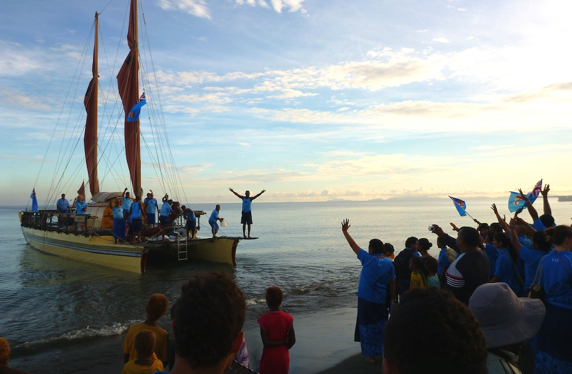

Our canoe has two hulls:
Cultural Wisdom
and Scientific Wisdom
Pictures: www.asiapacific.anu.edu.au
Kommol tata

