Slide 2
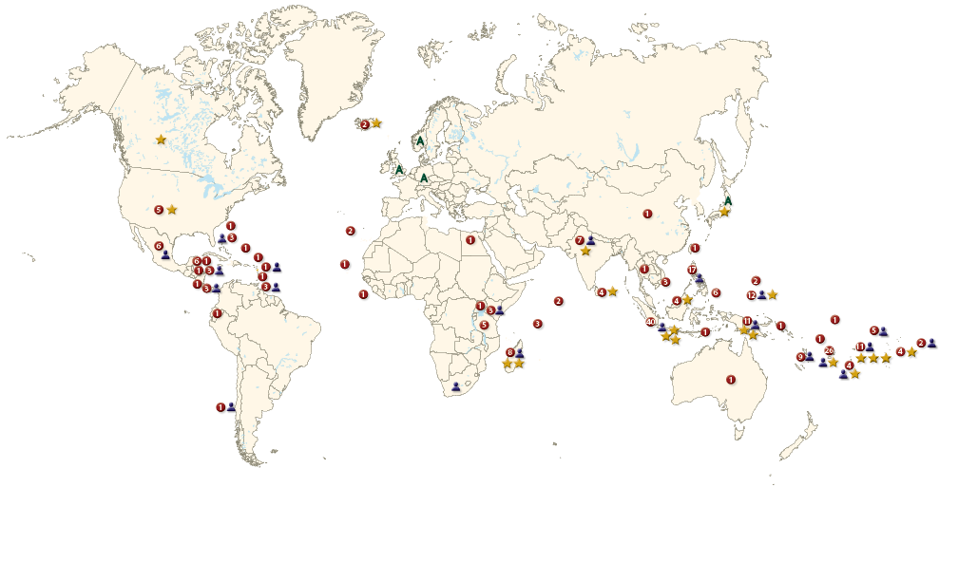
Seacology Projects Around the World
255 projects on 152 islands in 54 countries, preserving more than 1.4 million acres of terrestrial and marine habitat

Slide 3
Help islanders
protect their
environments and cultures
Seacology’s Goal

Slide 4
We work only on islands
We always work with local people
We listen
Why Seacology is special

Slide 5
23 projects in the region
Since 1999
Seacology in Micronesia

Slide 6
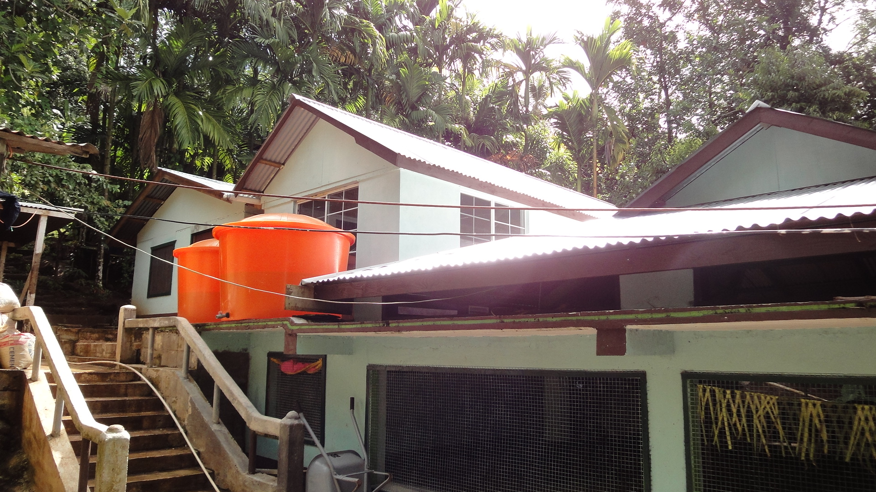
Onongoch, Fefen Island, Chuuk
Build community hall, install water tanks, toilets
Protect 15-acre upland forest

Slide 7
Onongoch, Fefen Island, Chuuk

Slide 8
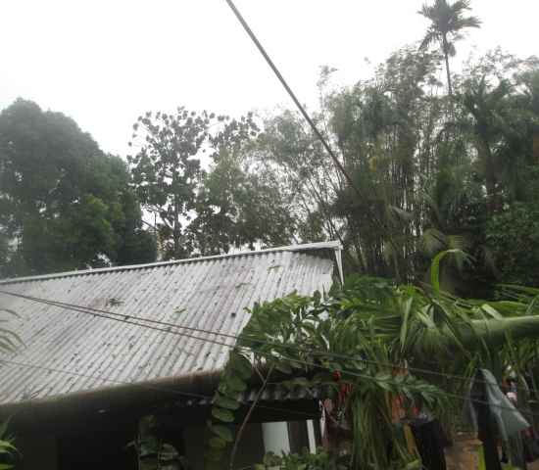
After Typhoon Maysak, March 2015
Maintenance grant for repairs of typhoon damage to Seacology-funded tanks

Slide 9
Nanwap, Pohnpei
Build community and education center
Protect 300-hectare marine area for 10 years

Slide 10
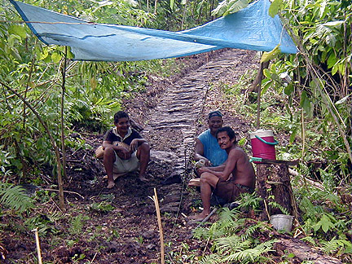
Yap
Repair stone trail
Establish 75-acre Dalipebinaw forest reserve

Slide 11
Awak, Pohnpei
Build youth development and education center
Set aside 308-acre permanent forest reserve

Slide 12
Qokaaw and Kadaay, Yap: 2010
Build surveillance platform
Establish 46-acre permanent mangrove sanctuary

Slide 13
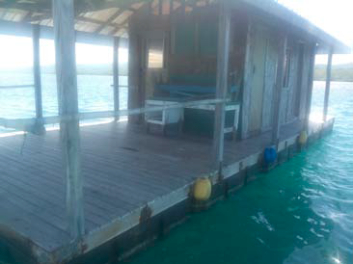
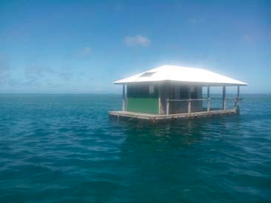
Qokaaw and Kadaay, Yap: 2015
Small grant for repairs and maintenance

Slide 14
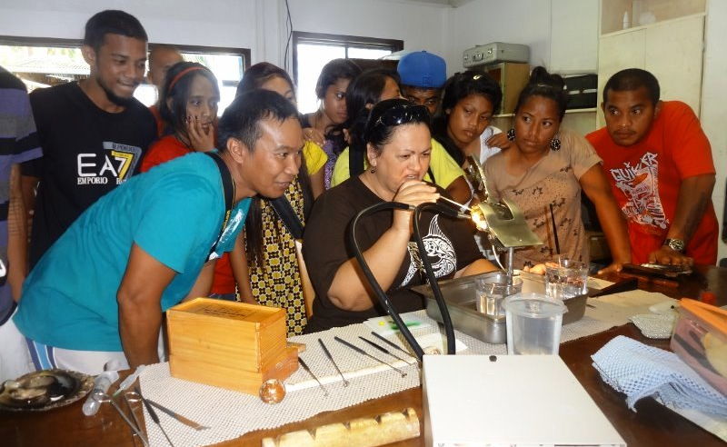
Namdrik Atoll, Marshall Islands
Build education and surveillance center, buy pearl farming equipment
Protect 35-hectare marine area for 10 years

Slide 15
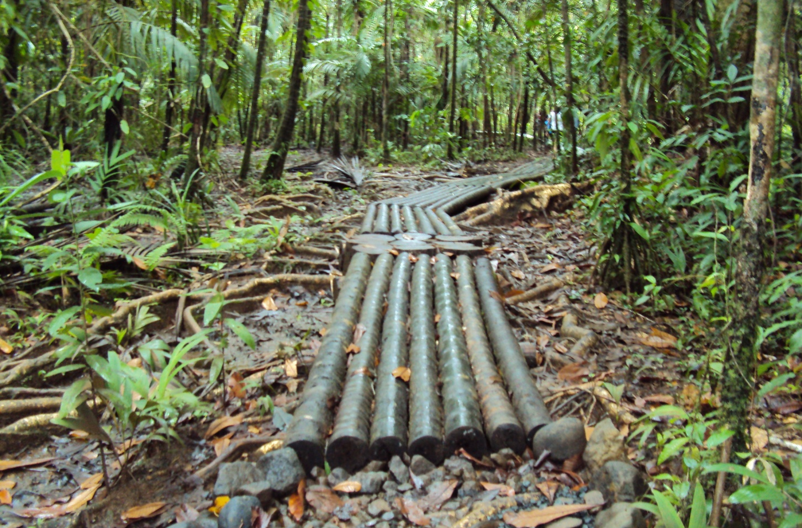
Palau
Conserve 1,500-acre Taki Conservation Area permanently
Build boardwalk

Slide 16
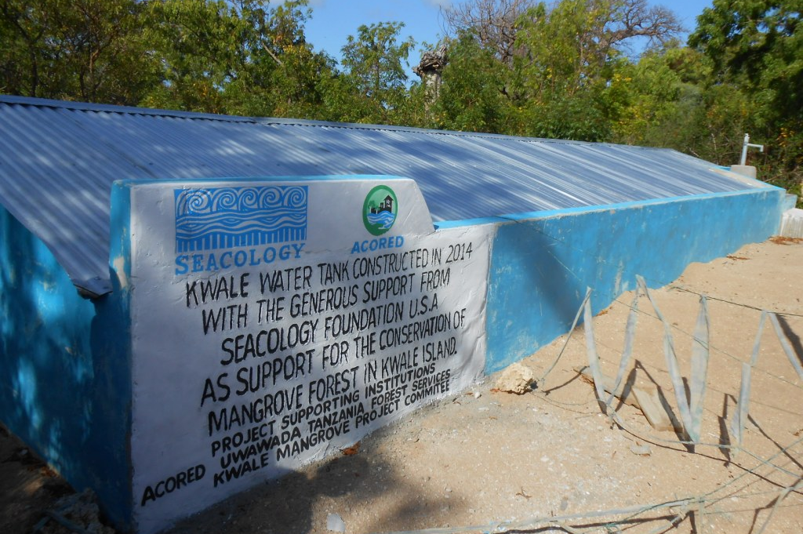
Tanzania
Construct water cistern, support community awareness program
Protect endangered turtles and 300-hectare mangrove forest for 10 years

Slide 17
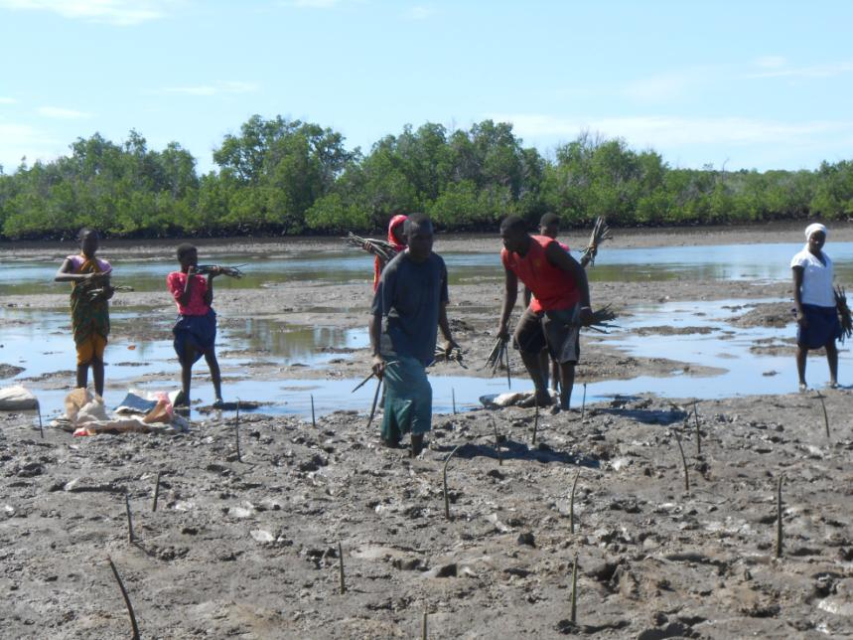
Tanzania

Slide 18
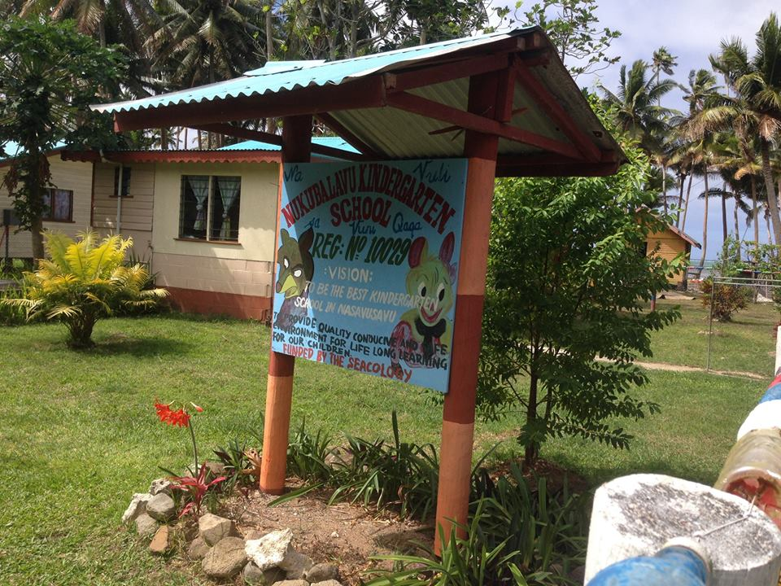
Fiji
Construct a kindergarten
Protect a 600-acre marine area for 20 years

Slide 19
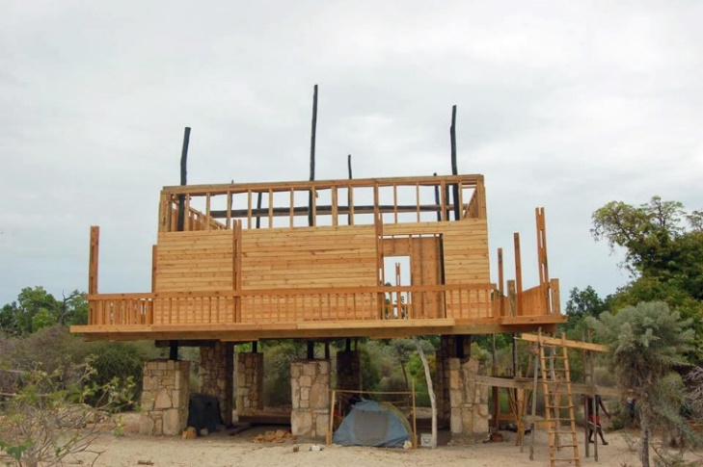
on of 1800 hectares (4448 acres) of threatened southwestern dry spiny forest for 20 years
Madagascar
Construct ecotourist welcome centers
Protect 4,448 acres of threatened forest for 20 years

Slide 20
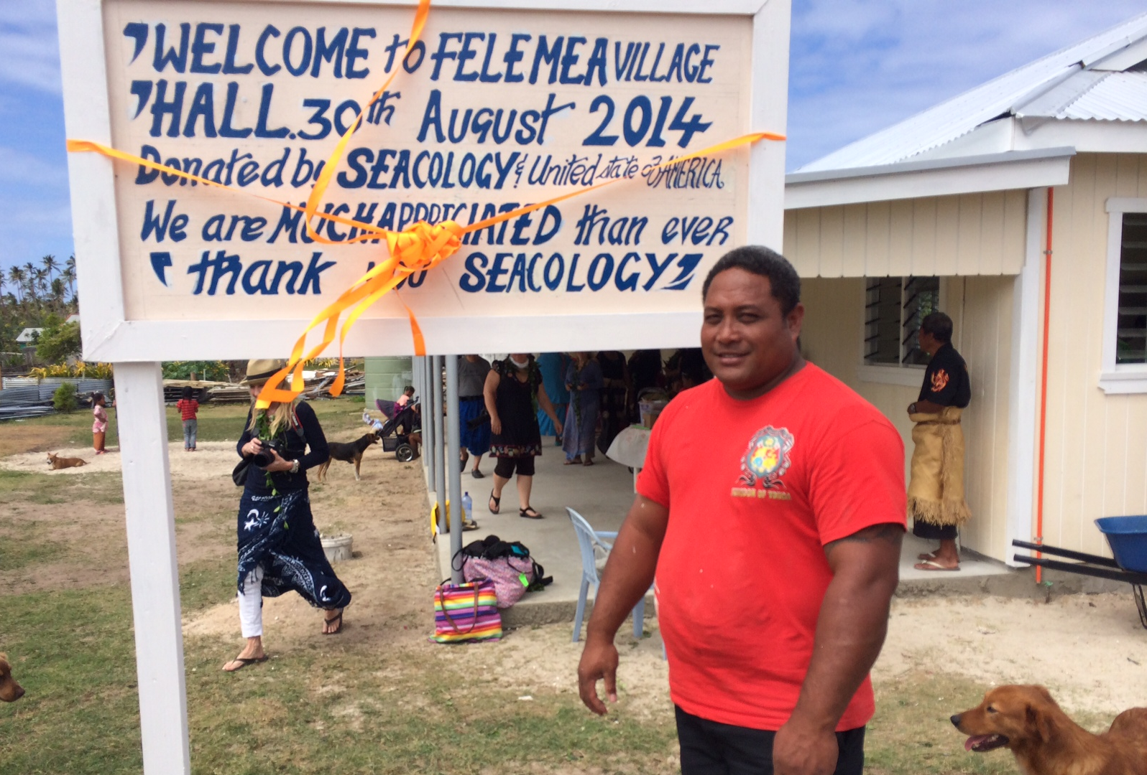
Tonga
Replace Seacology-funded community hall destroyed by cyclone
Notes:
Original project approved July 2010
Construction of new building, after original one destroyed by cyclone, approved Feb and April 2014, completed in August 2014.
$40,000 grant + $7500 admin

Slide 21
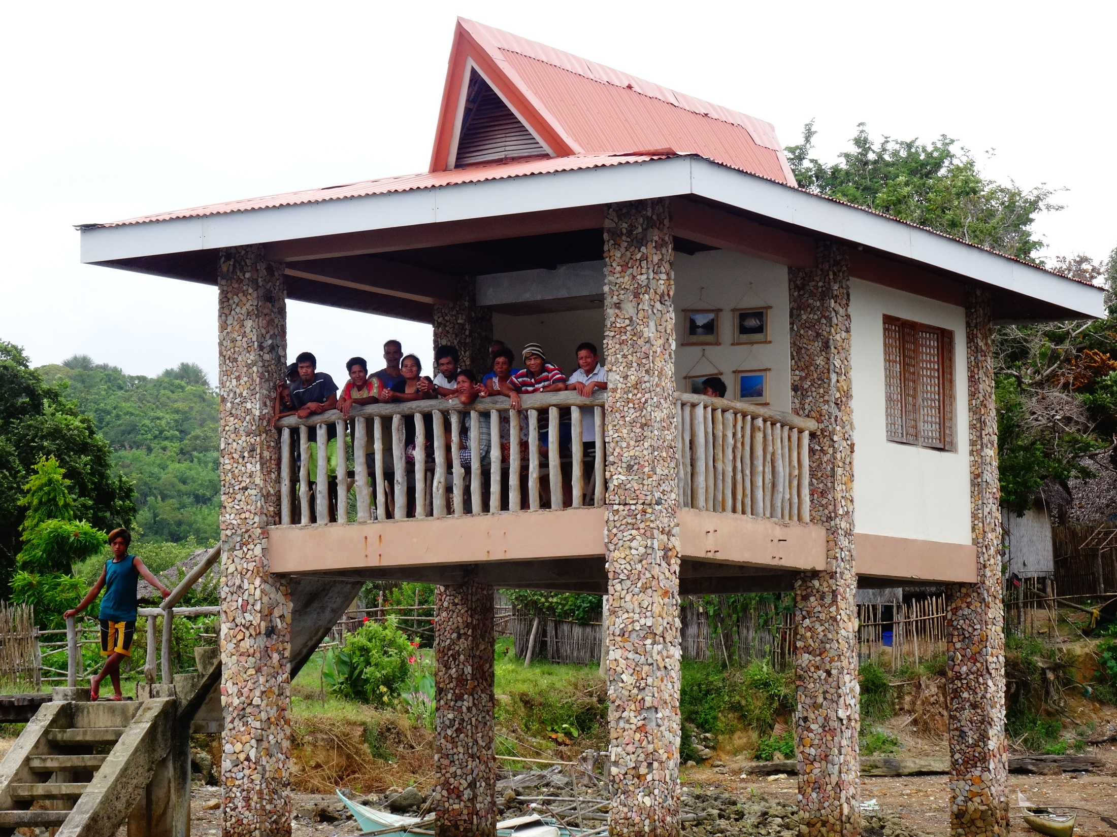
Philippines
Construct guardhouses
Establish 1,317-acre marine protected area for 25 years

Slide 22
Who Can Apply
Any community which has recently implemented a protected area or is planning to implement a protected area.
Local environmental NGO’s can apply on behalf of communities and assist them with project implementation

Slide 23
Types of Protected Area
Protected areas can be marine or terrestrial or a mix of both. Mangrove is classified as terrestrial.
Protection should be for a minimum of 10 years up to perpetuity (forever)
Size of the protected area is not too important but it should be significant to the community and also the environment

Slide 24
How to Apply
Email Simon Ellis at microellis@gmail.com to begin discussions
Submit a 1-2 page concept containing the following
State or island
Name of applicant (CBO, NGO, local government etc.)
Type of protected area (marine or terrestrial)
Size of protected area (acres or hectares)
Number of years of protection (minimum 10 years)
Type of reciprocal project requested by the community
Basic budget (3-4 lines including main cost items)
Map if possible

Slide 25
How to Apply Cont.
Following approval of the concept a full proposal is developed with Seacology staff
The project is then voted on by the Seacology board during semi-annual meetings
Following approval a Conservation Agreement is signed by key community members
A grant agreement is signed and funds are transmitted by wire transfer to begin work

Slide 26
What Seacology can fund
Just about any structure that the community wants with the exception of religious buildings. This could be ecotourism buildings, meeting house, dispensary, guard house
Signage, walkways, alternative livelihoods, water piping/tanks, certain durable equipment such as surveillance or farming equipment, kayaks

Slide 27
What Seacology CANNOT fund
ANYTHING THAT’S FUN!!
Salaries. Some funds can be used to pay for expert craftspeople where necessary
Motorized vehicles – boats and cars/trucks
Academic programs, travel, research, workshops or conferences
Renewable energy projects must show capability for maintenance and proper disposal of batteries
WMD

Slide 28
Funding Levels
Projects range from $5,000 to $35,000.
Applicants can apply for 10% administrative costs which must be part of the total budget.
Past applicants can also apply for funds to maintain their past projects. Generally in the range of $5000 although higher amounts may be granted.

