Slide 1
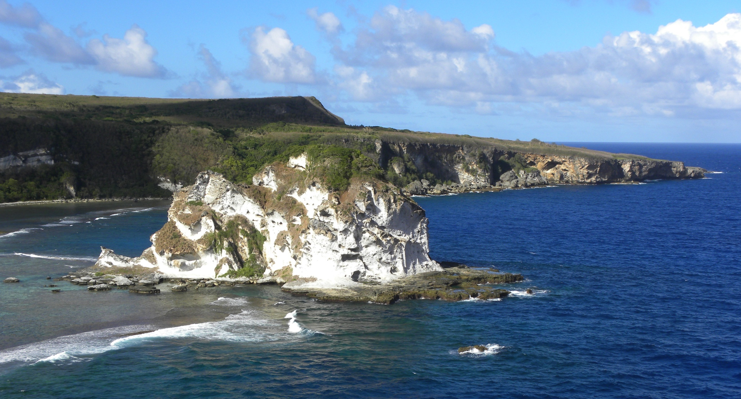
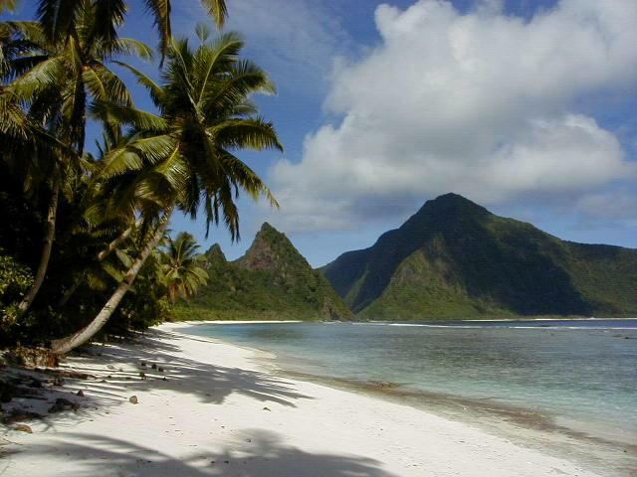
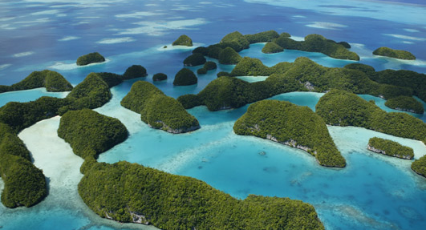
Pacific Islands Ocean Observing System
Heather Kerkering
Director
heather.kerkering@hawaii.edu
Melissa Iwamoto
Program and Outreach Coordinator
mmiwamot@hawaii.edu
Majuro
Republic of the Marshall Islands
April 24, 2013
US IOOS®: A Partnership for Lives and Livelihoods
Notes:
With this in mind, I am going to introduce you to the PacIOOS program and our efforts to support science for applications and decision-making in the Pacific. As you will notice throughout the program, all of our PIs are associated with UH campuses but our program is also made strong by the diversity of data and users. I appreciate the opportunity to be here and share with you a bit about what we offer.

Slide 2
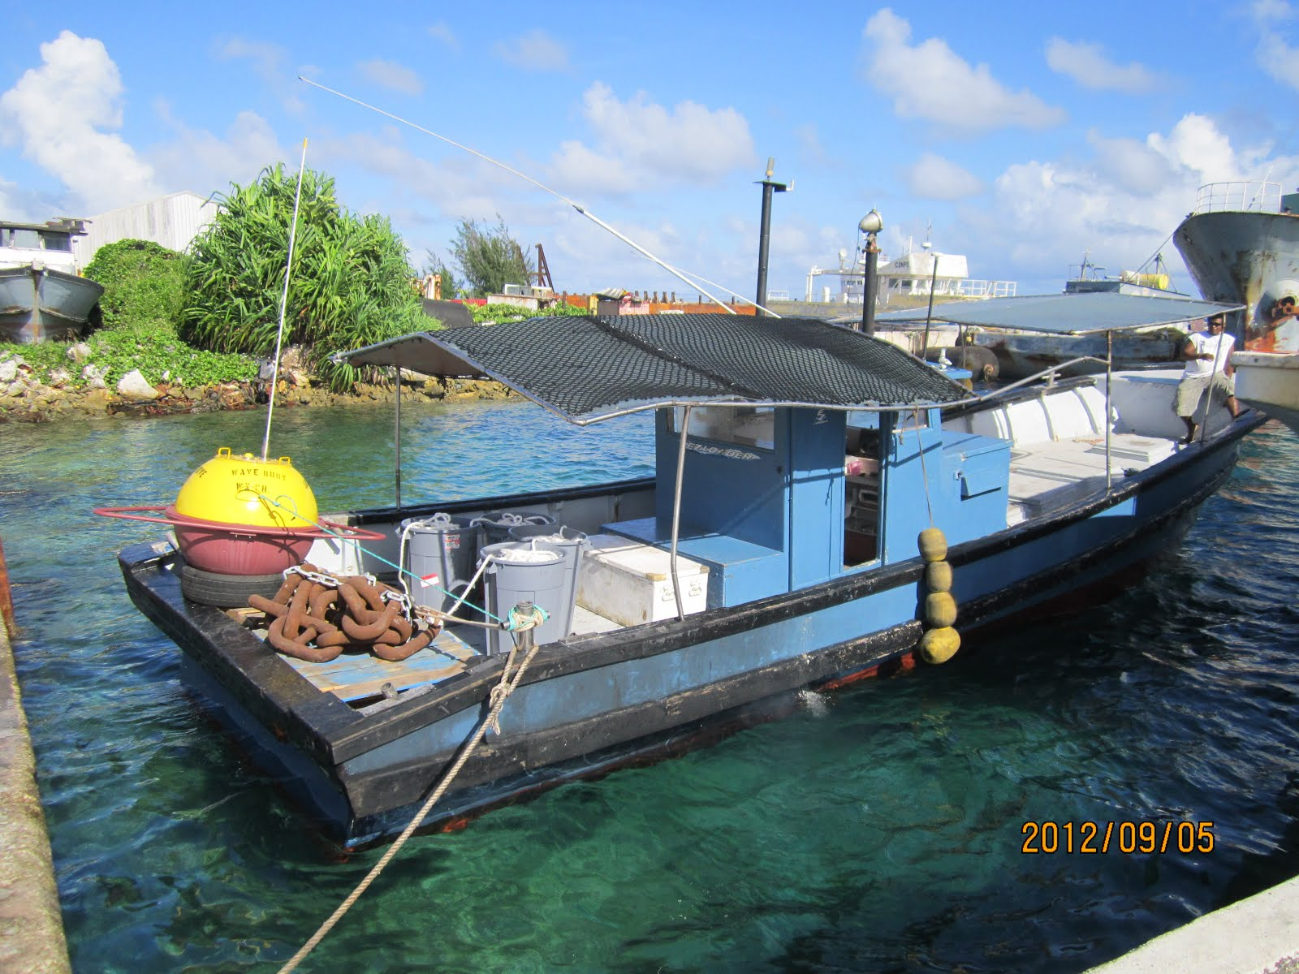
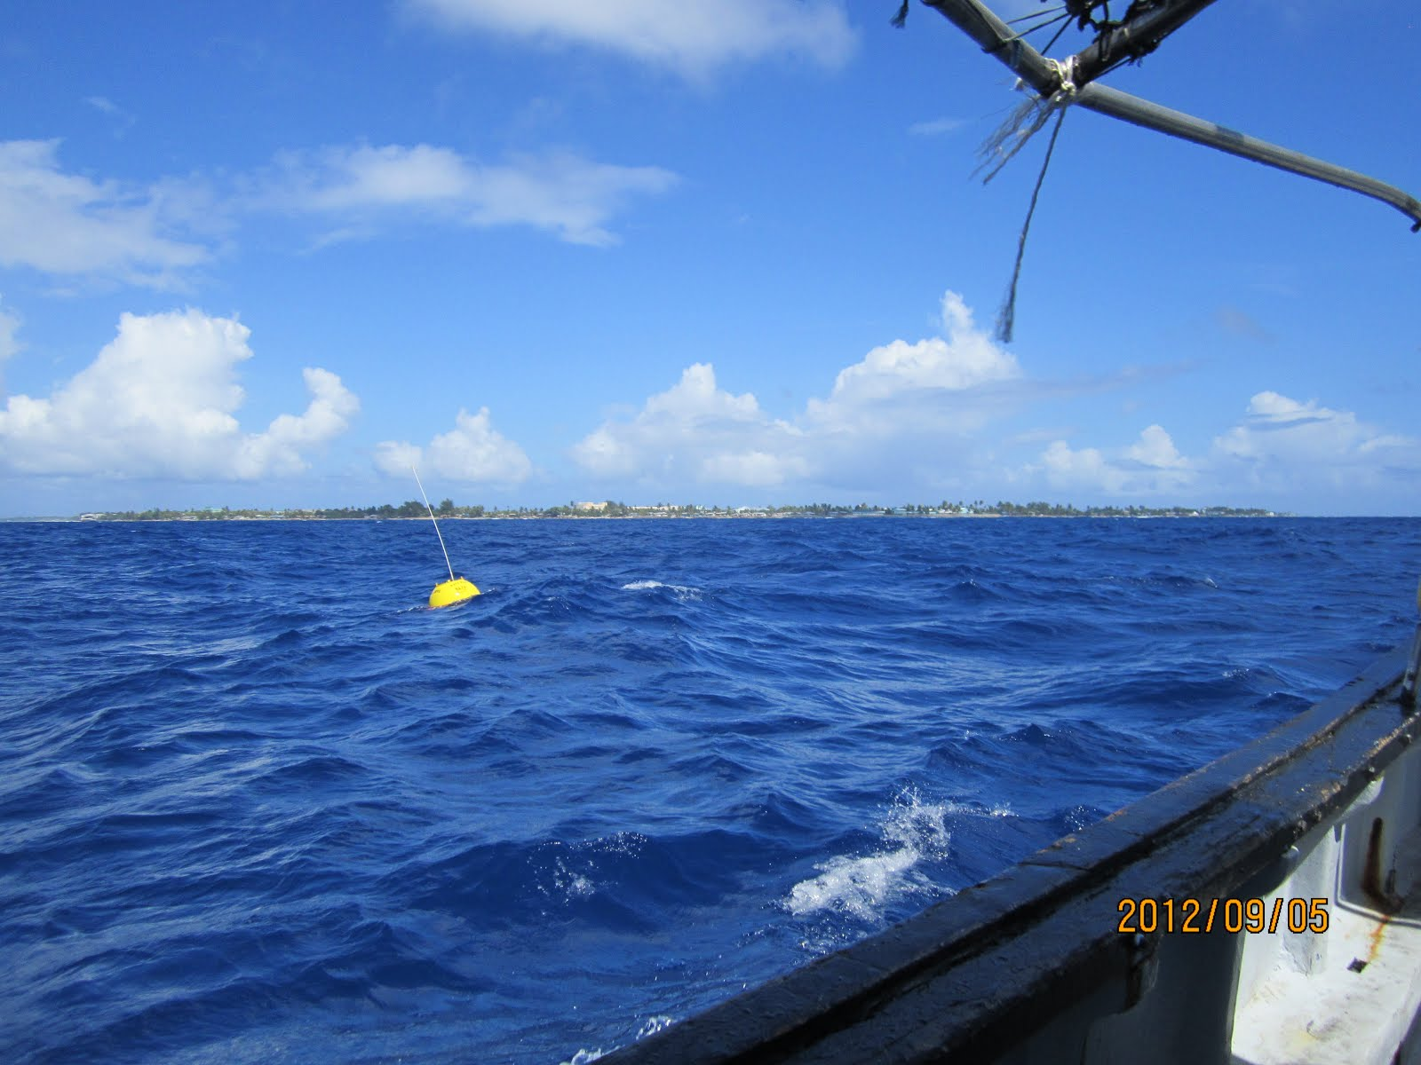
Wave Observations
Majuro deployment
2
Notes:
Wave buoy data provides:
- validation and boundary conditions for wave and current models
Real time data for harbor and shoreline conditions and near term forecasting
KALO BUOY

Slide 3
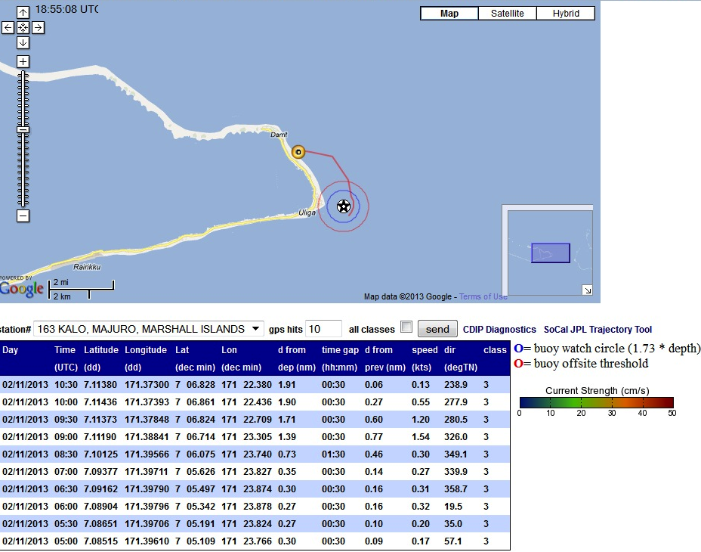

Slide 4
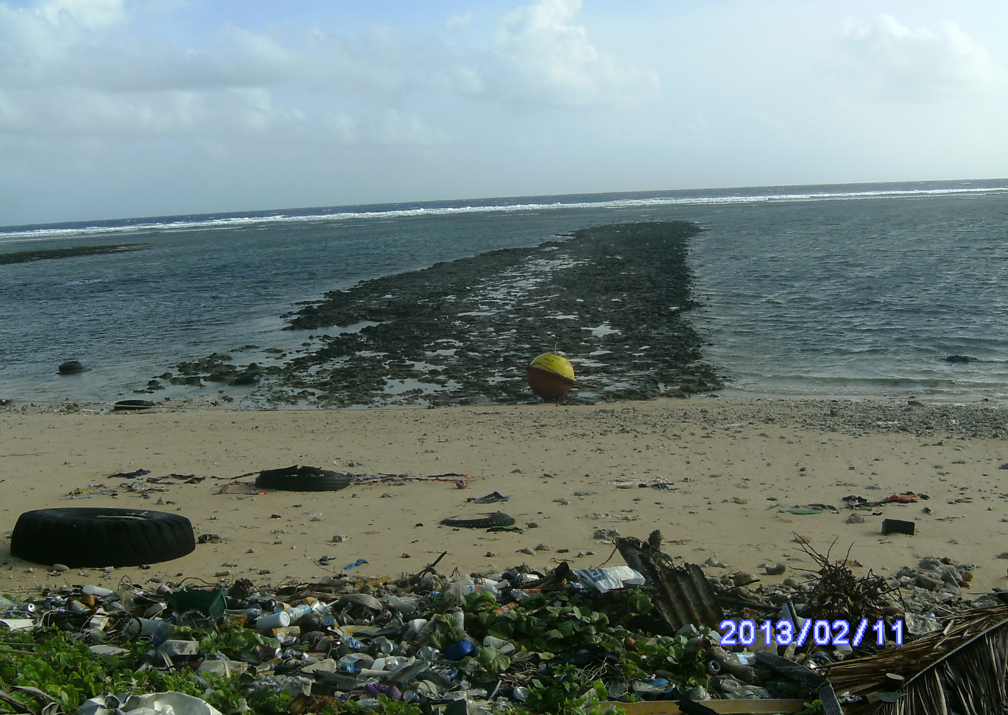
THANK YOU!!
Ken Kramer
Don Hess
Winson Bosin
Reggie White
Johnny Milne

Slide 5
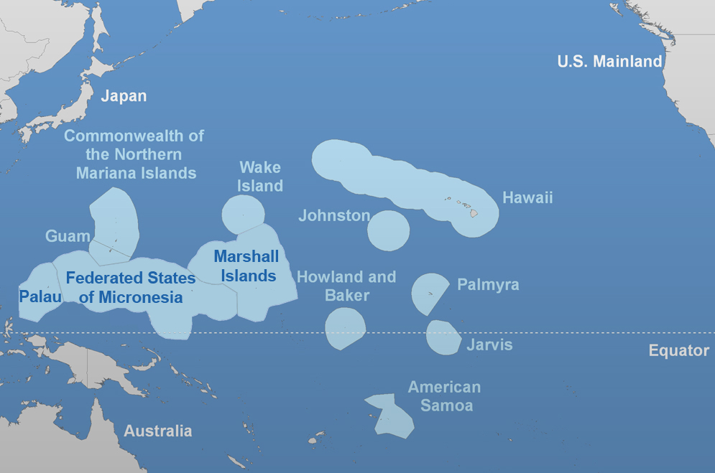
Hawaii
American Samoa
N Mariana Islands
Micronesia (FSM)
Guam
Marshall Islands
Palau
Wake Island
Johnston Atoll
Howland Baker Is
Palmyra Island
Jarvis Island
Notes:
The PacIOOS region is the largest of all the 11 regions..although AK likes to argue that point.
We span 6 time zones across the Pacific; straddle all 4 hemispheres, is distributed to nearly 35M km2 and over 2300 individual islands!
Each comes with its own unique politics, culture, environmental issues, economies and level of infrastructure that we take into consideration when building PacIOOS.
PacIOOS region consists of State of Hawaii, incorporated territories and Commonwealth, Freely Associated States of Micronesia, minor outlying islands (and functionally all interconnecting waters.)
I will follow this slide with examples of how we apply sponsored science to real-world issues….

Slide 6
PacIOOS MOA Partners
Hawaii
Liquid Robotics
UH- SOEST
Hawaii Department of Transportation – Harbors
Hawaii Office of Planning
Hawaii Harbors User Group
Marine and Coastal Zone Advocacy Council
Archinoetics, Inc.
Malama Maunalua
Maui Ocean Center
U.S. Coast Guard D-14
Kohala Center
Regional
NOAA – PIFSC
WPR Fishery Management Council
Outrigger Enterprises, Inc.
US Army Corps of Engineers
SAIC
CODAR Ocean Sensors
U.S. Pacific Command
Pacific Disaster Center
Republic of the Marshall Islands
College of the Marshall Islands
Federated States of Micronesia
College of Micronesia
Palau
Palau International Coral Reef Center
Coral Reef Research Foundation
American Samoa
American Samoa EPA
Department of Marine and Wildlife Resources
Guam
Guam, Office of the Governor
University of Guam Sea Grant
CNMI
CNMI, Office of the Governor
Pacific Marine Resources Institute

Slide 7
PacIOOS Council Members
Mr. Chris Ostrander, UH Manoa – SOEST
Mr. Jesse Souki, State of Hawaii Office of Planning
Mr. Davis Yogi, State of Hawaii Department of Transportation, Harbors Division
Ms. Donna Brown, Marine and Coastal Zone Advocacy Council
Dr. Kyle VanderLugt, Liquid Robotics
Mr. Gary North, Hawaii Harbors User Group
Dr. John Joyner, Governors Office, CNMI
Dr. Ruth Matagi-Tofiga, American Samoa Dept of Marine and Wildlife Resources
Dr. Rusty Brainard, NOAA PIFSC
Mr. McGrew Rice, WPR Fisheries Management Council
Mr. Todd Barnes, USACE, Honolulu
Dr. Chuck Kelley, Outrigger Enterprises
CDR Joyce Blanchard, U.S. Navy Pacific Fleet
Mr. Don Hess, College of the Marshall Islands
Dr. Yim Golbuu, Palau International Coral Reef Center
Mr. Brian Lynch, College of Micronesia
Mr. Joseph Artero-Cameron, Guam Department of Chamorro Affairs
Mr. Richard Roberts, US Coast Guard District 14

Slide 8
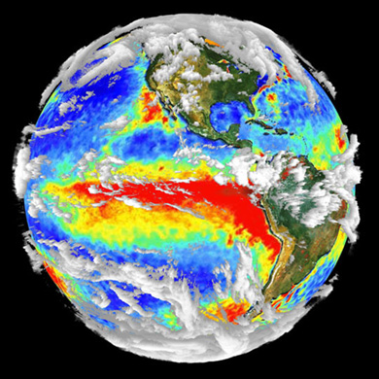
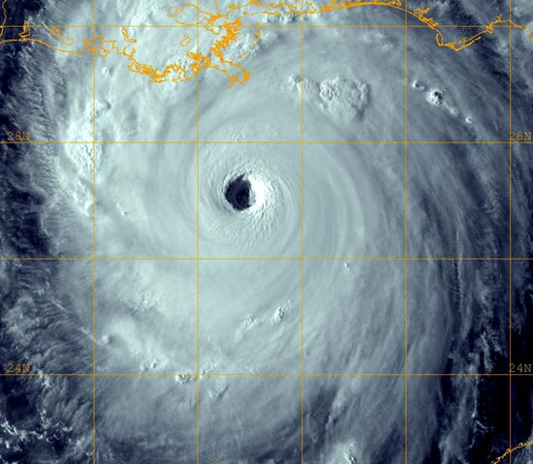
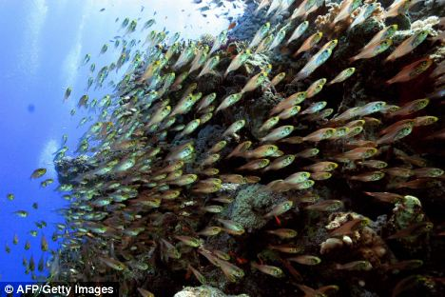
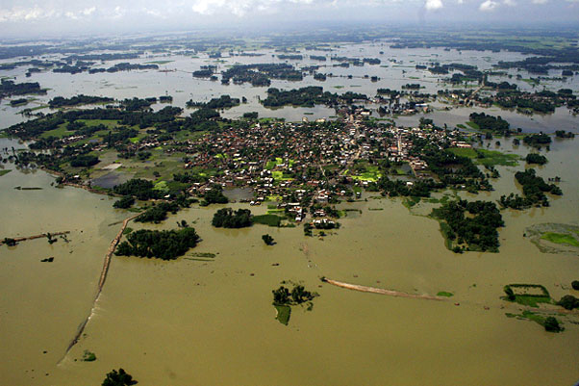
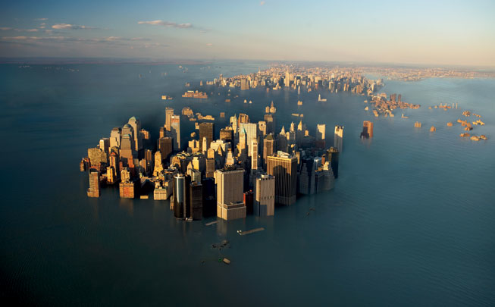
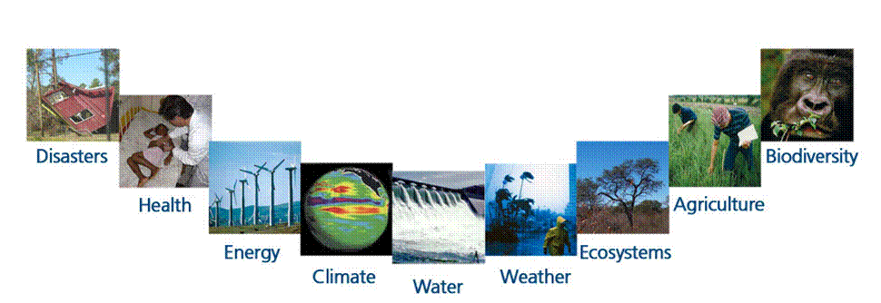
Why Observing Systems?
Information to address global, societal, complex issues
Notes:
Why observing systems? Ans: Global, societal issues (terrestrial and ocean): el nino, monsoon and storm flooding, Climate change: sea level rise, food suppy, biodiversity (habitat change)
These challenges touch on every aspect of human life, in each country----every single person is, at some level, affected.
----- Meeting Notes (4/20/12 13:05) -----
Addressing societal needs, based on user needs.

Slide 9
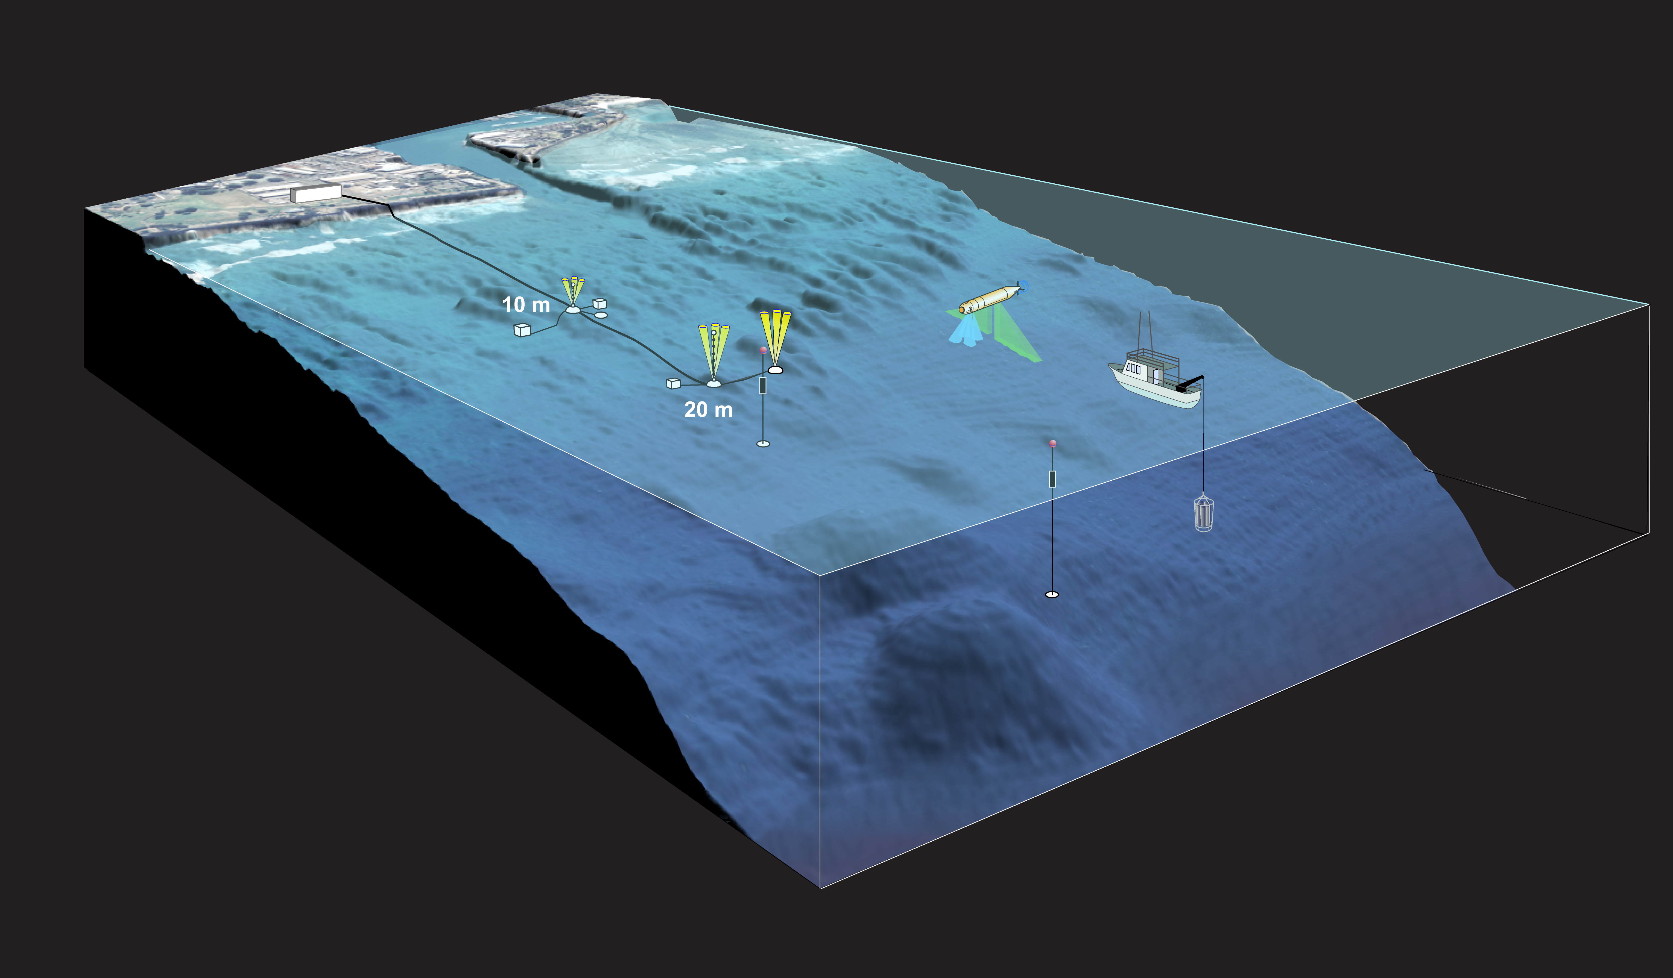
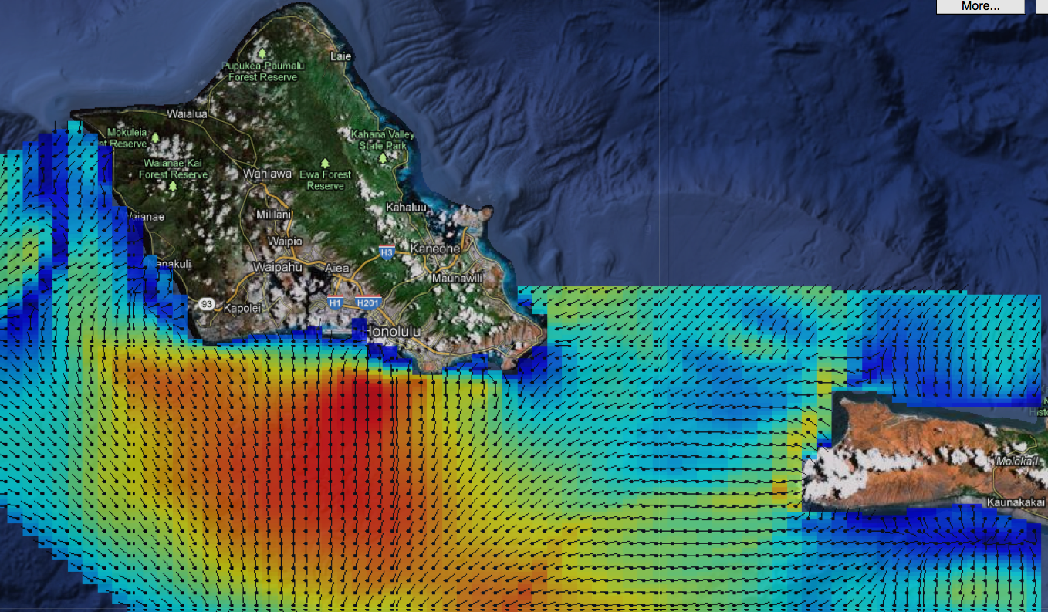
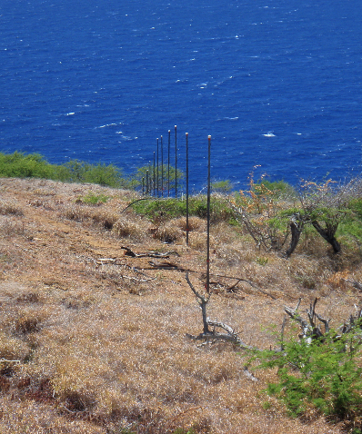
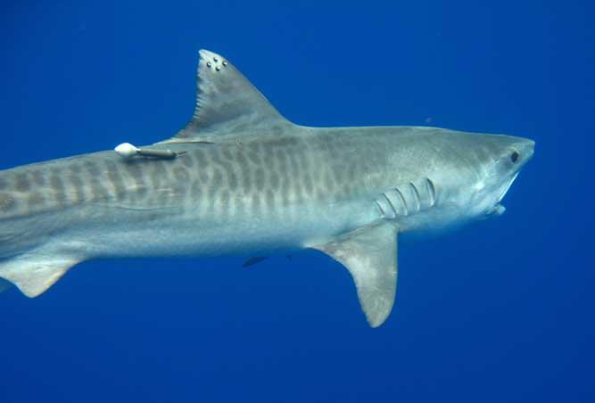
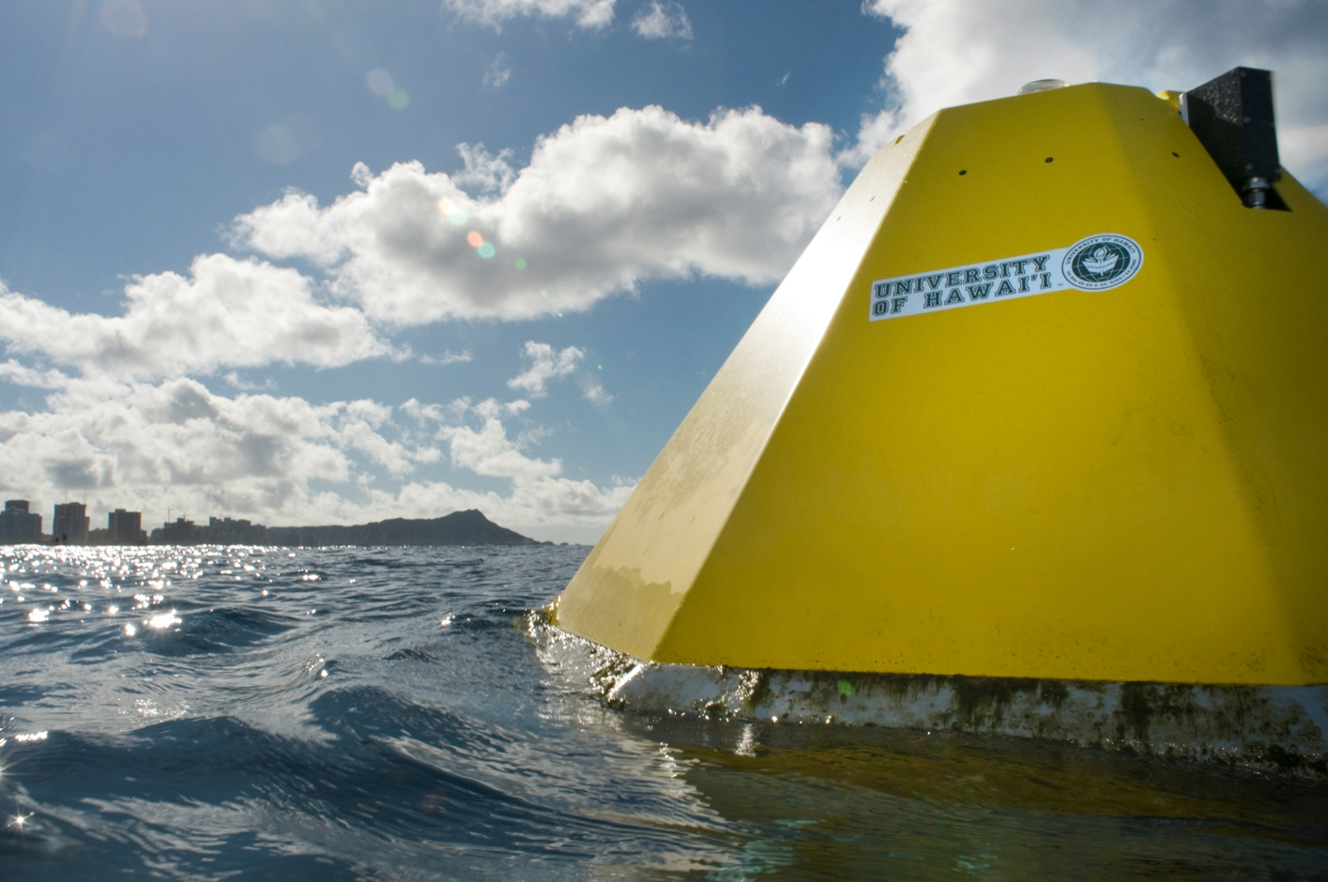
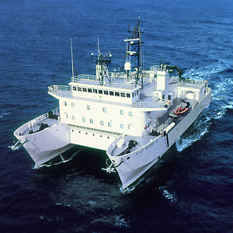
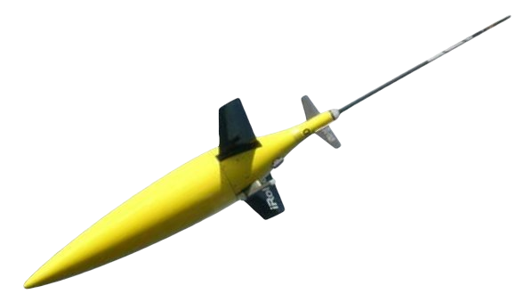
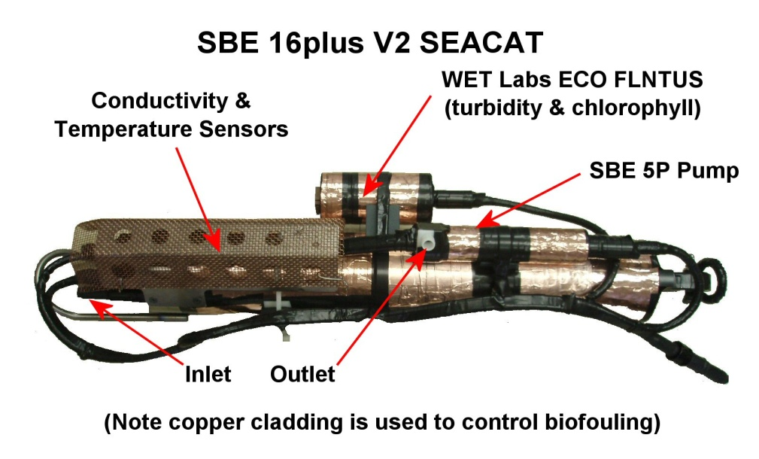
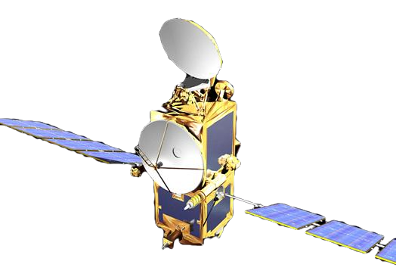
PacIOOS: Observing the Ocean
9

Slide 10
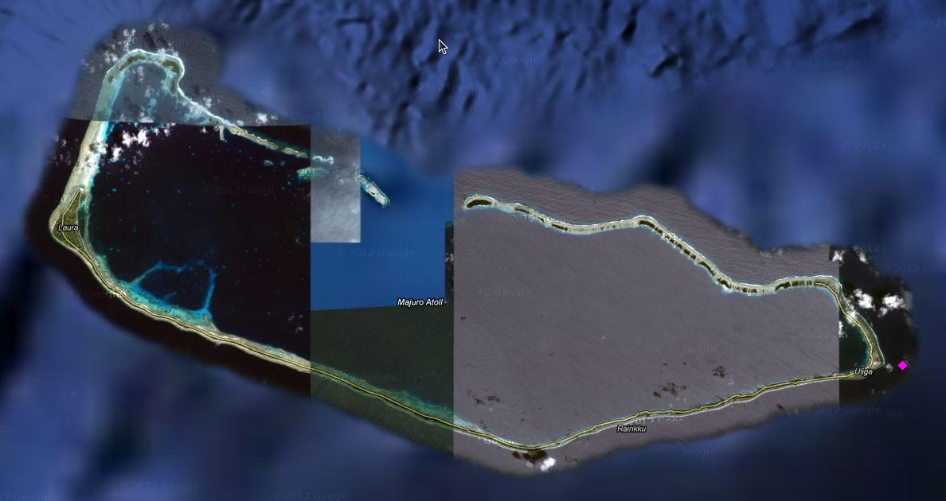
Wave Observations
Current live locations provided by PacIOOS
Majuro (Kalo)
The additional data provided by the Kalo Buoy enhanced our capability to provide reliable wave information and conditions to the mariners and the coastal communities. We are able to provide quality advisories and warnings and have saved lives and better protected coastal properties. - R. White
10
Notes:
The concept of an integrated ocean observing system has been a topic of discussion for well over a decade now, with increasing attention focused on the development such a system over the full US coastal area in the last 5-7 years.
The vision of IOOS is one of an end-to-end system of systems designed to gather information on the state of the coastal and open oceans of the US and serve that data, in raw and/or refined form, to meet identified user needs related to Marine ops, climate variability, ecosystems-fisheries-water quality, coastal hazards, and CMSP.
The need for this highly resolved and comprehensive data has, arguably, never been greater as understanding our most pressing problems: Climate change, ocean acidification, declining fish stocks, expanding anoxic zones, and the increasing and sometimes conflicting uses of our coastal waters, require an expanded network of observations, enhanced analyses and understanding, and improved predictive and forecasting capabilities.

Slide 11
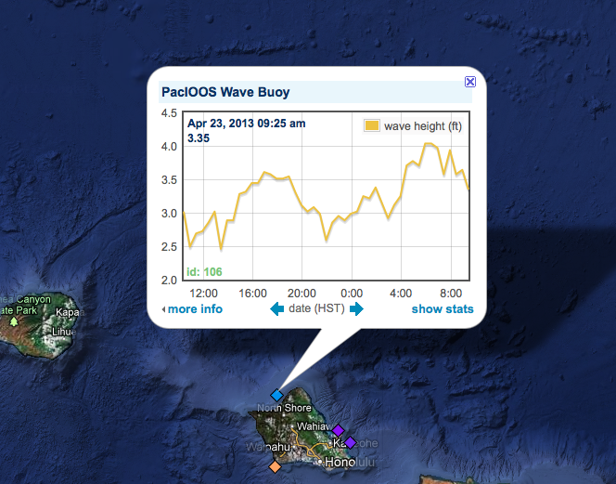

Slide 12
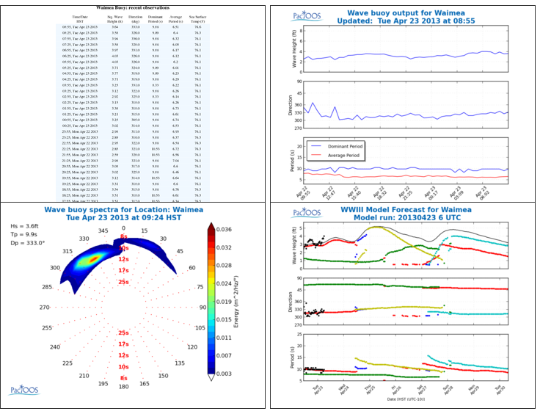

Slide 13
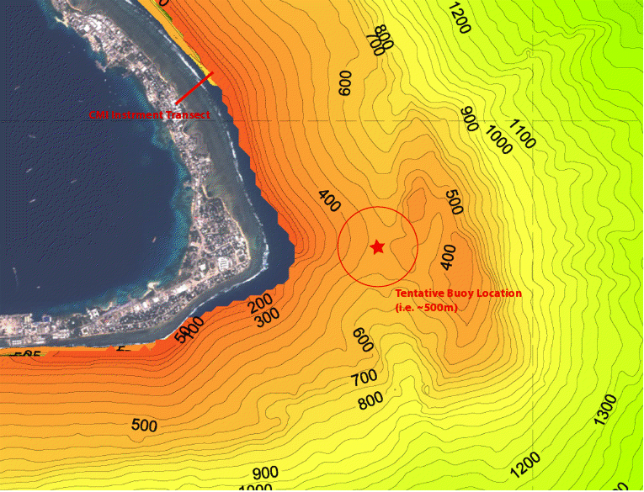
Notes:
If Majuro should proceed, the attached picture shoes the plateau at 400m depth just East of the 500m 'saddle' site we previously used. Advantages are: a little further, away from the last two moorings should they still be at the old site, and a fairly flat target. An acoustic release would be used this time. k-
The additional data provided by the Kalo Bouy enhanced our capability to provide reliable wave informations and conditions to the mariners and the coastal communities. We are able to provide quality advisories and warnings and have saved lives and better protected coastal properties.

Slide 14
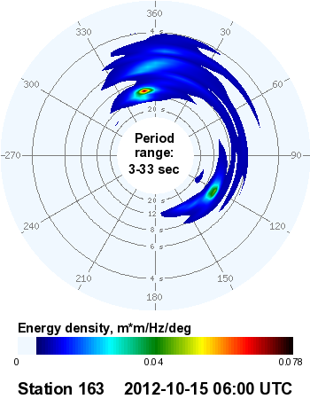
Wave Observations
Majuro real time spectral energy density form CDIP. This data allows for the spatial differentiation of incoming swell. With local directional swell, accurate run-up and inundation forecast become possible.
14
Notes:
The concept of an integrated ocean observing system has been a topic of discussion for well over a decade now, with increasing attention focused on the development such a system over the full US coastal area in the last 5-7 years.
The vision of IOOS is one of an end-to-end system of systems designed to gather information on the state of the coastal and open oceans of the US and serve that data, in raw and/or refined form, to meet identified user needs related to Marine ops, climate variability, ecosystems-fisheries-water quality, coastal hazards, and CMSP.
The need for this highly resolved and comprehensive data has, arguably, never been greater as understanding our most pressing problems: Climate change, ocean acidification, declining fish stocks, expanding anoxic zones, and the increasing and sometimes conflicting uses of our coastal waters, require an expanded network of observations, enhanced analyses and understanding, and improved predictive and forecasting capabilities.

Slide 15
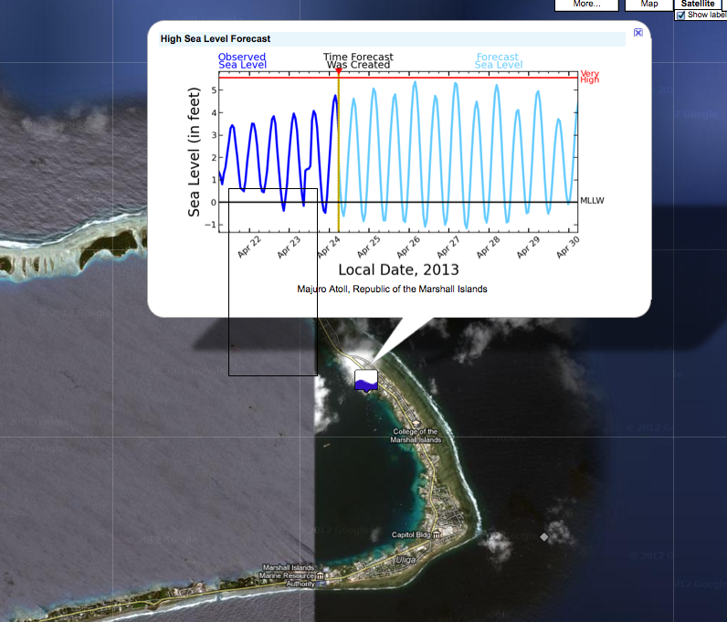

Slide 16
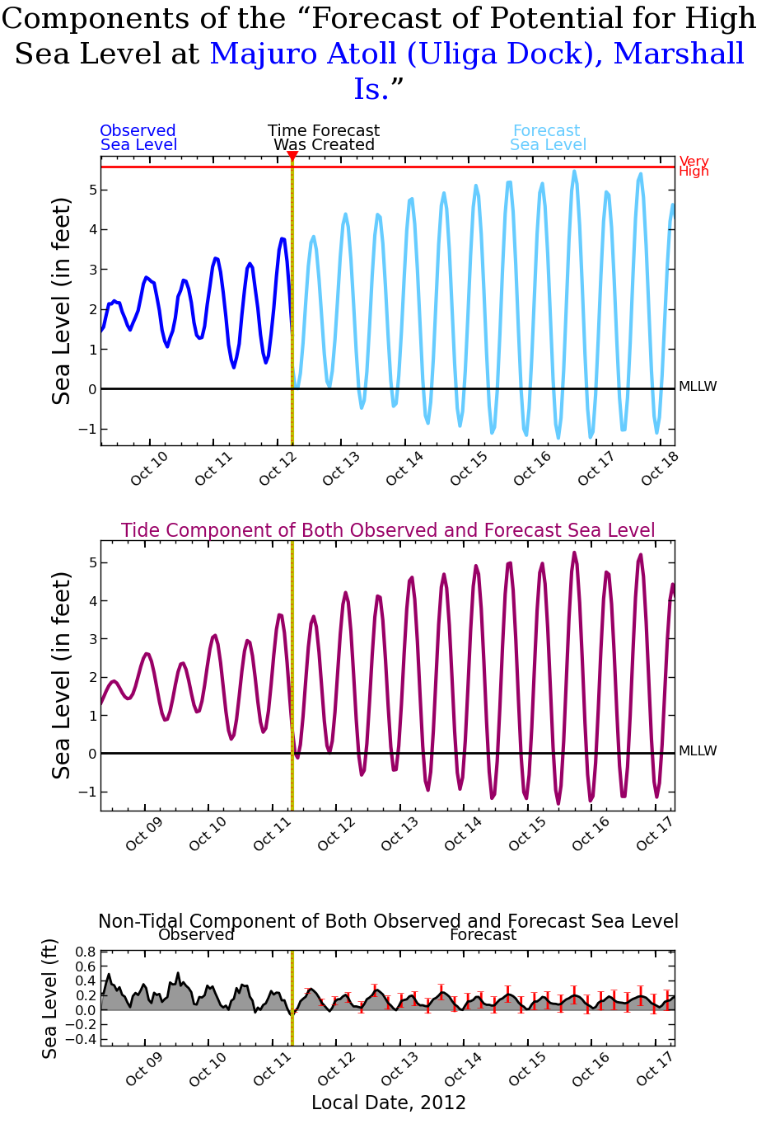
Sea Level Forecast for Harbors/Lagoons
Example of PacIOOS Majuro sea level forecast. Second page shows the forecast tide and residual forecast. Only two products are necessary to create a forecast for each station, a historical sea level record and real time sea level.
16
Notes:
The sea level station used in the forecast for Majuro is an IOC station 200832 (an Australian BoM Station Number) that collects data every minute.

Slide 17
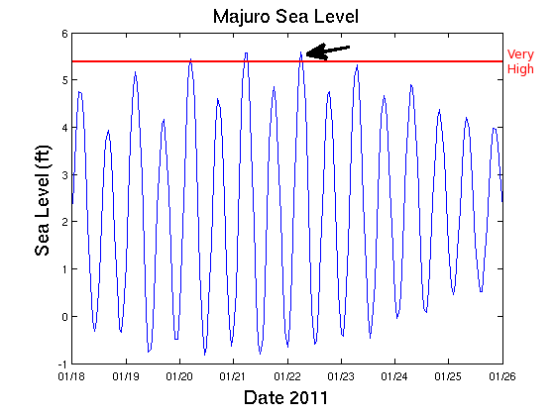
Sea Level Forecast for Harbors/Lagoons
An Example of Majuro Atoll Sea Level Driven to Higher Levels Resulting in Roadway Flooding (video)
17
Notes:
The concept of an integrated ocean observing system has been a topic of discussion for well over a decade now, with increasing attention focused on the development such a system over the full US coastal area in the last 5-7 years.
The vision of IOOS is one of an end-to-end system of systems designed to gather information on the state of the coastal and open oceans of the US and serve that data, in raw and/or refined form, to meet identified user needs related to Marine ops, climate variability, ecosystems-fisheries-water quality, coastal hazards, and CMSP.
The need for this highly resolved and comprehensive data has, arguably, never been greater as understanding our most pressing problems: Climate change, ocean acidification, declining fish stocks, expanding anoxic zones, and the increasing and sometimes conflicting uses of our coastal waters, require an expanded network of observations, enhanced analyses and understanding, and improved predictive and forecasting capabilities.

Slide 18
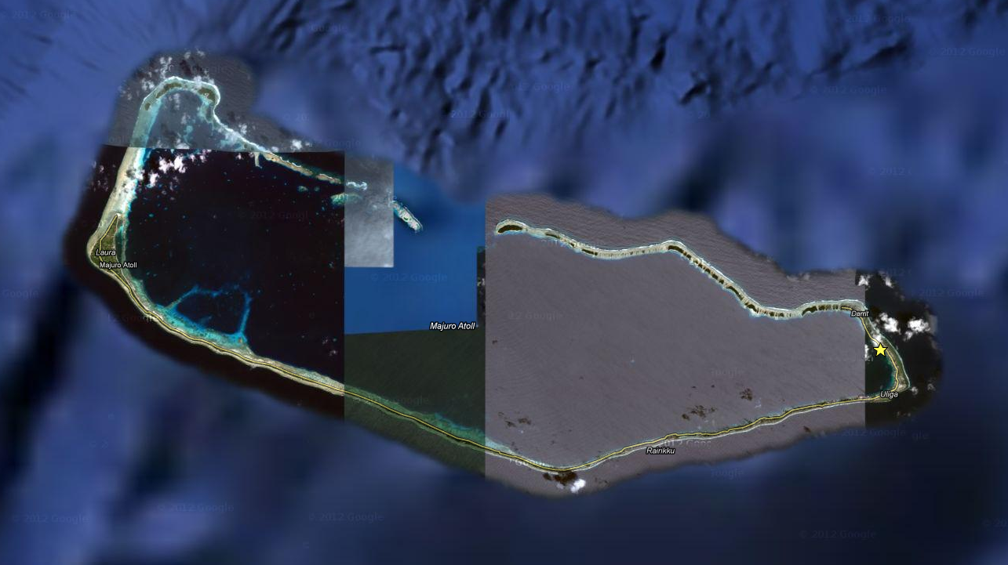

Slide 19
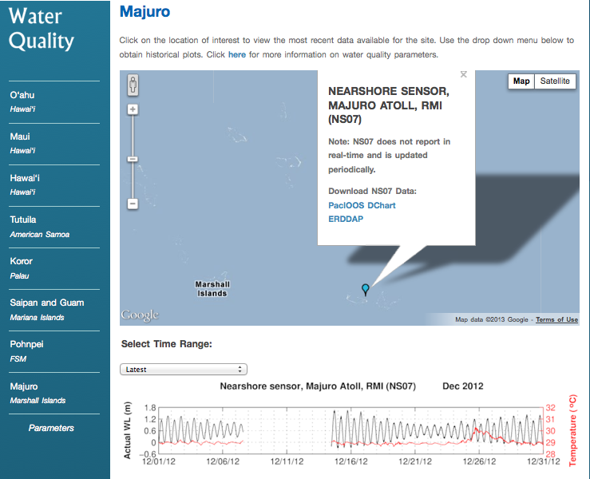

Slide 20
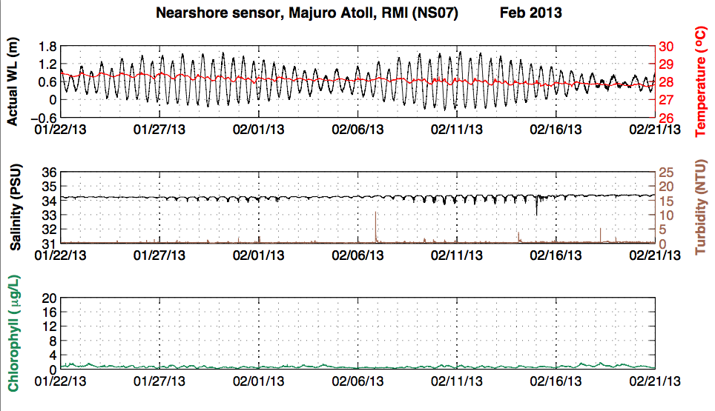

Slide 21
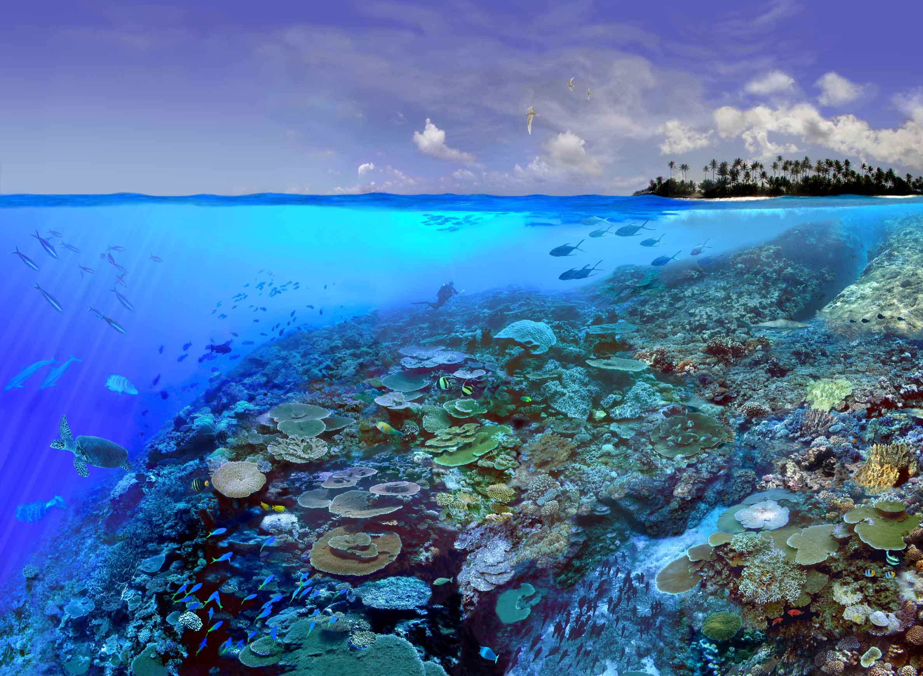
Mahalo
Mahalo
www.pacioos.org
Melissa.Iwamoto@hawaii.edu
www.pacioos.org

